Slide 1
Fair Market Value
What is it & how can it work?

Slide 2
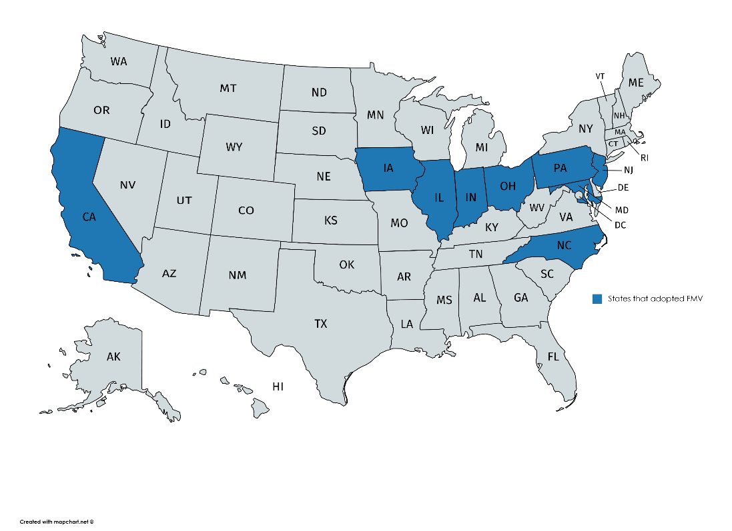
Currently water utilities are only able to acquire at net book value per current regulations (FL Rules 25-30.0371 & 25-30.037)
Bills were introduced in the 2019 Florida Legislative Session allowing water utilities to apply Fair Market Value (FMV) for acquisitions of other water utilities
  HB 1297 (Rep. Bell) & SB 1484 (Sen. Torres)
Bills were created to allow water utilities to grow
and/or divest more easily, voluntarily
States that already have FMV include Illinois, Indiana, Iowa, Maryland, Missouri, New Jersey, North Carolina, Ohio and Pennsylvania

Slide 3
Flowchart of HB1297 from 2019 Session
Acquiring Utility
Acquiring Utility appraisal
Appraiser gives Fair Market Value
Mutual interest
Average of appraisals is FMV
No interest
Yes
Utility to be acquired
Acquired utility appraisal
Appraiser gives Fair Market Value
Continued interest
No
PSC issues final order within 6 months
Application submittal to Florida PSC
PSC approves application
PSC retains authority to set rates for acquired system in future rate cases and may classify as separate system
Rate base for acquired utility is equal to lesser of purchase price or FMV
PSC denies application

Slide 4
Fair Market Value laws create a more reliable and accountable system of water & wastewater companies
  Example: Tymber Creek
Creates win-win proposition for customers and utilities because large utilities are more able to invest in infrastructure and customers still have protections including,
  PSC still has surveillance process and ability to capture over earnings
  PSC will still have a hearing
  Consumers will have a voice in this process
The passage of the bill will encourage growth by water/wastewater companies in Florida but also encourage others utilities to become engaged

Slide 5
THANK YOU!

