Slide 1
Advanced Reactors
Microgrid Applications
Steve Swilley
Vice President, Nuclear Sector
September 5, 2024

Slide 2
Objectives
DEFINE the landscape
REVIEW options
UNDERSTAND the timeline
Notes:
10 min

Slide 3
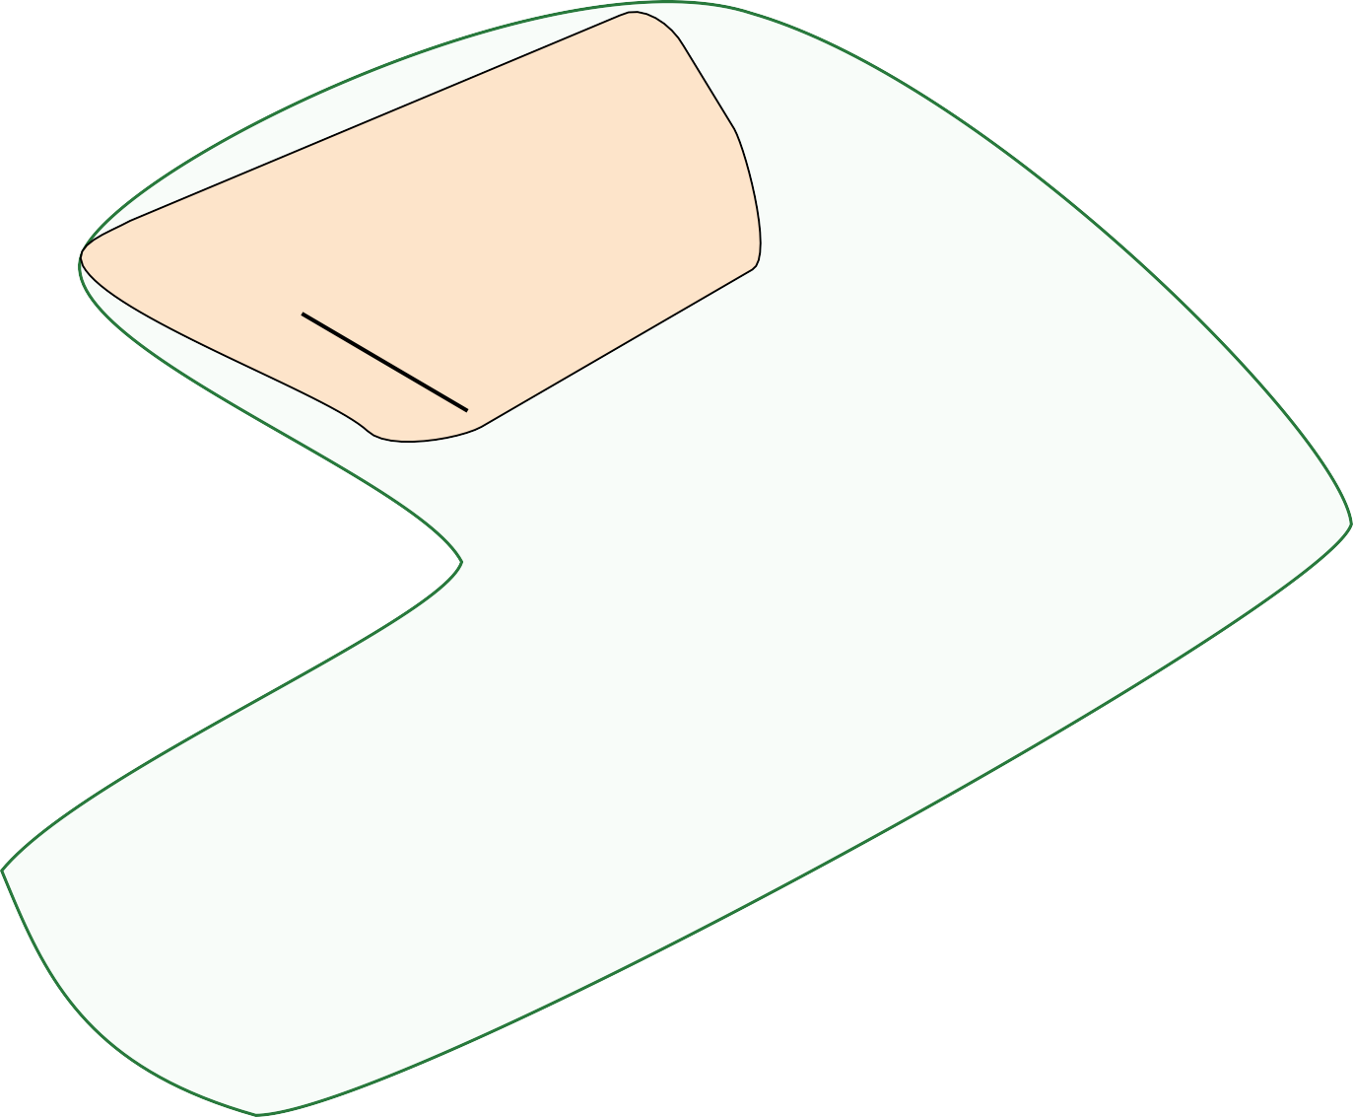
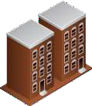
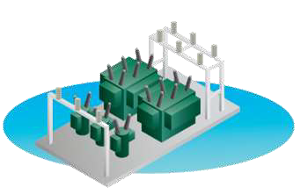
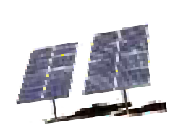
What is a Microgrid?
Multi-customer microgrid
EPRI defines this as:
1. A group of inter-connected loads and DER equipment
and devices, within defined electrical boundaries
2. Acting as a single controllable entity with respect to the grid
3. Able to connect and disconnect from the grid, operating in both grid- connected or island-modes
Feeder-level microgrid
Single-customer microgrid
MGC
Feeder
tie-line
Firestation
MGC

Slide 4
Types of Microgrids/Range of Objective
Commercial/Industrial: Generally built with the goal of reducing demand and costs during normal operation, although the operation of critical functions during outages is also important, especially for data centers
Community/Utility: Designed to improve reliability and to promote community participation
Campus/Institutional: Many campuses already have DG resources, with microgrid technology linking them together. They are usually large and may be involved with selling excess power to the grid.
Military: Critical loads, cyber and physical security, both for fixed bases and forward operating bases
Most microgrids will be grid-connected >99% of the time
Notes:
One way we’re improving on delivery and demonstration of value to our membership is by evaluating the NPC meeting format and making adjustments.
We recently assessed the meeting structure and effectiveness with the help of several EC members. You’ll see a few changes starting in 2025 based on this assessment. Actually, we’ve incorporated a few elements this year. Please let us know what you think.

Slide 5
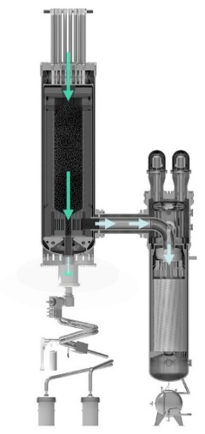
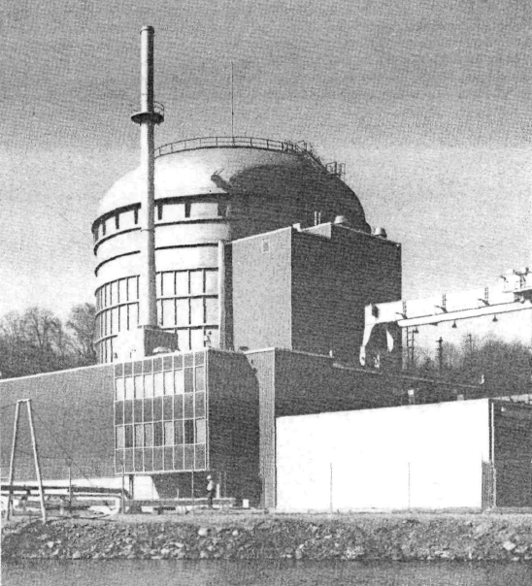
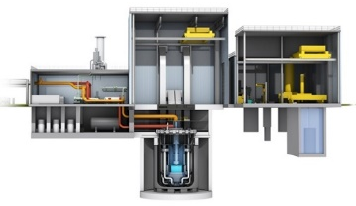
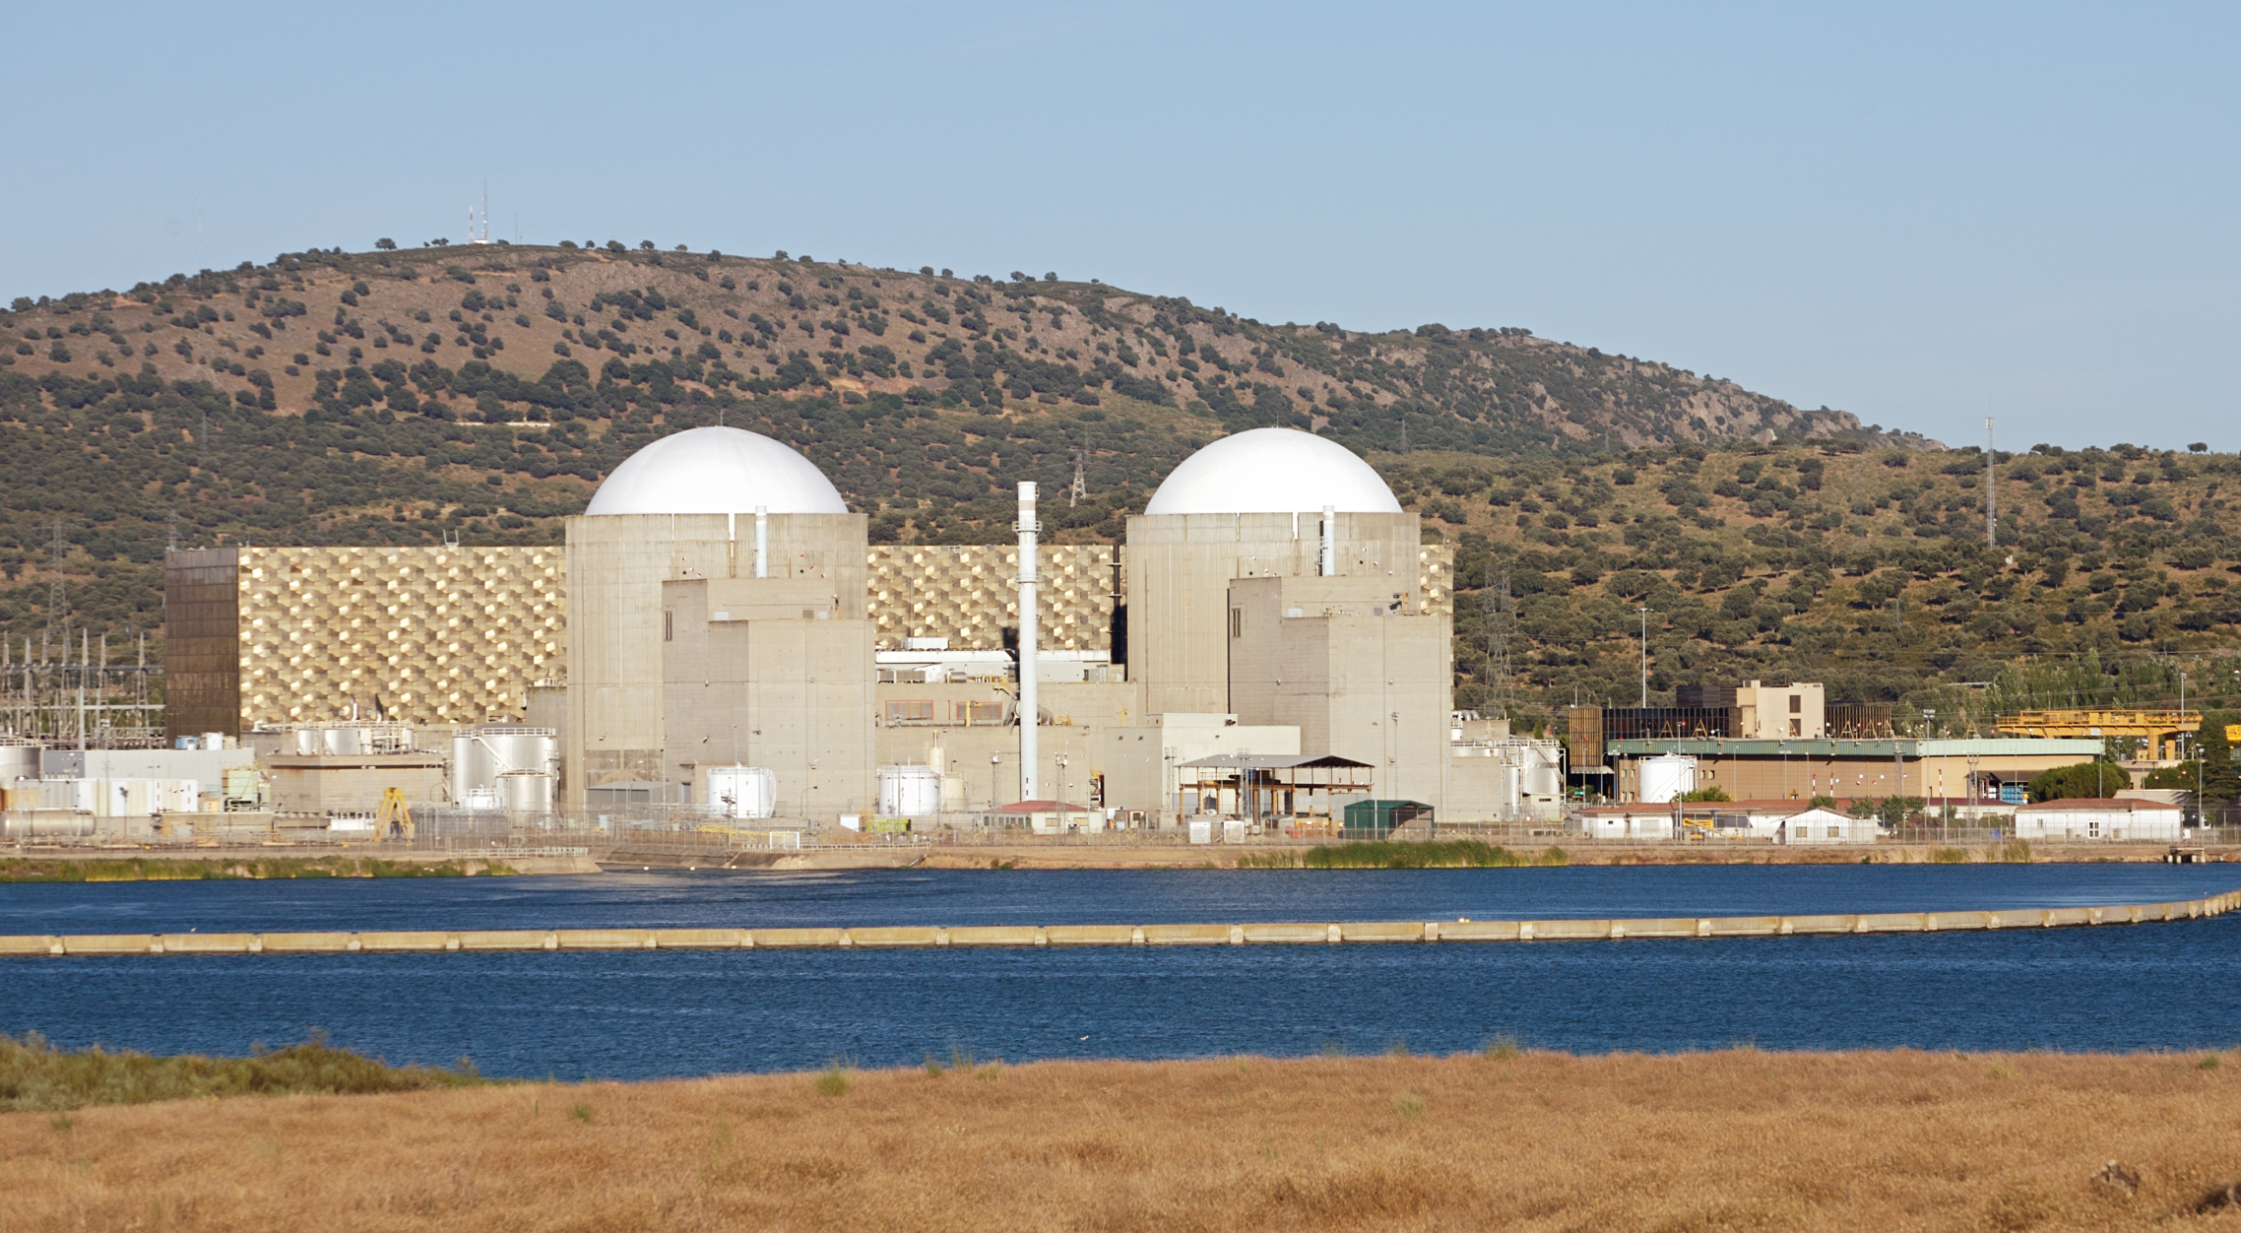
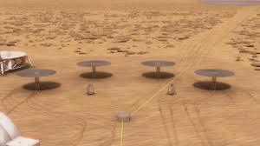
Evolution of Nuclear Power
GEN I & II
GEN III / III+
Advanced Reactors (ARs)
Microreactors
Early demonstrations through GW-scale commercial fleets
Evolutionary designs, GW-scale +
Beyond large LWRs: non-LWRs, lwSMRs
MWe-scale expands AR options
Convergence on ALWRs
Passive safety
Standardization
Integration with licensing
Emergence of SMRs
EPRI and European utilities established LWR-centric requirements
Diversity of designs
Diversity of vendors
Diversity within vendors
Limited standardization
Aggressive build rates
Evolving regulations
Aggressive cost and schedule targets
Competitiveness via new missions and customers
Evolving regulatory frameworks
EPRI published AR Owner-Operator Requirements Guide
Heat pipe cooling
Remote deployment
New markets
Competition with diesel
Notes:
Nuclear power has been evolving for decades and making substantial improvements as a result.
Most of the operating fleet is comprised of Gen II and III reactors, with more Gen III+ light water reactors going up around the world today.
Advanced reactors are on the horizon, bringing with them a variety of beneficial attributes, like their fundamental passive safety in physics.
There are a variety of technologies we refer to under this advanced reactor umbrella.

Slide 6
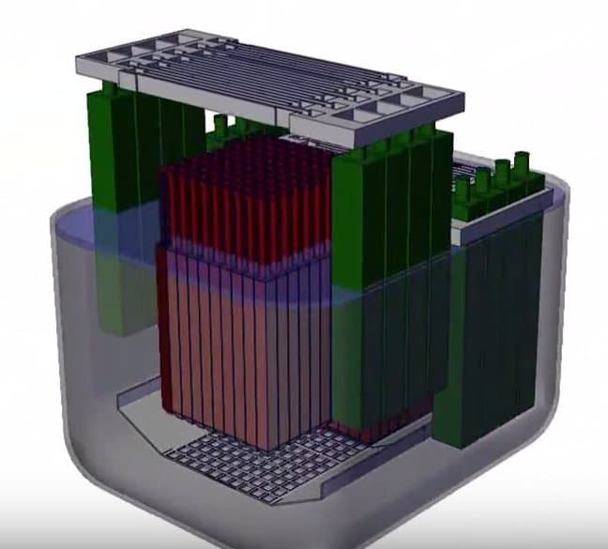
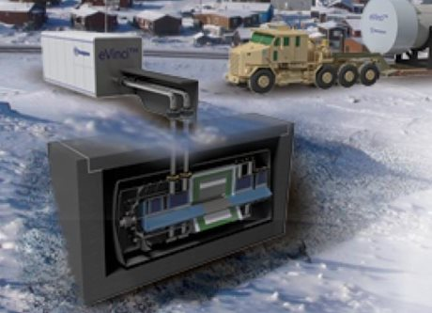
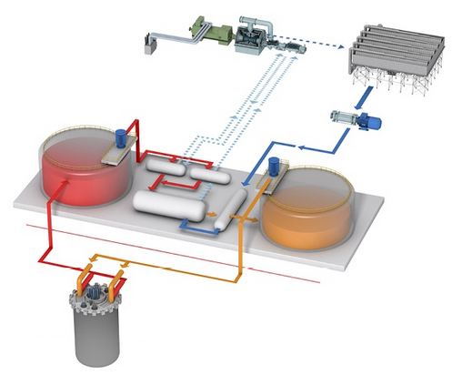
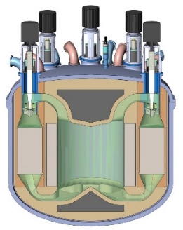
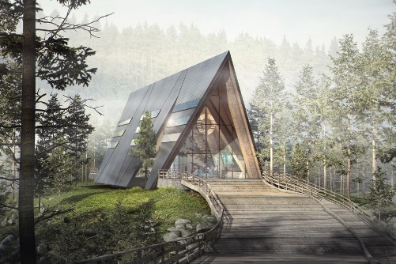
New Reactor Options
Water-Cooled Reactors
Sodium Fast Reactor
Molten Salt Reactors
High-Temperature Gas-Cooled Reactor
Microreactors
Schematic of the small modular light-water reactor (lwSMR) power module by NuScale
Design rendering of the Natrium reactor, TerraPower’s SFR
Design rendering of Westinghouse’s eVinci microreactor supplying remote energy
Rendering of Moltex’s stable salt reactor, which burns spent LWR fuel.
Natrium’s integrated molten salt thermal storage loop, enabling 150% power peaking
Rendering of Southern Co. and TerraPower’s molten chloride fast reactor.
Rendering of the Xe-100, X-Energy’s pebble-bed HTGR.
Artist’s rendering of Oklo’s microreactor power plant
Mature technology with deployment options and wide power range
Highly resource efficient with near-ambient pressure of operation
Wide diversity of coolant and fuel options for various missions
Test scale experience in Japan for advanced hydrogen production
Rapidly deployable, opportunity for industrial heat production
Advanced reactors create flexibility for size, coolant, fuel, products, and more

Slide 7
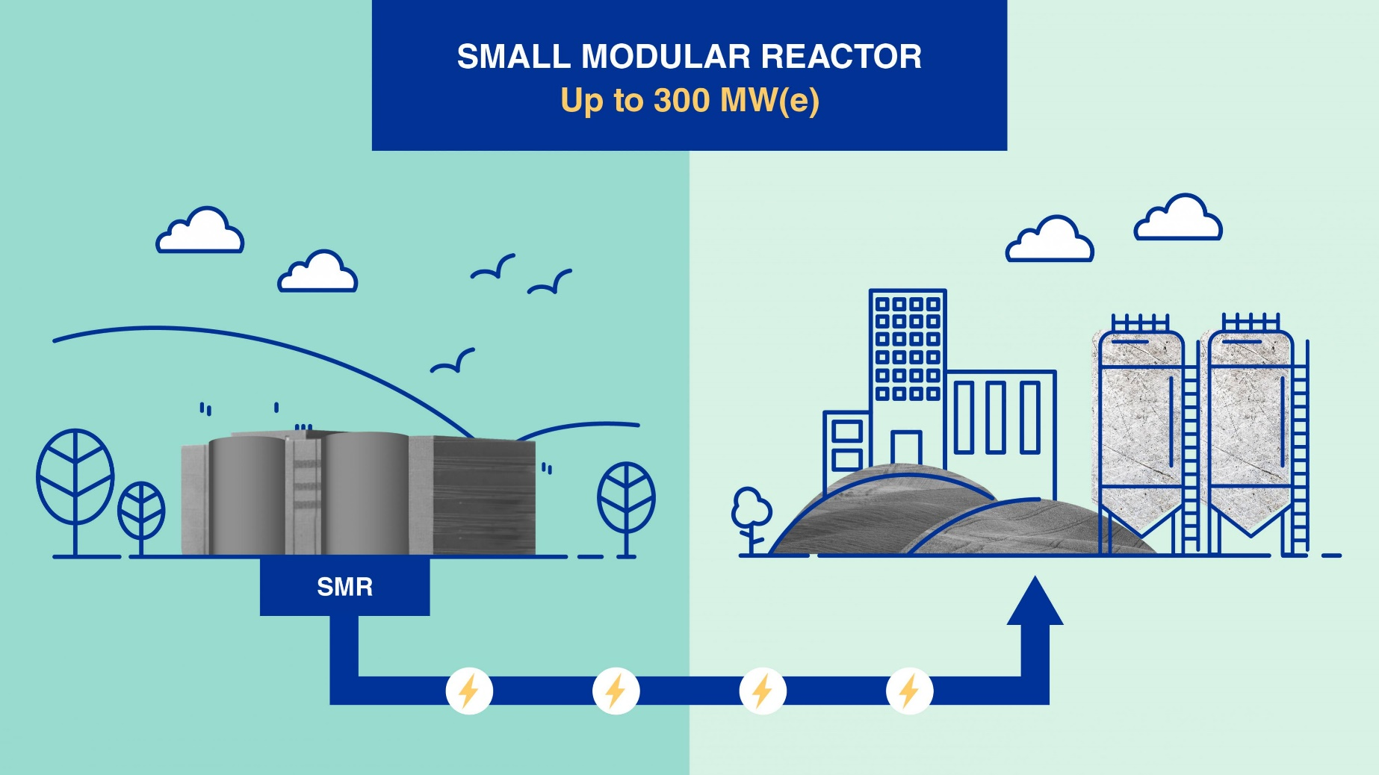
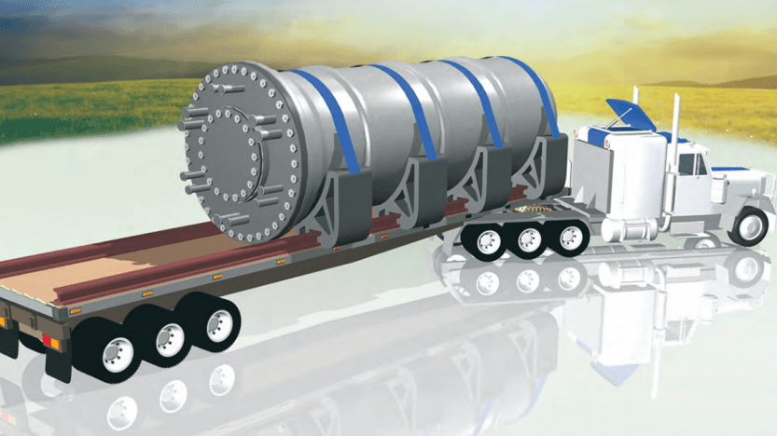
A look at SMRs
Economies of scale traded for economies of:
Numbers
Assembly
Flexibility
Reduced financial risk
Case has yet to be demonstrated:
Overcoming economies of scale
Increased asset flexibility
Simplified design
Enhanced safety
Factory-constructed, tested, and inspected
Graphics credit: IAEA

Slide 8
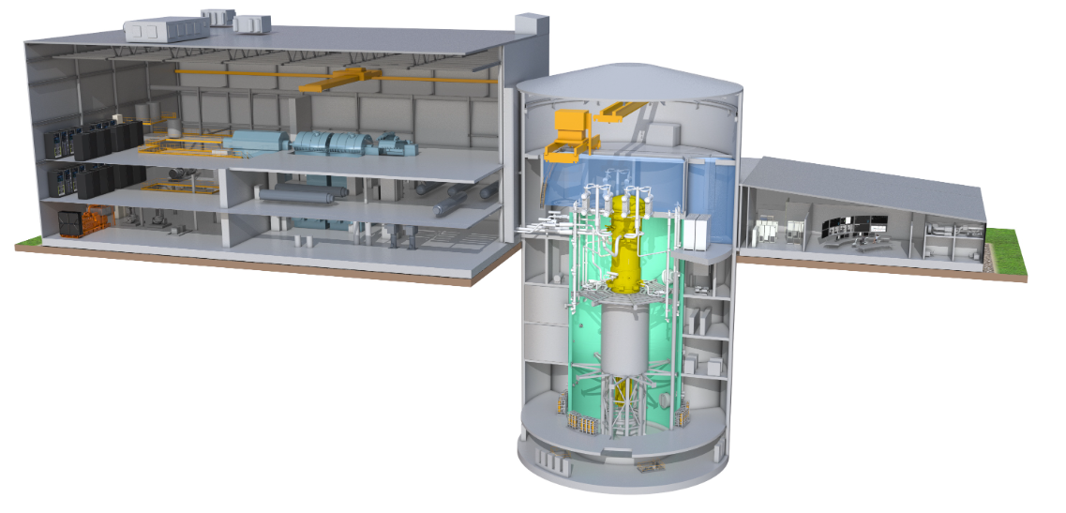
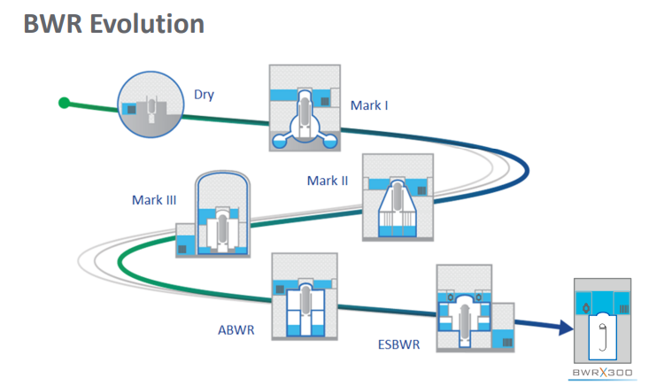
BWRx300 (A light-water SMR)
BWRx300 is the 10th generation BWR developed by GE Hitachi Nuclear Energy (GEH)
Water cooled 300 MWe natural circulation SMR.
Selling points: Design-to-cost, proven technology and components, innovative construction technologies
Turbine Building
Turbine Building
Control Building
Control Building
2/3 Below Grade Reactor Building
2/3 Below Grade Reactor Building
ABWR = Advanced Boiling Water Reactor
ESBWR = Economic Simplified Boiling Water Reactor

Slide 9
NuScale Power Module™ (another lwSMR)
Fully factory fabricated SMR referred to as a NuScale Power ModuleTM consisting of an integral nuclear steam supply system in which the reactor core, steam generators and pressurizer are all contained in a single vessel
Containment
Simple design eliminates reactor coolant pumps, large bore piping and other systems and components found in conventional reactors (reduced LOCA)
MateRPV: SA-508
Containment vessel: SA-508 and SA-965 (FXM-19), 308L & 309L cladded internal & external
rials
Pressurizer
Modules can be incrementally added to match load growth
Steam Generators
helical coil
inside-out
once through
No blowdown
NuScale Power ModuleTM Specifications
Electrical Capacity | 77 MWe
Modules per Plant | Up to 12 (924 MWe)
Design Life | 60 years
Fuel Supply | Existing light water reactor nuclear fuel
Safety | Walk-away safe
Emergency Planning Zone (EPZ) | Supports site boundary EPZ
Reactor Pressure Vessel
Reactor Core
ANT has completed various projects on EPZ analysis of iPWR for SMRs
Notes:
eliminates the external piping necessary to connect the steam generators and pressurizer to the reactor pressure vessel. Large break loss of coolants accidents are eliminated by design.

Slide 10
HTGRs: X-Energy and Xe-100
Coolant
Power Output | 200 MWt
Main Steam Temp | 565 °C
Main Steam Pressure | 16.5 MPa
Reactor Outlet Temp | 750 °C
Reactor Inlet Temp | 260 °C
Reactor Operating Pressure | 6 MPa
Reactor Structural Material | Steel/Graphite
Fuel Enrichment | 15.5% U-235
Refueling Schedule | Online/Continuous
Helium Gas
Fuel
TRISO
Pebble
n⁰ Energy
Thermal
n⁰ Moderation
Graphite

Slide 11
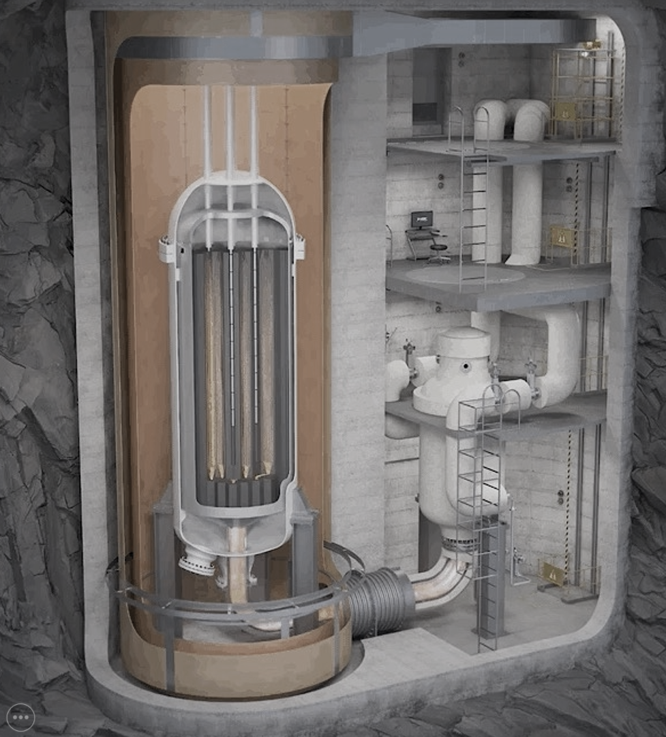
HTGRs: USNC and Micro Modular Reactor (MMR)
Coolant
Helium Gas
Power Output | 15 MWt
Reactor Outlet Temp | 630 °C
Reactor Inlet Temp | 300 °C
Reactor Operating Pressure | 3 MPa
Fuel Enrichment | <19.75% U-235
Refueling Schedule | No Refueling, 20 years
Fuel
TRISO
Prismatic
n⁰ Energy
Thermal
n⁰ Moderation
Graphite

Slide 12
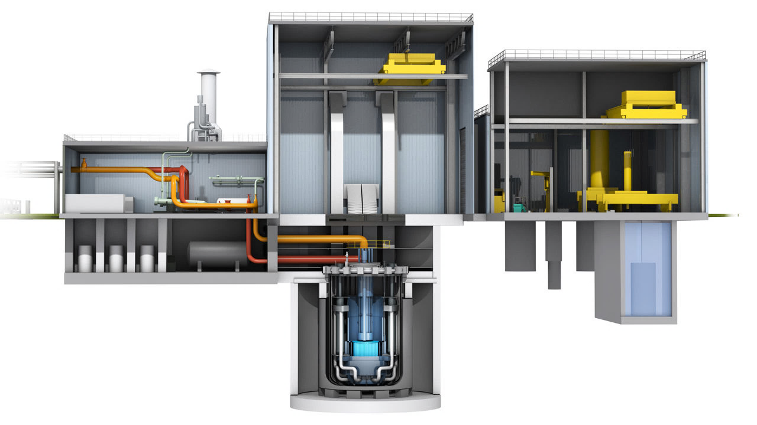
SFRs: TerraPower and Natrium
Coolant
Power Output | ~840 MWt
Main Steam Pressure | 19 MPa
Reactor Outlet Temp | 540 °C
Reactor Inlet Temp | 390 °C
Reactor Operating Pressure | ~ambient
Fuel Enrichment | <10-16.5% U-235
Intermediate Salt | Nitrate
Refueling Schedule | ~18 months
Sodium Metal
Fuel
Zirconium-Uranium Metal
n⁰ Energy
Fast
Notes:
Sodium conditioning
Sodium E&M pumps and primary facing components

Slide 13
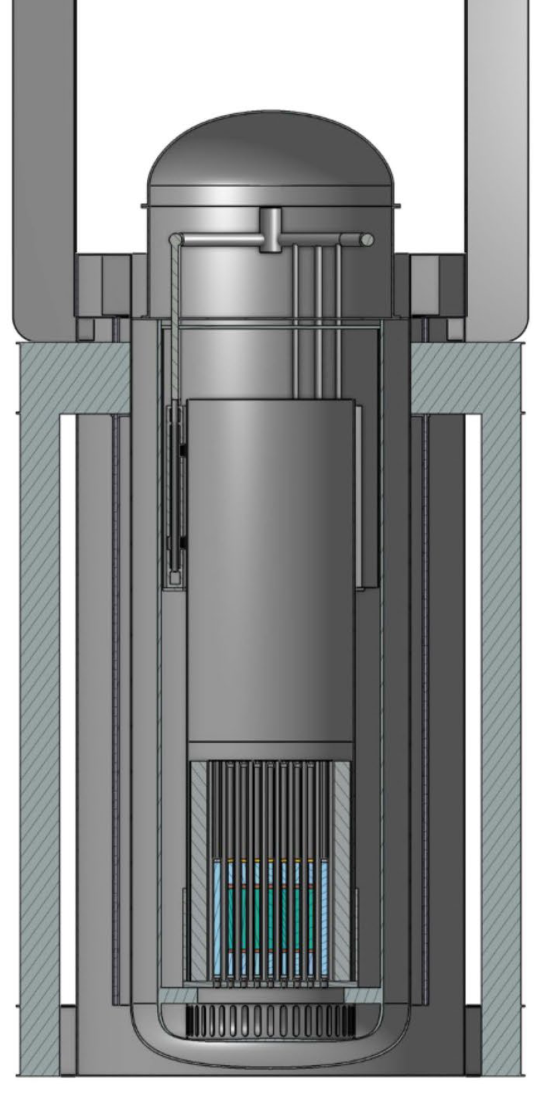
SFRs: Oklo and Aurora
Coolant
Sodium Metal
Fuel
Power Output | 40 MWt
Reactor Operating Pressure | ~ambient
Fuel Enrichment | 10.9-15.5% U-235
Uranium Metal
n⁰ Energy
Fast

Slide 14
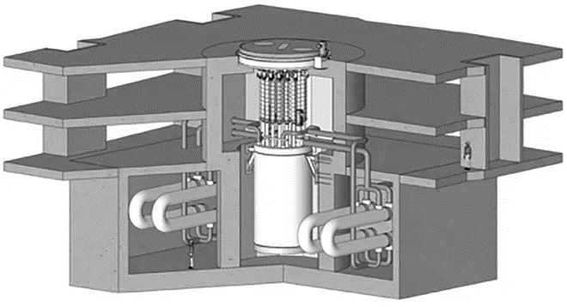
FHRs: Kairos Power and Fluoride High-temperature Reactor
Coolant
Power Output | 320 MWt
Main/Reheat Temp | 585 °C/ 585 °C
Main Steam Pressure | 19 MPa
Reactor Outlet Temp | 650 °C
Reactor Inlet Temp | 550 °C
Reactor Operating Pressure | ~ambient
Reactor Structural Material | Stainless Steel
Fuel Enrichment | 19.75% U-235
Intermediate Salt | Nitrate
Refueling Schedule | Online/ Continuous
FLiBe Salt
Fuel
TRISO
Pebble
n⁰ Energy
Thermal
n⁰ Moderation
Graphite

Slide 15
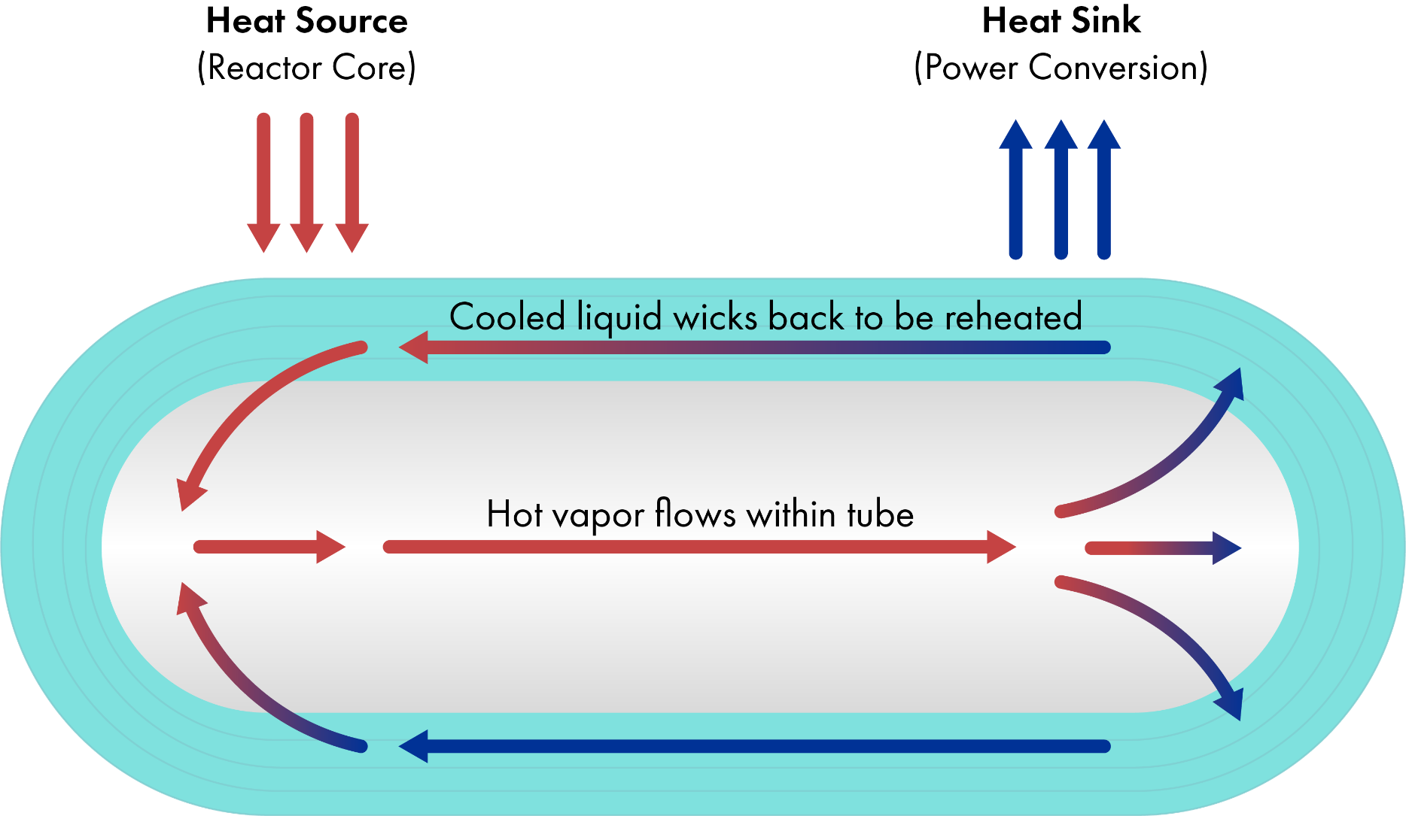
Microreactors: Heat Pipe Technology
Notes:
Many of the microreactor developers are developing what I referred to as heat pipe reactors.
Some of you may have heard of heat pipes, as they’re not a nuclear technology, specifically.
Originally developed at los alamos national laboratory, these help maintain the permafrost under large pipelines that run through tundra, dissipating the friction heat of the oil to protect the environment.
They do this through the natural circulation of fluid.
A heat source (be it a pipeline or a nuclear reactor) will vaporize liquid within the porous media on the walls of a thin tube.
This vapor will flow down the open center of the tube away from the hot side, towards the cold side.
At the cool end, enough heat is removed that the gas turns back into a liquid, which is absorbed in the wicking material that coats the tubes.
From there it wicks itself back to the heat source, and the cycle repeats.
The liquid used in the heat pipes that nuclear developers are using are commonly things like lithium or potassium, so they can function at over 1000 C if need be.
This passive convective heat removal monolith sits with one ends in the core of a reactor, and the other end at some heat extraction loop that is typically the power conversion.
Reactors designed this way can be configured to have no moving parts within the core.
No coolant is circulating, and between the fuel and the hot end of a heat pipe, you can get a monolithic, essentially solid-state nuclear reactor.
This excludes entire categories of accident scenario, and further helps to minimize the physical size of the system.

Slide 16
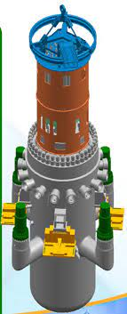
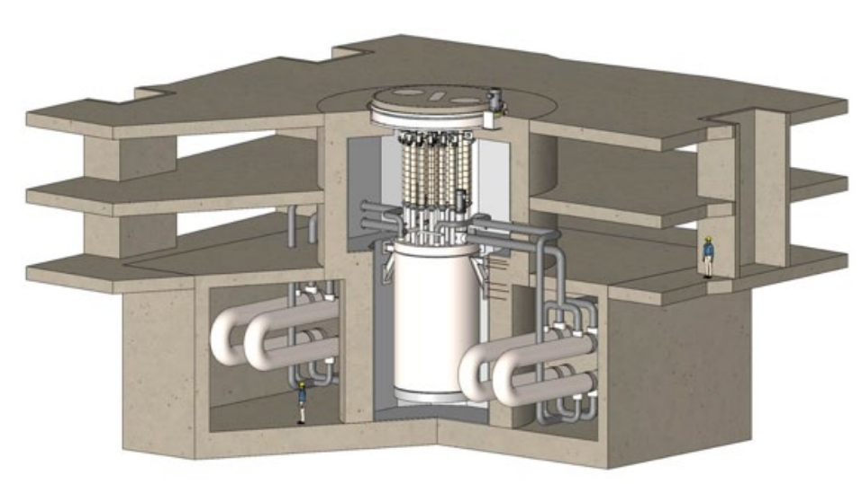
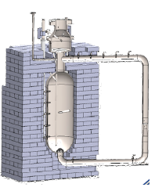
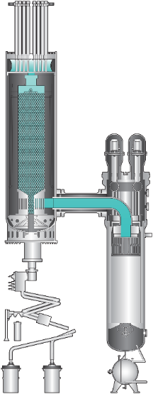
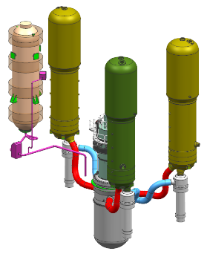
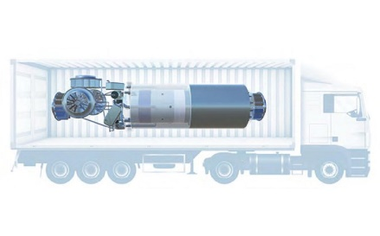
Advanced Reactors in this Decade
BWRX-300
GE Hitachi
ACP-100
CNNP
HERMES
Kairos Power
MCRE
Southern/TerraPower
XE-100
X-Energy
Rolls-Royce SMR
Rolls-Royce
HTR-PM
China
2024
2030
ARC-100
Arc
Project Pele
DoD
MSRR
ACU/Natura
LEU Test Reactor
Copenhagen Atomics
NATRIUM
TerraPower & GE

Slide 17
Deployment Timeline for New Reactors
2033 – Begin commissioning activities
2028 – Complete system design
2030 – Begin major component manufacture
2032 – Apply for operating license
2035 – Commercially Operating Advanced Reactors
2026 – Site and tech selection
2029 – Apply for construction permit
2031 – Break ground to begin construction
Siting Guide - 3002023910
Demonstration of PM-HIP- 3002010500
Turnover Guide - 3002007425
Owner-Operator Requirements Guide - 3002015751
Hot Functional Testing Chemistry Guide - 3002008296
Inspection Guidance for Reinforced Concrete - 3002015934
Reactor Technology Assessment Guide - 3002025344
Support from the EPRI Nuclear Sector
Mass Concrete Modeling - 3002007577
Basis for Timeline:
nth of a kind (NOAK) advanced reactor
Commercial in 2035
Deployed in in the US
Licensed under 10 CFR Part 50.
Constructability Guide-3002015932
Cyber Security Guidance during Construction - 3002010470
Notes:
This slide is a bit more of a tailored roadmap, and one I want to keep the basic idea behind (matching products to their place in a timeline to show how and when we can offer guidance). The rest of the structure is flexible!

Slide 18
ANT Technology User’s Groups
Purpose
Information Exchange
Provide overview of technologies
Create a forum for technology specific discussions
Issue Identification & Resolution Research & Guidance Development
Identify and develop technology specific resources
User’s Groups for Advanced Reactors

Slide 19
Summary Discussion
Why?
Drivers
Mission
How?
Nuclear
Hybrid
Other
When?
Impacts technology selection
Other considerations
Back-up power
Integration of DER
Spent fuel management
Workforce
Asset owner/licensee
Cyber
Reliability
Resilience
Black start capability
24/7 Carbon Free Power

