Slide 1

Advaned Nuclear Technology Update, Timeline, and Economics
September 5, 2024
Mary Lou Dunzik-Gougar, Professor of Nuclear Engineering on sabbatical with INL
Chris Lohse, GAIN Innovation and Technology Manager
Florida Public Service Commission Nuclear Workshop
Tallahassee, FL
Notes:
[10:16 AM] Chris Lohse
https://www.ans.org/news/article-6099/army-solicits-bids-for-microreactors-to-site-at-military-bases/
Army solicits bids for microreactors to site at military bases

Slide 2
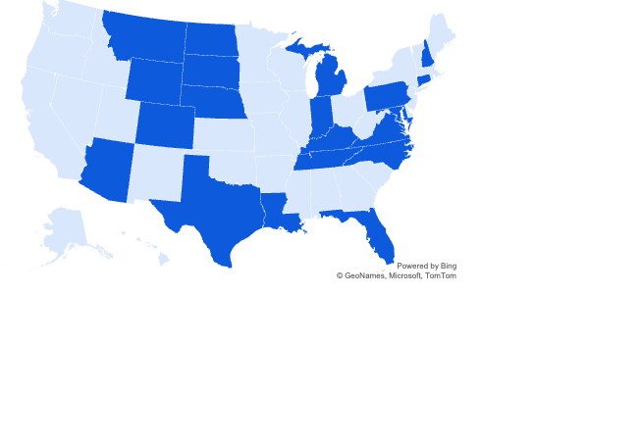
State Nuclear Feasibility Studies
Total: 25 Feasibility Studies
12 Complete
4 Pending Completion by Fall 2024
2 Pending Completion by 2025
6 Committed Studies without Set Due Date
1 Started but Incomplete
Updated September 2024
Notes:
Some are
state led (legislation, executive order)
community led (e.g. what happens if coal plant closes? CO)
vendor led (X-energy to replace coal with Xe-100 in MD)
SD started but didn’t finish (meanwhile, Energy Northwest plans to deploy in SD)
Some states created working groups that will continue after the report is completed (e.g. VA asks the question, how do we make VA the center for nuclear innovation – the only capacity they don’t currently have is waste disposal)

Slide 3














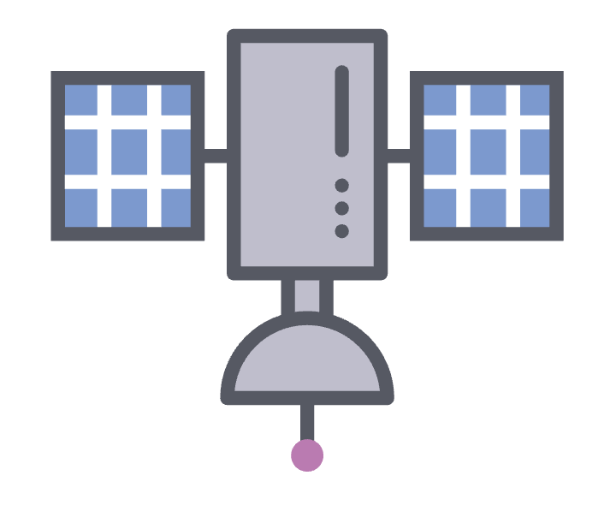
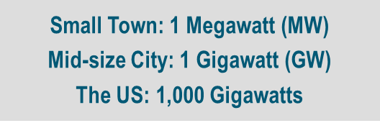
Advanced Nuclear Versatility
Spectrum of Sizes and Options
Variety of Outputs
Multitude of End Uses
Micro
(Few MW)
Mini
(10s of MW)
Small
(100s of MW)
Homes
Vehicles
Businesses
Electricity
Aviation
Rail
Shipping
H₂ Hydrogen
Concrete
Steel
Factories
Large (1,000+ MW)
Process Heat
Water
Space
Notes:
Discuss diversity of advanced nuclear technologies.
Note that there are various technologies involved, but that’s not the lead.
Leading effort is looking at the “end Uses” of the energy which may impact the technology choice that is desired (temperature range required).
Various sizes also under consideration that can provide various options for uses.
1 GW serves 750,000 homes (1.3 kW per home)

Slide 4
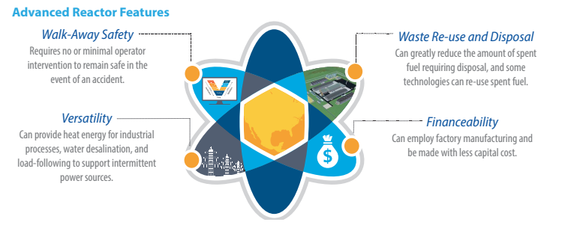
Advanced Reactors
Advanced Reactors: a nuclear fission reactor with significant improvements, including additional inherent safety features, compared to reactors operating on December 27, 2020, in the U.S
Source : https://www.energy.gov/sites/default/files/2020/05/f74/Advanced-Reactor-Types_Fact-Sheet_Draft_Hi-Res_R1.pdf
Notes:
Here are various features of many of the advanced reactors.
Run through each and give a brief explanation.
We have a definition for adv. Rx. A the bottom

Slide 5
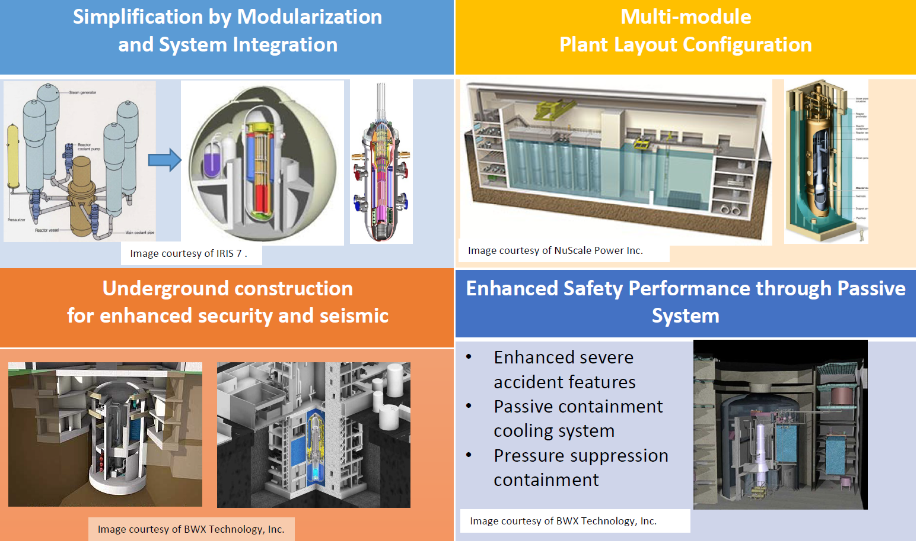
Features of Small Modular Reactors (SMRs)
Slide credit: Frederik Reitsma (GIF Webinar: Overview of SMR Technology Development, July 2020)
Notes:
Some additional features that many SMRs will employ for their designs.
These will vary by reactor designer and needs.

Slide 6
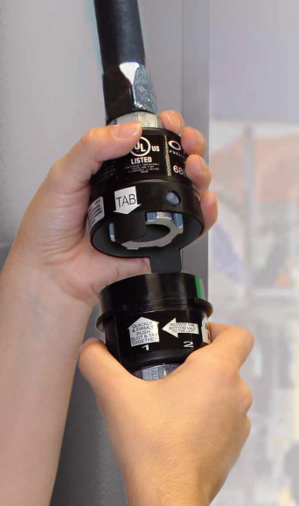


Active, Passive, or Inherent Safety
Active | Passive | Inherent
requires an external input to function | relies on natural forces, property of materials, or internally stored energy | rely on fundamental properties or design choices
a valve needs an electrical current to operate or a pump needs electricity to operate | Long term decay heat removal to heat sink using density changes and gravity heads | Design achieves reactor shutdown by negative power reactivity feedback (self limiting reaction)
Current plants | Advanced Reactors (light water and non-light water) | Advanced Reactors (light water and non-light water)
Notes:
Many of these reactors have a different safety basis where passive/inherent safety is employed. This is different than many of our operating reactors that rely on active systems. These are some examples to help show the difference between active and passive systems and some of the inherent safety features used.
So, a valve needs an electrical current to operate or a pump needs electricity to operate. An example of an active safety system would be a car airbag where there is an electrical signal sent from a sensor to deploy the airbag.
An example of an inherent safety feature would be the quick disconnect at a gas station pump. It is designed to disconnect and reduce damage/injury if someone drives away with the pump nozzle in their car.
An example of a passive system is a self-retracting lifeline that construction workers utilize when working to protect against falls. The self-retracting lifeline has an internal mechanical mechanism that engages when line is quickly let out (someone falls). This is the same type of feature in a car seatbelt where it locks when it is quickly pulled

Slide 7
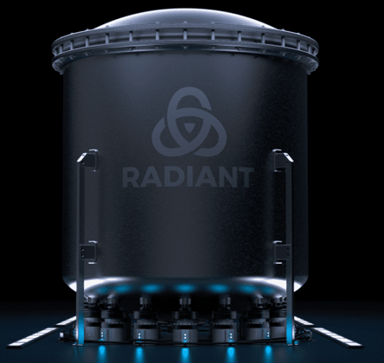
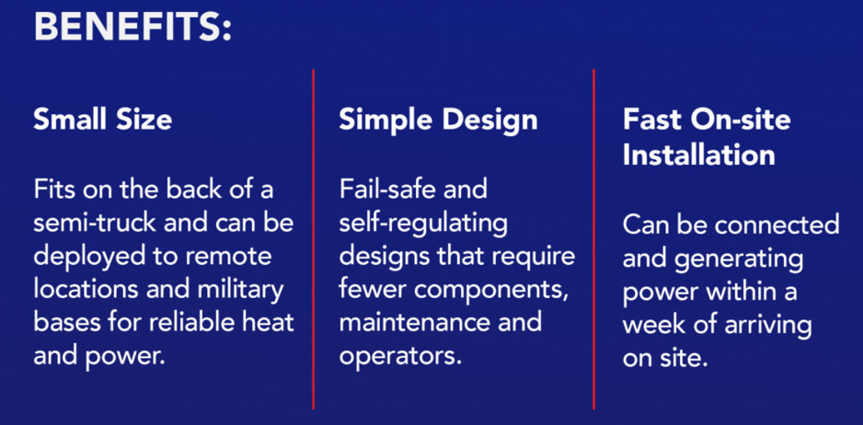
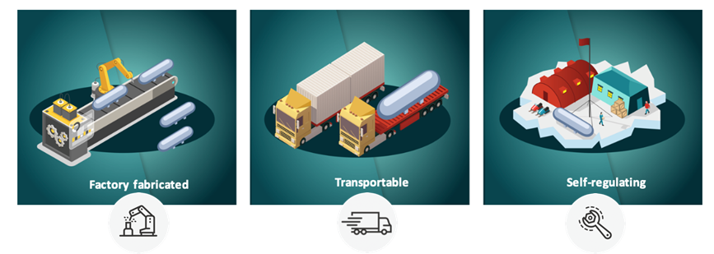
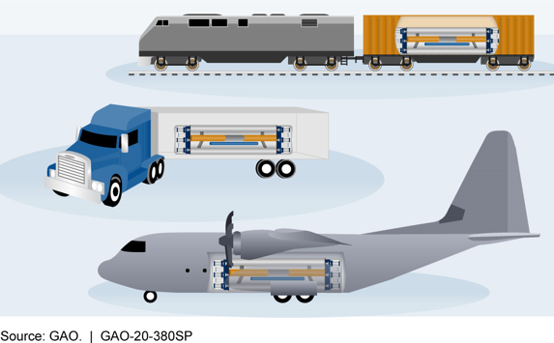
Microreactors: Megawatt-scale Nuclear Reactors
https://www.energy.gov/ne/downloads/infographic-what-nuclear-microreactor-0
Notes:
Many reactors under development are microreactors now. Here are some of the features/benefits. Again, anyone making a decision needs to look at their use case to determine what may be the best option for them

Slide 8
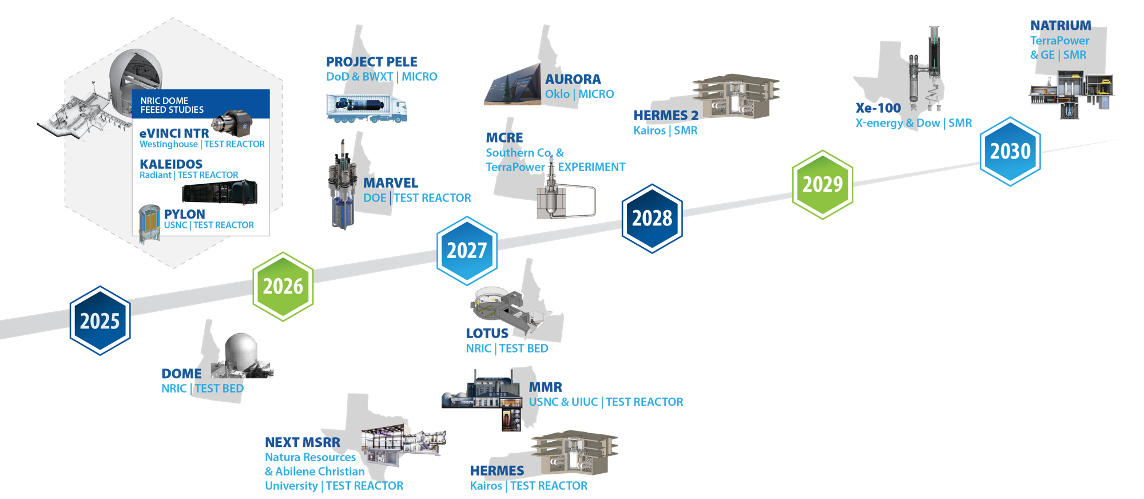
Accelerating advanced reactor demonstration and deployment
Notes:
Here is a current timeline that INL tracks for reactor demonstration and deployment. This is not ALL inclusive. We will discuss some of the other commercial ones on the next slide
The left hand of this is looking at the demonstration and R&D side. You have demonstrations planned for INL for microreactors in 25-26. Project Pele from the DOD. MARVEL which is a microreactor in 26 as well.
The ARDP projects are out at the end of the decade.
Define ARDP

Slide 9
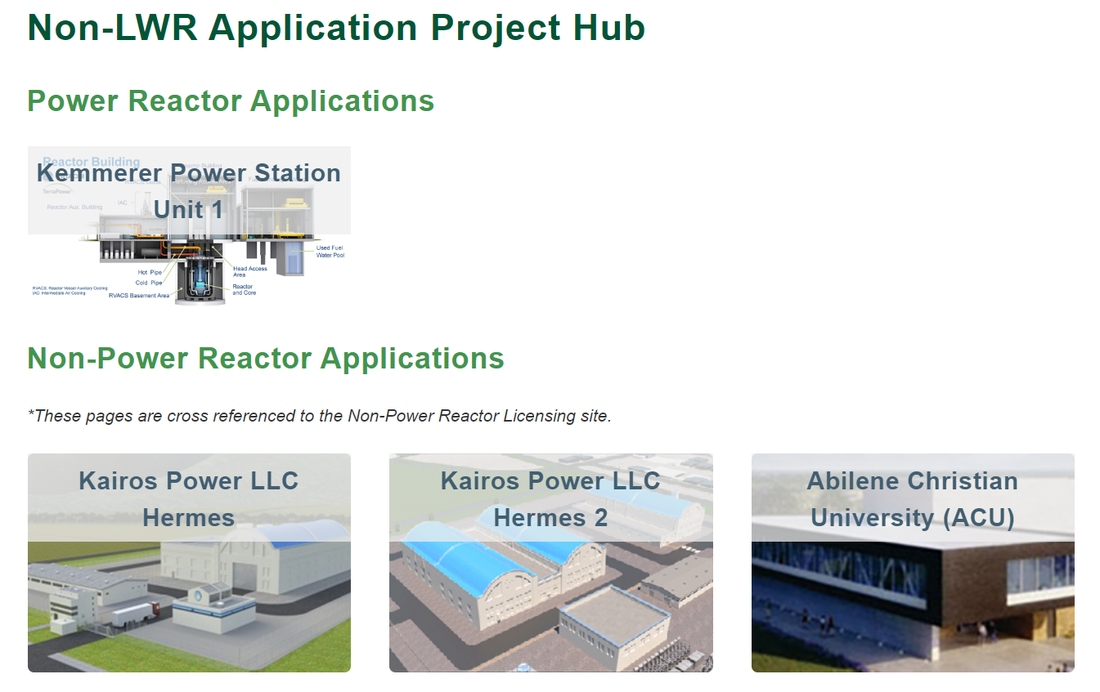
Developers and Reactors
Currently tracking over 30 developers with over 40 reactor designs in the US
Includes all variety and sizes
  Water, Gas, Sodium, Lead, Salt
  From 100s kWe to 100s MWe
NRC Activities
  Pre-application engagement
    13 non water designs
    4 water designs
  NRC Licensing
    1 Commercial
    3 Research/Test
BWRX-300 at OPG (Application submitted)
TVA – Clinch River (Pre-Application for CP)
Duke – Belews Creek (ESP)
Notes:
GAIN currently tracks over 30 companies developing reactors designs and that includes over 40 actual designs in various stages of development. Early concept to ones in licensing/deployment
Technology varies, sizes vary.
Current NRC activity is picking up. Many developers in pre-application engagement for designs.
You can see the NRC licensing efforts here in the figure with 3 research/test reactors (Hermes has a construction permit, Hermes 2 and the ACU are in review for their construction permit). TerraPower has an application in for their construction permit.
On the utility side, the first SMR in North America is going to be the BWRX-300 at OPG in Canada.
TVA is working on their Clinch River site and in pre-application for a construction permit.
Duke has started engagement on an early site permit at their Belews Creek site.
Kemmerer Part 50 license is 1 commercial
Construction Permit (CP)
ESP is Early Site Permit

Slide 10

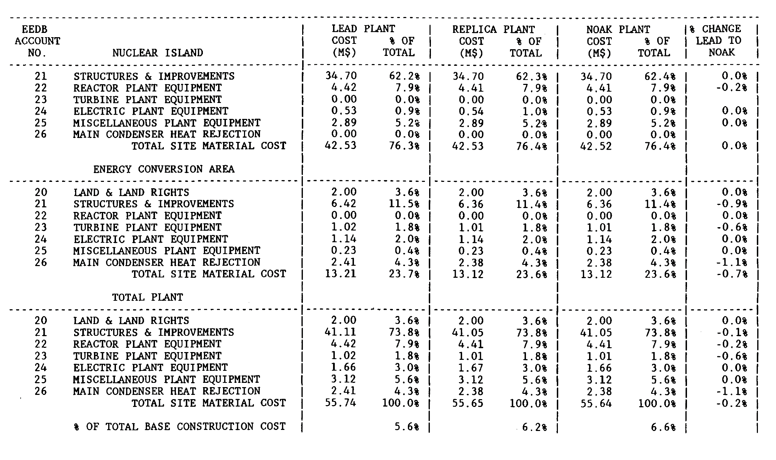
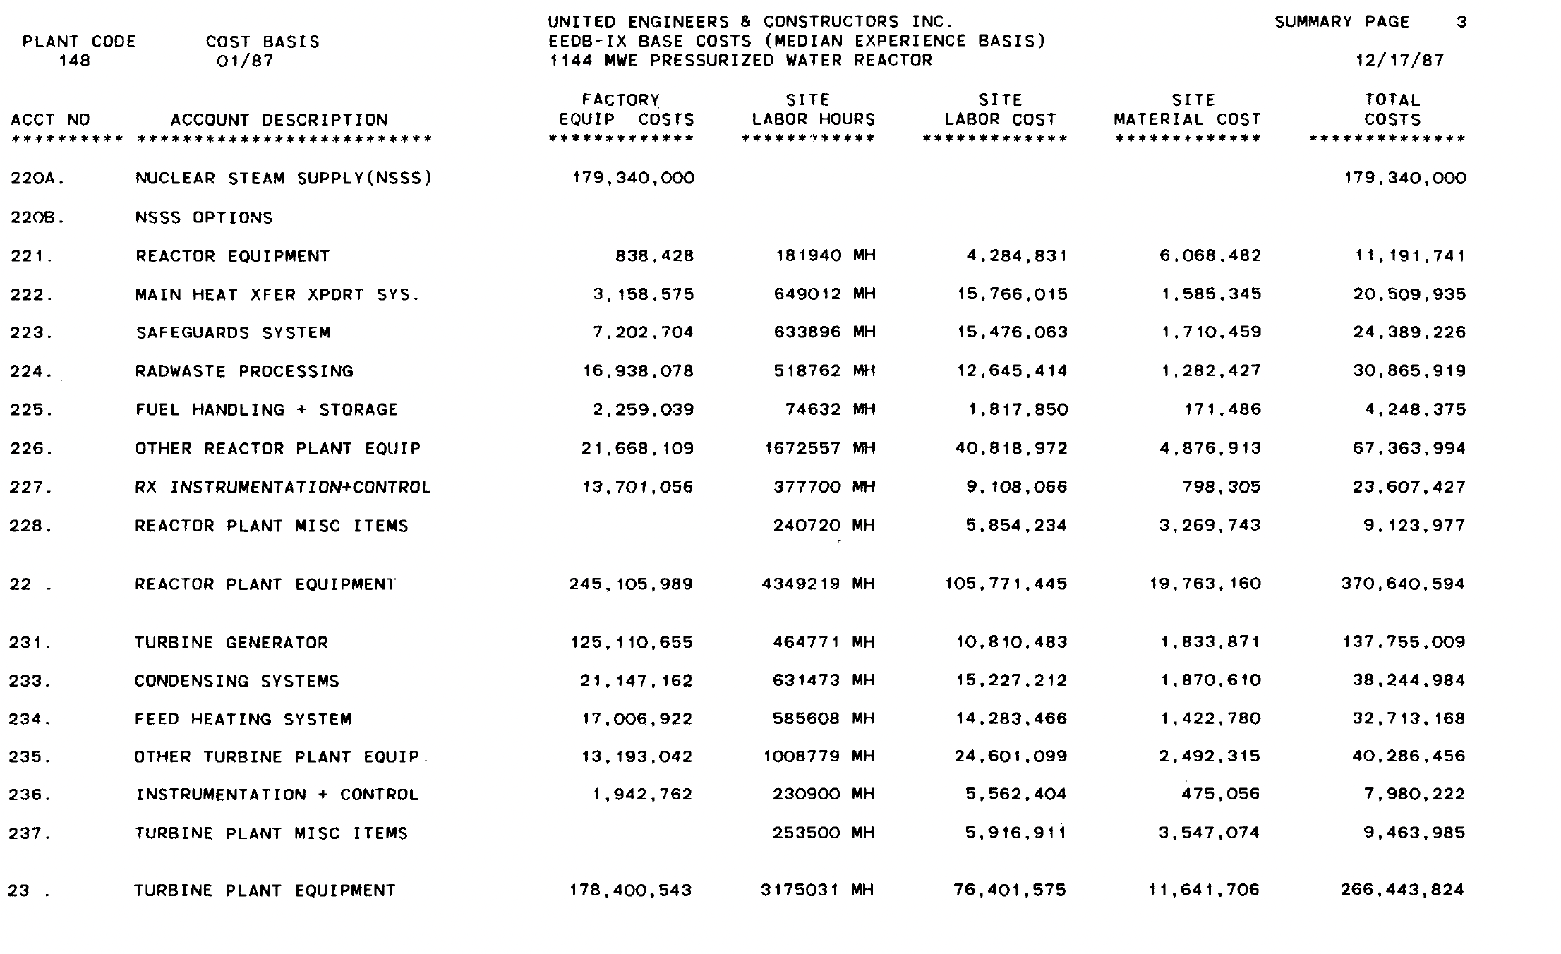
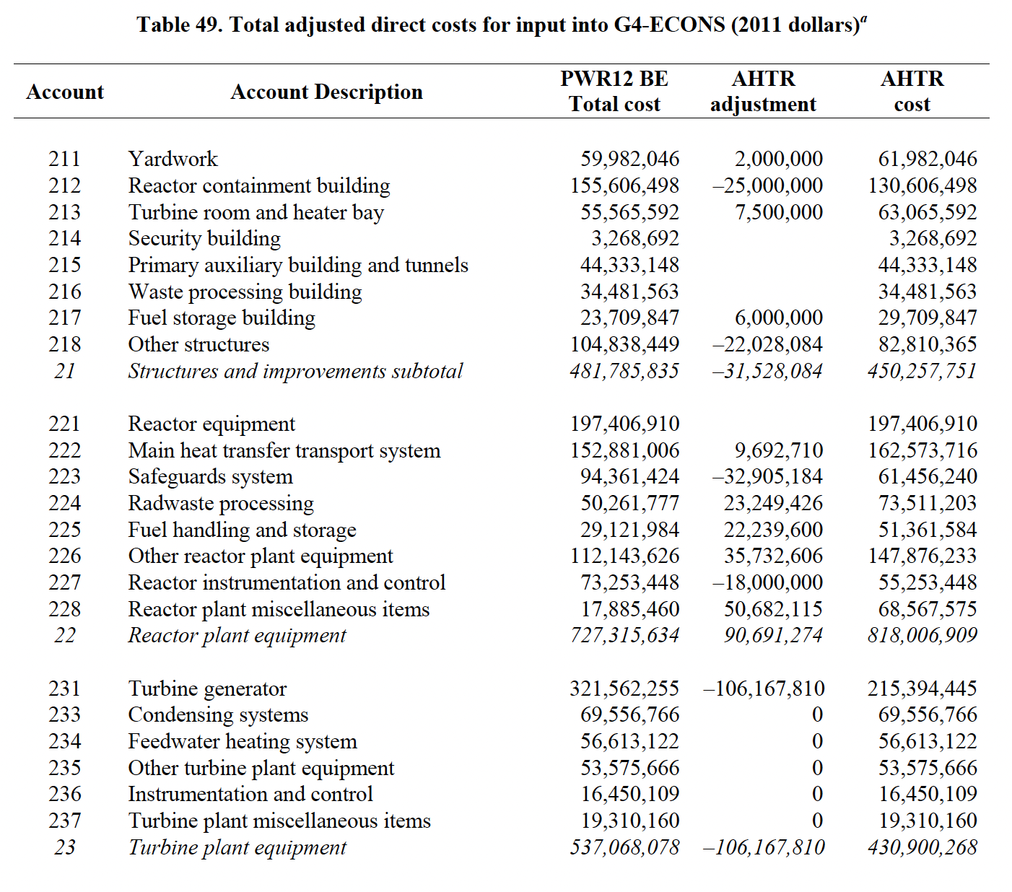
GAIN Meta-Analysis of Advanced Reactor Cost Estimation
Meta-study of cost estimation reports for advanced reactors
Focus on detailed bottom-up estimates to ensure cross-comparison
Compiling, mapping, and processing all datasets
Analyzing trends and potential ranges for users
Intent 1: Provide high-level costs for NREL ATB and other databases
Intent 2: Make detailed Code of Account (COA)-based database openly available on GAIN website
Focus group meeting weekly. Includes representatives from Utilities, academia, think tanks, NGOs, vendors
Report available at: https://doi.org/10.2172/2341591
Notes:
Moving on to reactor costs.
GAIN worked with DOE programs to compile various cost estimates in the literature. The goal was to create high level costs based on the various bottom up cost estimates that were publicly available.
Important here is to note that these are NOT FOAK numbers, but are some intermediate between-of-a-kind number and that first of a kind numbers are taken out by the govt. supported projects
These numbers are intended to be utilized by those people who have a need to look at forward planning (IRPs, capacity expansion modeling, etc.)
NREL ATB is National Renewable Energy Laboratory Annual Technology Baseline
What is IRP?
What is COA?

Slide 11
Reference Cost Ranges for Large and Small Modular Reactors
Capitals (Shown right) are given in conservative, moderate, advanced scenarios to highlight potential ranges of capital costs
Costs are shown as Between-of-a-kind (BOAK) or costs after First-of-a-kind demonstrations have taken place, but before Nth-of-a-kind learning has materialized
The INL report behind these values includes important information to energy mix planners on how to adequately capture advanced nuclear technology (e.g., capital costs, construction times, ramp rates)
Reference O&M costs for large reactors and SMRs
 | Large Reactor |  |  | SMR
 | Advanced | Moderate | Conservative | Advanced | Moderate | Conservative
Nuclear Fuel Costs ($/MWh) | 9.1 | 10.3 | 11.3 | 10.0 | 11.0 | 12.1
Nuclear Fuel Costs ($/MBTU) | 0.88 | 0.99 | 1.09 | 0.97 | 1.06 | 1.17
Fixed non-fuel O&M ($/kWe-yr) | 126 | 175 | 204 | 118 | 136 | 216
Fixed O&M ($/MWh) @ 93% capacity factor | 15.5 | 21.5 | 25.1 | 14.5 | 16.6 | 26.5
Variable non-fuel O&M ($/MWh) | 1.9 | 2.8 | 3.4 | 2.2 | 2.6 | 2.8
Total O&M ($/MWh) | 26 | 35 | 40 | 27 | 30 | 41
Reference Overnight Capital Costs (OCC) for large reactors and SMRs
Notes:
Here are the ranges developed. There are 3 ranges developed.
It should also be noted that there is a cost reduction assumed based on deployment scenarios. The cost reductions are based on learning rates from bottom up learnings in the literature and an assumed reactor deployment mix.
There has been further work to look at how these cost reductions actually can happen.
NREL ATB terms: Advanced, Moderate and Conservative

Slide 12

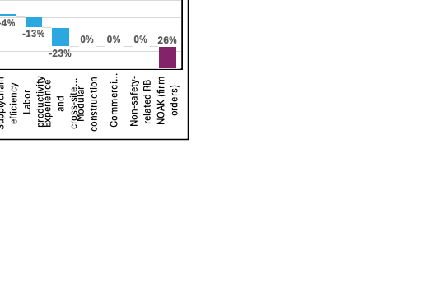
Cost Reduction Pathways
Number of Firm Orders | 13
Interest Rate | 6%
Design Completion | 80%
Design Maturity (0, 1, 2) | 1
Supply Chain Proficiency | 0.5
A/E Proficiency | 0.5
Construction Proficiency | 1
Cross-Site Standardization | 80%
Modular Civil Construction | TRUE
Commercial-Grade BOP | TRUE
Non-Safety-Related Reactor Building | FALSE
ITC Amount | 40%
Number units with ITC | 1
Tool to evaluate various pathways towards cost reduction
‘Untangles’ the effects from learning rate
Provides a useful framework to explore cost drivers and areas where stakeholders can explore impact of ‘levers’ on cost projections
Target audience: utilities, energy users, gov stakeholders, vendors, etc.
Report link: https://www.osti.gov/biblio/2361138
Spreadsheet tool link:
https://fuelcycleoptions.inl.gov/Shared%20Documents/Nuclear-Reactor-Capital-Cost-Reduction-Pathway-Tool.pdf

Slide 13
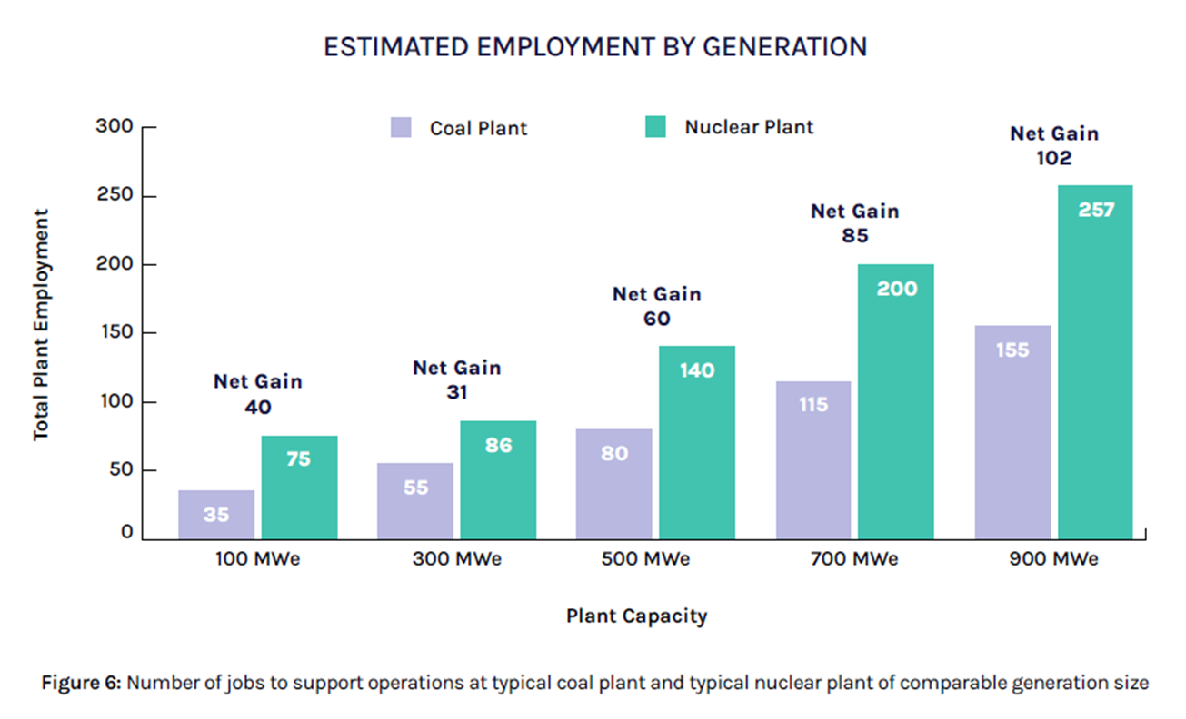
What does coal to nuclear conversion offer a community?
Nuclear can bring lasting jobs to a plant for 40-80 years
There are both direct jobs created as well as indirect and induced jobs
Many other renewable technologies only bring construction jobs
Source: DOE April 2024: COAL-TO-NUCLEAR TRANSITIONS: AN INFORMATION GUIDE
Notes:
Indirect - plumbers that must go to the site
Induced – services, infrastructure

Slide 14
Notes:
GAIN stands ready to help you do your work as efficiently as possible

Slide 15
Cost Reduction Scenarios Considered in Study
Two advanced reactor design considered: concept A & concept B
Four scenarios considered to highlight different paths towards ‘cost-competitive’ Nth OCC of $3,600/kWe (based on DOE Liftoff 2023)
  Scenario 1 = realistic levers
  Scenario 2 = bad FOAK execution, but larger order book to balance average costs with Scenario 3
  Scenario 3 = Scenario 1 with 4 units qualifying for ITC
  Scenario 4 = Optimistic scenario
Sensitivity analysis shows biggest contributors:
  Order book – Interest Rates – Standardization – Construction Proficiency – ITC – Modularization etc.
NCI
OCC
Notes:
DOE Liftoff?
Number of orders is biggest factor

Slide 16
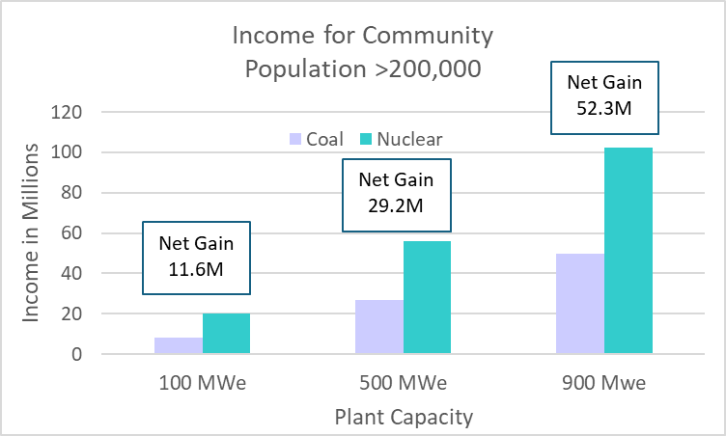
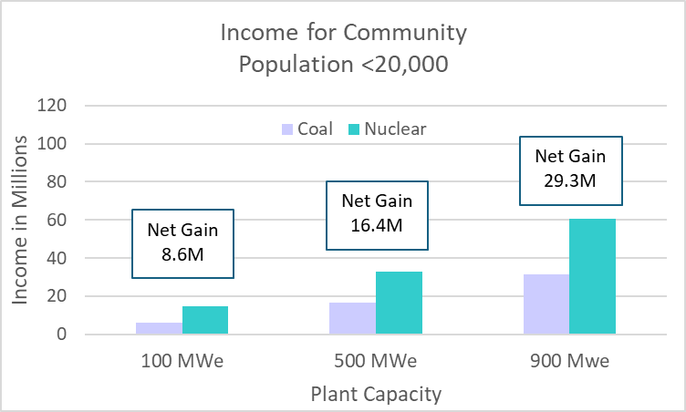
Economic Impact of Coal Plant Transition to Nuclear
Nuclear has a multiplier of ~1.5
For every $100 of electricity produced, $50 of economic activity occurs in suppliers and support industries
Notes:
Maybe delete this one

Slide 17
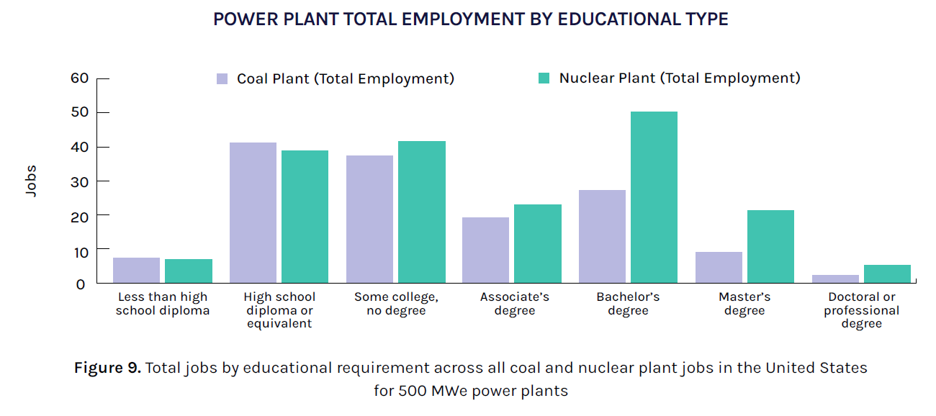
Overlap in Job Types and Education Levels
Comparing occupation codes shows the similarity in roles from each power plant type
45 percent of the added nuclear jobs share identical occupation codes with the coal plant
72 percent of the added share similar occupation codes
This implies that many occupations at the CPP have the educational background to work at the NPP
NOTE: Analysis does not account for nuclear, industry-specific training.
Notes:
Maybe delete this one

