Slide 1
Finding Buried Treasure or Marooned on a Deserted Island: The Use and Misuse of Economics in Utility Regulation
Kenneth Rose
Independent Consultant and
Senior Fellow, Institute of Public Utilities
at Michigan State University
39TH ANNUAL NATIONAL CONFERENCE OF REGULATORY ATTORNEYS
Tampa, Florida
June 20, 2016

Slide 2
Why Attorneys, and Others in Regulation, Should Know Some Economics
States and federal regulators are dealing with market and regulatory issues that requires economic literacy
Will cover some terminology and concepts here that may come in handy
Also, some of Harry Trebing and the “institutionalist” views that are still useful today
  will use RTO capacity markets to illustrate this point

Slide 3
What Characterizes a Market?
Perfectly Competitive Markets
Not So Perfect Markets
large number of buyers and sellers
free entry and exit
product homogeneity
perfect information
no externalities or internalized
few suppliers, or one dominate one
significant barriers to entry
product differentiated
imperfect or asymmetric information
significant externalities ignored or not fully accounted for

Slide 4
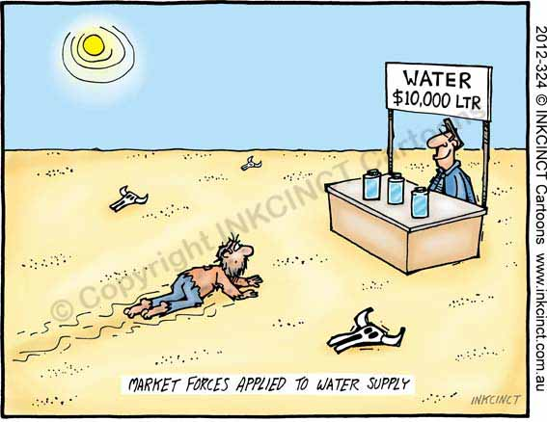
Rorschach test for economists:
Is this an efficient market outcome, or price gouging?

Slide 5
Harry Trebing’s First “Major Postulate” of the Institutionalist Model
Harry Trebing laid out five “major postulates” of the institutionalist model in an 1987 article
The first states why government intervention is necessary in his view:
  “industrialized societies give rise to concentrations of power, increased uncertainty, performance failures, uncompensated costs, and adverse distributional effects” and in
  “many sectors, markets are not self-correcting and are incapable of assuring an adequate supply of goods and services at least cost”
There is a real-life example of Prof. Trebing’s first postulate in the electricity supply business—the development of Regional Transmission Organizations (RTOs)

Slide 6
RTO Evolution
RTOs evolved from “power pool” arrangements between regulated and vertically integrated utilities to very complex organizations
RTOs over the last 20 years have become major enterprises with considerable influence that now plays a critical role in the U.S. utility infrastructure
The largest RTO by sales volume is PJM Interconnection, which covers a region that includes all or part of 13 states and the District of Columbia with over 61 million people
  In 2014, PJM produced 837,796 Gigawatt hours of energy and had over $50 billion billings for the year

Slide 8
RTO Evolution (continued)
RTOs did not evolve by design or from government fiat, but rather have developed and grown over time taking on increasing responsibility and importance
The result has been institutions that were not prescribed by legislation or regulation but now exert a powerful influence with little public input
RTOs are overseen by the Federal Energy Regulatory Commission (FERC) and are governed by “independent” boards and committees of “stakeholders” that include market participants with strong economic interest in rules and procedures of the RTO
However, public input is peripheral, at best

Slide 9
RTO Evolution and Capacity Markets
RTOs have grown and adapted to regulatory requirements and other perceived challenges over the years and this has led to considerable complexity
This includes multiple market structures that few can or do understand
A prime example is RTO capacity markets
The argument for creating a capacity markets within the RTO structure was that energy and ancillary services market revenues alone were insufficient to induce an adequate amount of new capacity or to prevent existing capacity from leaving the market

Slide 10
RTO Capacity Markets
There has been a heightened sense of urgency as power plants close or are scheduled to close soon
The cause of these closures and announcements has been attributed to
  the continued relatively low electricity energy prices (largely a consequence of relatively low natural gas prices),
  the impact on energy prices from intermittent power sources (primarily wind),
  and stricter environmental requirements for existing coal power plants
In response, some RTOs have altered or “enhanced” their capacity markets to improve performance by capacity resources (which capacity markets were intended to solve in the first place)

Slide 11
A summation . . .
Redesigned capacity markets, such as PJM’s RPM, are generating more revenue for capacity owners,
however, it may well still be insufficient, from the resource suppliers’ perspective
From the customers’ perspective, the cost continues to increase, even when energy prices have fallen and remained relatively low since the late 2000s
This seems to confirm Prof. Trebing’s first postulate, particularly that markets for this type of product are not “self-correcting” and cannot assure “an adequate supply of goods and services at least cost”

Slide 12
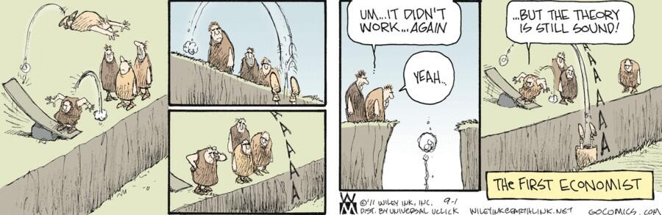
We should learn from failure, not double down

Slide 13
What reforms are necessary? (continued)
In a 1984 essay, Prof. Trebing summarized another institutionalist, Horace M. Gray’s take on economic regulation the sharing of economic and political power, noting that
  “Gray argued that regulation involves a sharing of power between public and private authority, but such sharing is inherently unstable because private power will ultimately co-opt public power. This comes about because of government’s failure to apply its power . . ..”
FERC has only used oversight authority as RTOs were developing markets and other pricing mechanisms—leading to the problems we have witnessed

Slide 14
True or False?
In wholesale energy markets, the price is the same as the marginal cost
FALSE Suppliers bid a price, not necessarily their marginal cost.
Unit dispatch for the region is based on bid prices submitted by suppliers, not marginal operating cost
Suppliers with market power can raise the price above marginal cost
Why is this important for regulators to know?
  Should not assume that because there is a “market,” that means it is a competitive
(Corollary: mitigation by the market monitor does not fix all market power)

Slide 15
True or False?
A firm that earns “economic profit” is able to do so because they can exercise market power and inflate the price
FALSE A firm can earn economic profit (defined as profit above a normal profit) without having market power (ability to raise the price significantly above the competitive market price).
In a competitive market, economic profit dissipates as other firms enter the market—this cannot happen with prohibitive entry barriers
Why is this important for regulators to know?
  Avoid policies that allow a regulated firm to earn economic profit, and assume that your market power provisions with limit it.

Slide 16
True or False?
A firm that is not covering all of its fixed costs will certainly go out of business.
FALSE As long as a firm can cover variable cost and make some contribution to its fixed costs, it will likely remain in business. However, if the firm cannot cover its variable costs, then it will likely shut down.
There’s a difference between being mostly dead and all dead (mostly dead is still partly alive—wisdom from Miracle Max)
Why is this important for regulators to know?
  Should be skeptical of claims that the regulated firm will fold because it cannot cover all its costs

Slide 17
True or False?
When prices are falling, that’s proof that the market is working, and there is no market power.
FALSE Definitely false—even a pure monopolist will lower their price when their costs decrease.
Conversely, rising prices do not mean there is market power.
Why is this important for regulators to know?
  Need good analysis to detect market power—not soothing bromides that make you think everything is fine.

Slide 18
True or False?
There is no substitute for careful analysis and thinking with your brain
TRUE!

Slide 19
Status Report on Energy Policy in the U.S. Today
State of Energy Policy in the U.S.
A Brief Summary

Slide 20
We now have incoherent . . .
Regulation, because they are not matched to the industry characteristics
Markets, that are also not matched to industry characteristics—and because we keep tampering and trying repair them with more markets
Environment policy, that is maybe the biggest mess of the three—since it is now a hodgepodge of technology subsidies, command-and-control regulations, tax incentives, and mandates that only indirectly impact emissions
We have chosen a costly route for solving our problems

Slide 21

This may sum it up the best
Gridlock [grid-lok]
noun
3. any situation in which nothing can move or proceed in any direction

