Slide 1
The Clean Power Plan and a Tale of Two Cities
Steps to Implementing the CCP in the Capital Cities of
a Regulated and Deregulated State
National Conference of Regulatory Attorneys
June 19 - 22, 2016
Michael G. Cooke
cookem@gtlaw.com
813.318.5728

Slide 2
Overview of Presentation
Brief description of CPP and litigation
General nature of State Plans, responsibility for preparing them, and potential difficulty
Contrast two states (one restructured/one traditionally regulated) and describe factors that would affect development of State Plans if rule upheld
Describe the types of State Plans that EPA will accept under the 111(d) rule.

Slide 3

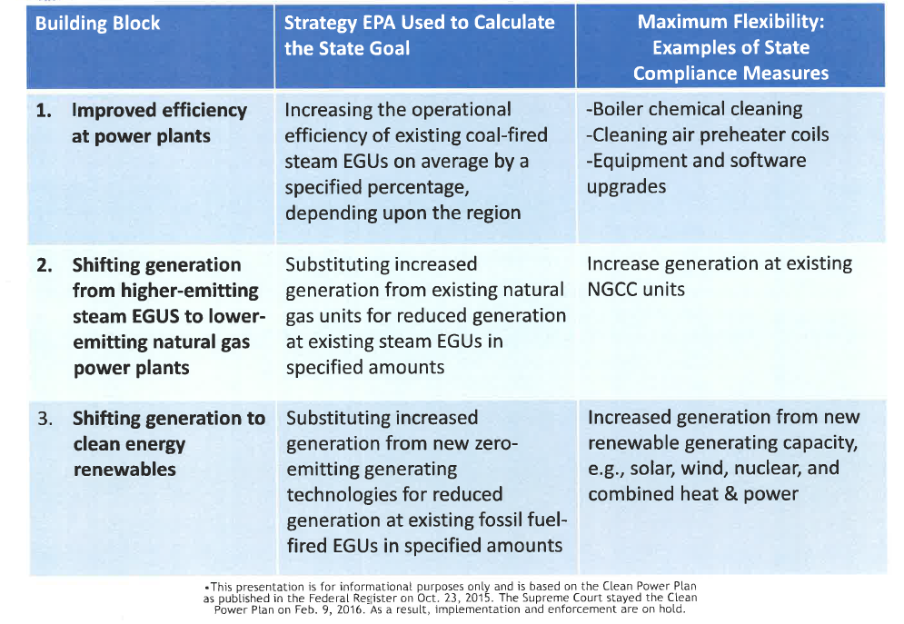

Slide 4
Compliance Timeline
State must submit initial SIPs (or final SIPs, if no extension requested) 9/6/2016.
State must submit FINAL SIPs, if extension previously granted, by 9/6/2018
Clean Energy Incentive Program begins
Initial Compliance Period Begins 1/1/2022
Milestone Status Report Due 7/1/2021
Deadline to achieve goals 1/1/2030
2016 | 2017 | 2018 | 2019 | 2020 | 2021 | 2022 | 2030

Slide 5
Litigation
West Virginia v. EPA, Case No. 15-1363 (and consolidated cases) filed Oct 23, 2015.
Motions for Stay denied by U.S. Court of Appeals for D.C. Circuit but granted by U.S. Supreme Court on February 9, 2016

Slide 6
U.S. Supreme Court Stay (Feb. 9, 2016)
The Environmental Protection Agency’s "Carbon Pollution Emission Guidelines for
Existing Stationary Sources: Electric Utility Generating Units,“ 80 Fed. Reg. 64,662
(October 23, 2015), is stayed pending disposition of the applicants’ petitions for review
in the United States Court of Appeals for the District of Columbia Circuit and
disposition of the applicants’ petition for a writ of certiorari, if such writ is sought. If a
writ of certiorari is sought and the Court denies the petition, this order shall terminate
automatically. If the Court grants the petition for a writ of certiorari, this order shall
terminate when the Court enters its judgment.

Slide 7
Current Litigation Timeline
  September 27, 2016—
  Oral arguments at D.C. Circuit to be heard en banc
  Late 2016 or Early 2017?—
  D.C. Circuit en banc decision; Application for
  Certiorari to U.S. Supreme Court expected
  2017 – 2018?—
  Supreme decision
  (Pre-stay rule—State plans due September 9, 2016, with possible extension to September 2018; Start of interim compliance—2022; Final compliance 2030)

Slide 8
One of the Major Legal Issues—What is the “Source” ?
111(a)(1) The term “standard of performance” means a standard for emissions of air pollutants which reflects the degree of emission limitation achievable through the application of the best system of emission reduction which . . . the Administrator determines has been adequately demonstrated.
111(a)(3) The term “stationary source” means any building, structure, facility, or installation which emits or may emit any air pollutant.
111(a)(6) The term “existing source” means any stationary source other than a new source.

Slide 9
Other Litigation Issues
Statutory language in Senate amendment of CAA in 1990 vs House version—never reconciled
House version--111(d) applies to pollutants that are not emitted “from a source category” which is regulated under section 112
Senate version—111(d) applies to any pollutant not “listed under section 112”
Defenders of CPP argue that sources that have been subjected to CPP section 112 MACT standards can also be regulated under 111(d)
Opponents note that House version would bar regulation of sources subject to 112 MACT standard from regulation under 111(d)—

Slide 10
State Plans under 111(d)
111(d)(1) Standards of performance for existing sources; remaining useful life of source
The Administrator shall prescribe regulations which shall establish a procedure similar to that provided by section 7410 [State Implementation Plans] of this title under which each which State shall submit to the Administrator a plan which (A) establishes standards of performance for any existing source . . . .
Regulations of the Administrator under this paragraph shall permit the State in applying a standard of performance to any particular source under a plan submitted under this paragraph to take into consideration, among other factors, the remaining useful life of the existing source to which such standard applies.

Slide 11
Basic Elements and Other Factors Affecting State Plans
May require new state legislation
States can develop individual state approaches or participate in collective approach with a group of states—but state rulemaking likely required either way
Must identify “affected entities”
Standards must be quantifiable, non-duplicative, permanent, verifiable, enforceable
Normally a function of the State environmental agency to develop SIPs, but this will require coordination with utility commissions and others

Slide 12
EPA Thinks State Plans for CCP Won’t Be Difficult
Janet McCabe, declaration in EPA Brief Opposing Motion For Stay in West Virginia:
  “Any state that submits … a state plan will be able to meet the requirements without undue burden–no more than, and in some cases less than, the state would have for other CAA state plans.”
  December 3, 2015

Slide 13
U.S. Energy Policy - Authorities
DOE
Overall Energy Policy
EPA
FERC
Regulation of Utilities
Interstate
Intrastate
States
State Energy Policy Regulation of Utilities

Slide 14
Entities that will Influence Each State’s approach to Creating a 111(d) plan
Governor and State Legislature
State Attorneys General
Public Utility Commissions/Public Counsels
State Environmental Agency
Environmental Advocacy Entities
Generator Entities

Slide 15

Annapolis, Maryland
Deregulated electricity market in 1998
Republican Governor, Democratic majority in Legislature, Democratic AG
Member of Regional Greenhouse Gas Initiative (RGGI) and has RPS
Part of Pennsylvania, New Jersey, and Maryland (PJM) RTO
Energy mix - 44% coal; 9% natural gas; 38% nuclear; 5% hydro; 1% oil; 2% other
Per 111(d), must reduce CO2 by 37% by 2030 (from 2031 lbs/MWh to 1287 lbs/MWh; from 20,171,027 short tons to 14,347,628 short tons)
Net summer capacity = 12,215 MW

Slide 16
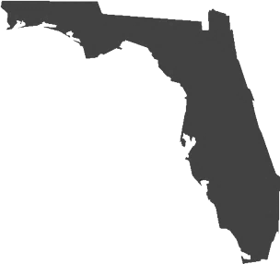
Tallahassee, Florida
Traditionally regulated state
Republican Governor, Republican majority in State Legislature, Republican AG
No RPS
Peninsular state essentially on its own grid with reliability council only (no ISO/RTO)
Energy mix -18% coal; 65% natural gas; 13% nuclear; 4% other
Per 111(d), must reduce CO2 by 25% by 2030 (from 1,247 lbs/MWh to 919 lbs/MWh; from 118,395,844 short tons to 105,094,704 short tons)
Net summer capacity = 59,139 MW

Slide 17
2015 Republican and Democrat Control in the States
Republican Control of Executive and Legislative Branches (24)
Democrat Control of Executive and Legislative Branches (7)
Split Control of Legislature (8)
Republican Controlled Legislature; Democrat Controlled Executive Branch (7) (Alaska Gov. is Independent)
Democrat Controlled Legislature; Republican Controlled Executive Branch (4)

Slide 18
2015 States Supporting or Challenging CCP
27 states suing
4 states not suing
1 state is exempt (AK)
16 states supporting
3 states exempt & supporting

Slide 19
Economic Factors to Consider
Tallahassee
Annapolis
Cost of generating & transmitting electricity
Former PSC Commissioner using EPA’s estimated average cost of $100/kw, estimated Block 1 for Florida would costs about $1.2 billion
Using EIA cost calculations for utility scale solar installations, former PSC Commissioner determined the installed costs of 4,345 megawatts of new renewable generation would be $16.8 billion
Cost of generating & transmitting electricity
Commissioner Speakes-Backman −as part of multistate trading group (RGGI), auction proceeds to Maryland via RGGI participation has added $230 million investment in Maryland, with 85% going to energy efficiency and direct bill assistance

Slide 20
Existing Technical Factors to Consider
Tallahassee
Annapolis
Isolated grid/fuel diversity issues
All fuels imported
Investor-owned, municipal, electric cooperatives, and merchant plants
Relatively diverse fuel mix and part of RTO
Some Marcellus shale in western MD
Investor-owned, municipal, and electric cooperatives

Slide 21
Existing Statutory Factors to Consider
Tallahassee
Annapolis
Avoided cost – 366.91, Fla. Stat., renewables must be purchased by grid but at full avoided cost
§403.519(3), Fla. Stat., cost-effectiveness analyzed for EGUs
Chapter 120.541(3), Fla. Stat. (Legislative ratification of agency rules costing more than $1 million)
Wholesale/Retail Issues
FERC Demand Response jurisdictional issues— Maryland Public Service C’mmsn v. Talen Energy (CPV Maryland, LLC v. PPL EnergyPlus, LLC) ; Electric Power Supply Association v. FERC

Slide 22
Key To EPA’s Strategy:
The State Plans
Two basic options for CCP State Implementation Plans. First is called an “Emission Standards Plan” and has two approaches:
  “Rate-based Approach” – Impose Federally enforceable emission standards directly on covered fossil fuel units in the State using rate-based approach (e.g. national emission rates—1305 lbs/MWh hour (coal), 771 lbs/MWh (natural gas))* or use some form of averaging so state value-based standard is met; also allows market trading of credits; or
  “Mass-based Approach” – Ensure that the State achieves compliance with the State-specific mass based goals (e.g., a cap-and-trade platform that may permit individual EGUs to exceed 1,305/771 or possibly by applying mass-based limits to individual EGUs). EPA seems to contemplate allowing new EGUs to participate in mass-based trading.
  *N.B.-- Final CO2 NSPS (for new fossil fuel sources) = 1400 lbs/MWh for coal and 1000 lbs/MWh for natural gas sources.

Slide 23
Key To EPA’s Strategy:
The State Plans (Cont’d)
  Second is called a “State Measures Plan:” Design a plan that will achieve State emission reductions goal -
    States can use most any method or control so long as the requirements are enforceable, permanent and verifiable, and will achieve goal.
    Not bound by EPA’s “3 Building Blocks” assumptions (e.g., could include energy efficiency or RPS programs).
  No matter what approach a state considers, EPA’s clear preference is for some kind of market trading scheme, including regional multi-state approaches, using either credits (rate based) or allowances (mass based).

Slide 24
What happens if states don’t submit approvable state plans
EPA FIP – EPA proposed a template FIP; comments were due January 21, 2016; two approaches:
  Possible rate-based approach where power plants are responsible for meeting emissions standards either by reducing their emission rates or obtaining (e.g. buying) emissions reductions credits; or
  Mass-based approach using allowances (effectively cap and trade)

Slide 25
Clean Power Plan in Florida – Preliminary Analysis
Could be significant retirements of coal capacity with stranded asset/cost recovery issues
Might create capacity challenges:
  Significant increase in renewable capacity will be needed Increased reliance on “intermittent power” may create reliability challenges
  Availability of fast ramping capacity and operational reserves will be important
Continued shift to natural gas
Instate cap-and-trade might be “easiest”

Slide 26
Clean Power Plan in Maryland – Preliminary Analysis
Likely to rely on multistate trading approach
Some retirement of coal capacity
Continued emphasis on RPS
Uncertainty regarding how to structure new instate generation incentive programs (e.g., contract price vs. clearing price per Talen Energy)

Slide 27
Conclusions
Clean Power Plan rule is an unprecedented exercise of power by EPA.
Outcome of litigation is uncertain, except for two things:
  It will almost certainly end up in front of the Supreme Court; and
  It will take time.
In the meantime, EPA will be pressing forward with its agenda, and the States, industry and other stakeholders will be figuring out what to do.
  This uncertainty provides significant opportunities for advocacy at state level.

Slide 28
Thank you
Michael G. Cooke
813.318.5728 (office)
cookem@gtlaw.com

