Slide 1
Regulatory Policy Issues
Karl McDermott
Ameren Distinguished Professor University of Illinois Springfield
Presented June 20, 2016

Slide 2

The Truth is Out There
What is Really Going on in the Public Utility Sector?

Slide 3
Scenario
Declining electric intensity
Declining load growth
FC vs. VC
Peak Growth vs. Total Usage
Increasing storms and weather events
Energy Market Evolution?
Rise in Real Price of Energy?
Potential for Conservation?
Automation and Micro-technology?

Slide 4
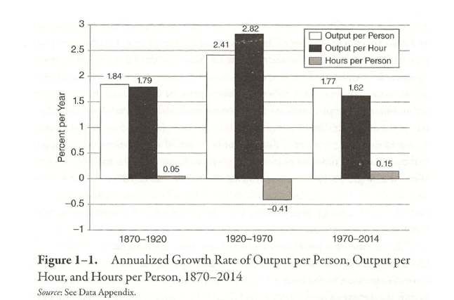
Gordon part 2

Slide 5
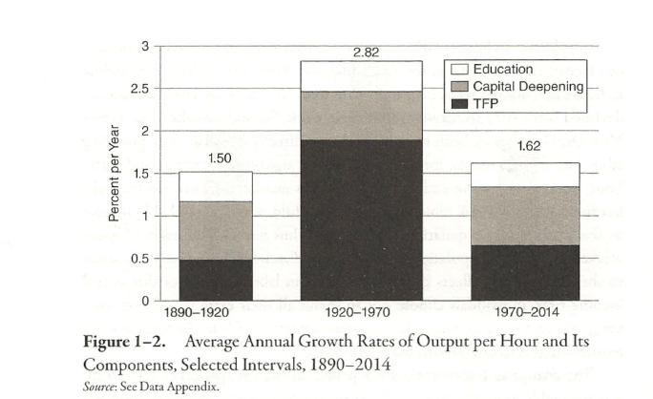
R. J. Gordon Rise and Fall of American Growth

Slide 6
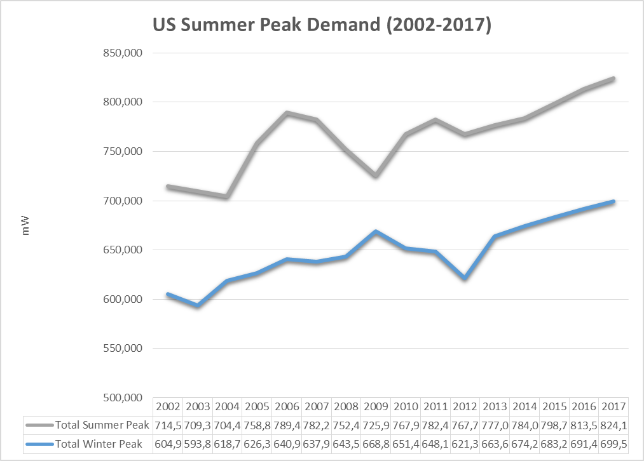

Slide 7
Declining Demand Growth

Slide 8
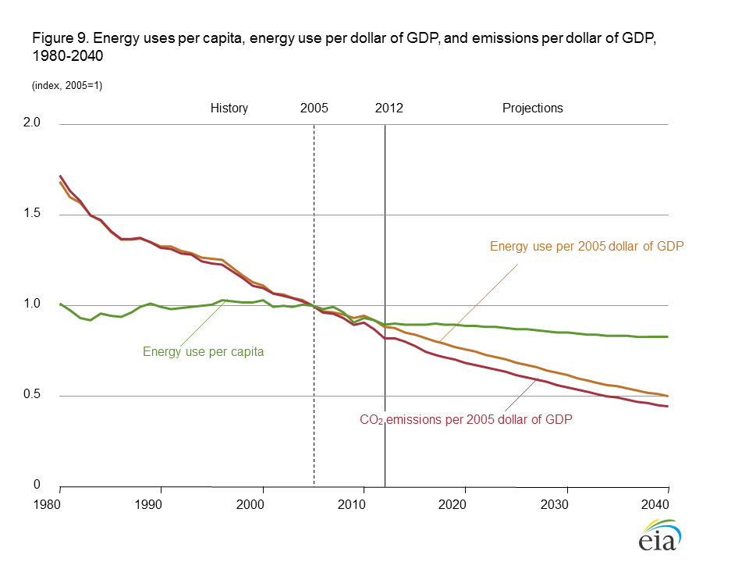

Slide 9
Climate Cycles

Slide 13
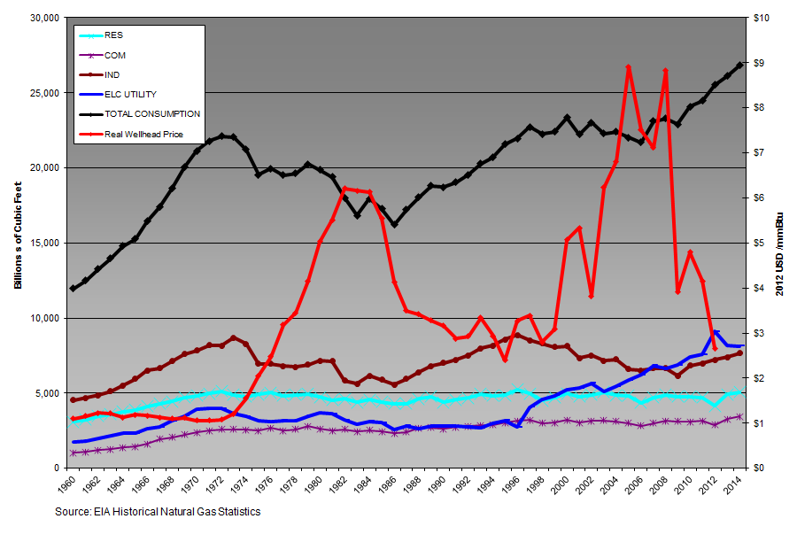
Demand for and Prices of Natural Gas

Slide 14
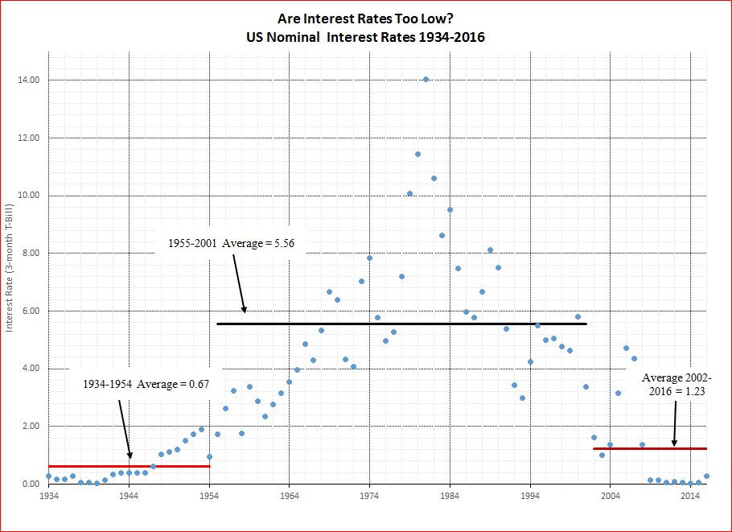

Slide 15
Transition in World Views
Old World View
New World View
Universal Access
Safe-
Reliable- Deliver those Kwh/MCF
Affordable- Can buy Kwh/MCF
Carbon Constrained world
Electricity is going to be more expensive- affordability Access
Attitudinally the role of consumption or conservation-optimize value
Resilience in face of variability- the new reliable

Slide 17
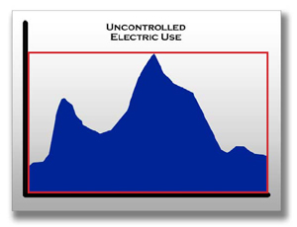
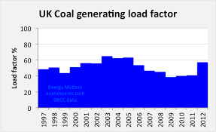
Transition from world where we passively meet a customer driven demand to a world where we control Demand

Slide 18
Utility of the Future- Home as Power Plant
Grid as platform-the Laminar World
Who is responsible to reliability? I think it is the Disco!
How to price these services? LMP on distribution grid?
  ISO doesn’t want to go down to distribution level?
Home as power plant-Prosumer?
Utility customer partnerships
  Utility behind the meter
    Callable resources
    Dedicated resources
    Emergency resources

Slide 19
The Home as Power Plant
Investments in DG- Solar, Natural Gas, Propane, Wind
Investments in Smart Appliances
Investments in Energy Management Systems
Investment in Battery Systems
Investment in EV-V2G
Investments in Home Design- Passive solar, tightening envelope

Slide 20
Implications for Regulation
Core and Non-Core Services?
Open access and Imputation?
Transactive services and menu of contracts?
Outcome focused Regulation
  Performance or Incentive Regulation
  Metrics for Core and Non-Core
  Performance Measures
    Degree of Transactive Services
    Range of Services
    Values Customer Receives

Slide 21
What Are the Questions Regulators and Industry Must Face?
Is there a threat to the business as usual model of a utility?
Is it disintermediation or refocused intermediation in the future?
What is the role of transactive markets and how will we regulate it?
Home as power plant is the next frontier for competition.

