Slide 1
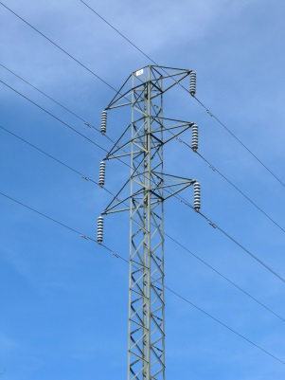

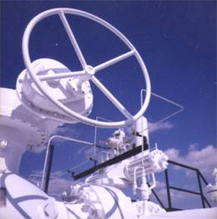


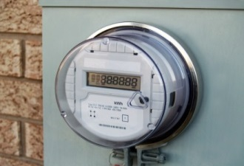
The future of policy and regulation.
Unlocking the Treasures of Utility Regulation, Annual Meeting, National Conference of Regulatory Attorneys, Tampa, Florida
David E. Dismukes, Ph.D.
Center for Energy Studies
Louisiana State University
June 20, 2016

Slide 2
Take-aways
Regulation has, and will continue to change in ways that significantly deviate from traditional theories, practices, and emphases.
Regulatory emphasis has shifted away from cost/rate minimization and towards maximizing utility development of social capital.
This will make regulatory policy and governance entirely more subjective and undermine (if not entirely eliminate) traditional regulatory tools for imposing utility discipline (i.e., regulatory lag, prudency).
Result has been, and will continue to be, a dramatic variation in rates across the country that will reflect regulatory activism in supporting social capital investments.
The profit maximizing outcome for utilities will be to support, if not expand upon these social investment initiatives provided their associated risk is removed.
New Natural Gas End Uses & Fuel Diversity Concerns
© LSU Center for Energy Studies

Slide 3

Center for Energy Studies
Traditional Regulation: Theory and Practice
© LSU Center for Energy Studies

Slide 4
Monopoly
Traditional Regulation
Traditional Regulation
Center for Energy Studies
The purpose of utility regulation
In theory, utilities are regulated for (at least) two reasons:
  Utilities are imbued with the public interest: utilities provide critical services (electricity, natural gas) that are essential for a modern economy; and
  Utilities are “natural monopolies.” Utilities have (natural) cost characteristics that allow them to drive competitors out of the market and then price their services at rates higher than competitive markets.
© LSU Center for Energy Studies 4

Slide 5
Traditional Regulation
Traditional Regulation
Center for Energy Studies
Comparison of pricing outcomes and regulation
Regulators have to choose prices that reflect some middle ground that give utilities a “fair-return” for their investments. This results in prices lower than what would occur under an unregulated monopoly, but higher than those arising in competitive markets.
$
Monopoly
Price
P_{m}
Fair Return
Price
Price and costs
P_{f}
ATC
P_{r}
MC
Socially
Optimal Price
D
MR
Q_{m}
Q_{f}
Q_{r}
Quantity
© LSU Center for Energy Studies 5

Slide 6
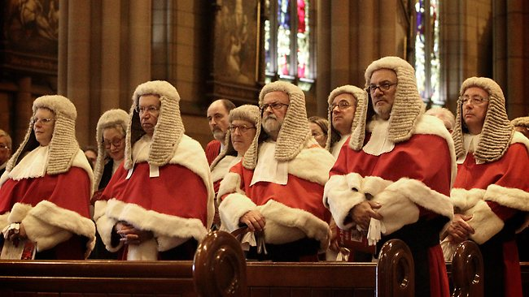

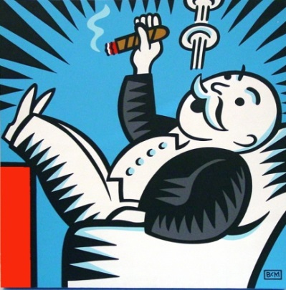
Monopoly
Traditional Regulation
Traditional Regulation
Center for Energy Studies
Regulatory actor incentives
Cloud of Asymmetrical Information
Regulators
Utilities
Ratepayers
Incentives: to maximize the public interest by reducing unnecessary rate increases.
Incentives: to maximize profits subject to regulatory constraints.
Incentives: to maximize benefits subject to budget constraints.
© LSU Center for Energy Studies 6

Slide 7
Monopoly
Traditional Regulation
Traditional Regulation
Center for Energy Studies
Utility incentives
About mid-century, the theory of regulation started to ask questions about the traditional profit-seeking incentive for utilities.
Question: what incentive does a utility have to operate efficiently, and maximize its overall profits since, if a utility operates efficiently, and reduces its costs, it will increase its profits above its allowed level, thereby stimulating a rate case that will lower its rates and returns.
If regulators repeatedly expropriate profits, there is little incentive to be efficient nor innovate (?).
In fact, the only way to increase rates is through an increase in reported costs.
© LSU Center for Energy Studies 7

Slide 8
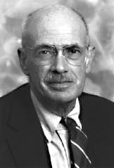
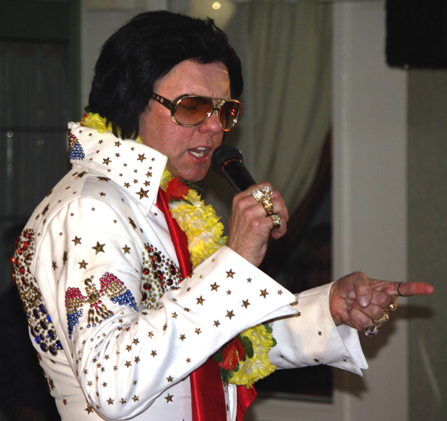
Traditional Regulation
Center for Energy Studies
What is the Averch-Johnson effect?
Harvey Averch and Leland Johnson and published in the American Economic Review in 1962, posited that rate of return regulation creates an incentive for regulated utilities to overcapitalize, resulting in an inefficient utilization of resources and higher than optimal rates.
This finding, however, was premised upon a model with a number of assumptions, one of which presumed there was no regulatory lag and that rates were set on a period-to-period basis: in other words, rates were set on a “cost-plus” regulatory approach.
Source: H. Averch and L. Johnson. (1962) “Behavior of the Firm under Regulatory Constraint.” American Economic Review. 52:1052-1069.
© LSU Center for Energy Studies

Slide 9
Traditional Regulation
Center for Energy Studies
Follow-Up A-J research
Soon after its publication, Averch’s and Johnson’s article was met with a flurry of scholarly research attempting to empirically verify the A-J effect, as well as examining the conditions under which the effect would, and would not, be sustained.
Rejoinders to the research noted that two characteristics of the regulatory process tended to temper the likelihood and prevalence of the A-J effect and other inefficiency incentives:
the possibility of disallowances through the prudence review process and
the positive efficiency incentives created by regulatory lag. In fact, a series of articles published soon afterwards noted that regulatory lag typically creates incentives for utilities to seek efficiency opportunities between rate cases since the gains (profits) from those investments inure to shareholders instead of ratepayers.
© LSU Center for Energy Studies

Slide 10
Traditional Regulation
Center for Energy Studies
Regulatory lag as a form of market discipline
Regulatory lag is often defined as the period of time between when a utility’s rates go into effect and its next rate case and is an important means by which traditional regulation is thought to inject discipline upon utilities similar to that arising in competitive markets.
Under traditional regulation, rates are set on a utility’s prudently-incurred costs:
If a utility improves its operating/investment efficiencies after a rate case, then the increased profits associated with these actions accrue to the utility much like they would in a competitive market.
The inverse occurs if a utility becomes less efficient or is unable to contain its costs after a rate case: profits will fall much like they would in a competitive market.
© LSU Center for Energy Studies

Slide 11
New Natural Gas End Uses & Fuel Diversity Concerns
Social Capital
© LSU Center for Energy Studies

Slide 12
Social Capital
Market failures
Today’s social investment policies are intended to address a variety of perceived energy market failures:
Natural monopolies/market power: when you have few firms and/or one firm controls/dominates the market.
Externalities: when one party’s actions impose an unaccounted for cost (or benefit) onto another party.
Asymmetric information: when one party has more information than another and uses that information for strategic gain.
Risk & Uncertainty: arises in markets influenced by a variety of random factors that can be partially known (can be assigned probabilities) or entirely unknown (cannot be assigned probabilities).
New Natural Gas End Uses & Fuel Diversity Concerns
© LSU Center for Energy Studies

Slide 13
Social Capital
Efficiency and current policy agendas
What social investments are attempting to address which market failures?
  Renewables (externalities)
  Safety/reliability (externalities, public goods)
  Environmental (externalities)
  Energy efficiency (imperfect info, risk/uncertainty)
The regulatory challenge is that these policies’ benefits, by definition, do not have an easily-measured market value. Just about any benefit estimate can be used to justify any level of investment. How do you know the investment has been cost-effective?
Today, prices continue to increase despite the fact that the commodity cost of the energy being transformed and/or delivered has been decreasing.
New Natural Gas End Uses & Fuel Diversity Concerns
© LSU Center for Energy Studies

Slide 14
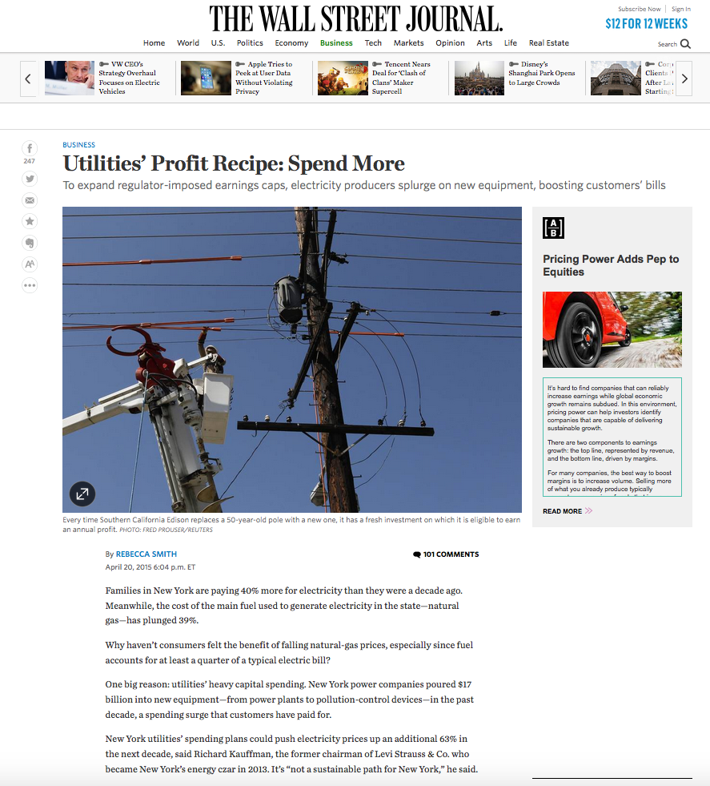
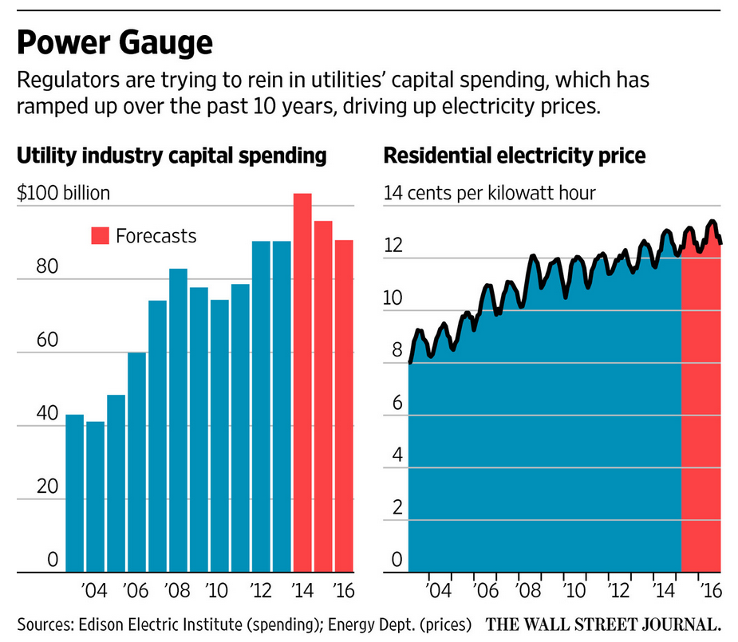
Monopoly
Social Capital
Traditional Regulation
Center for Energy Studies
This is an issue already getting recognized, to a certain extent, by media.
© LSU Center for Energy Studies 14

Slide 15
Social Capital
Center for Energy Studies
Current policy agendas: conceptual impacts
Current policy agendas are increasing rates through (a) a significant increase in non-growth related capital investment and (b) a reduction in system utilization through demand reductions and intermittent resources.
Rates
Increasing unit costs due to policies encouraging reduced usage.
P₃
C’
P₂
Increased total costs for non-revenue producing (cost-reducing) investments.
P₁
C
Quantity
Q₂
Q₁
© LSU Center for Energy Studies 15

Slide 16
New Natural Gas End Uses & Fuel Diversity Concerns
Rate Implications & Impacts
© LSU Center for Energy Studies

Slide 17
Impacts
Annual percent change in base rate versus fuel rate – electric
Base rates (electric) have increased almost 90 percent since 2005, compared to fuel rates that have decreased by 24 percent.
Indexed Rate (1995=1)
Base rates = -38.2%
Fuel rates = 76.7%
Base rates = 89.2%
Fuel rates = -24.1%
Source: Energy Information Administration, U.S. Department of Energy; and Federal Energy Regulatory Commission.
© LSU Center for Energy Studies

Slide 18
Impacts
U.S. electric prices – range of prices
Simple “high-low” chart further illustrates the growing dispersion in retail electricity prices.
Electric Price, cents/kWh
Source: Energy Information Administration, U.S. Department of Energy.
© LSU Center for Energy Studies

Slide 19
Impacts
U.S. electric prices – skewness
The skewness in the distribution of utility rates is increasing rapidly indicating that states with higher rates are dominating the distribution.
The distribution of electric rates is strongly skewed towards high rate states (summary statistic is 3 to 4 times a relatively balanced distribution).
Skewness Statistic
A value of 1.0 indicates a relative balance in the distribution of rates.
Source: Energy Information Administration, U.S. Department of Energy.
© LSU Center for Energy Studies

Slide 20
Impacts
U.S. electric prices – coefficient of variation (standardized dispersion)
The variability of retail electricity prices has grown considerable over the past two decades and is now higher than during the restructuring period.
Restructuring implementation
Coefficient of Variation
Post-2005 policy agenda implementation (EE, RE, decoupling, trackers, etc.)
CV is defined as the standard deviation divided by the mean.
Source: Energy Information Administration, U.S. Department of Energy.
© LSU Center for Energy Studies

Slide 21
Impacts
U.S. electric utility capacity factor
Utilization of generation plant is falling, not increasing, and has been dramatically decreasing since 2006.
Capacity Factor (%)
Source: Energy Information Administration, U.S. Department of Energy.
© LSU Center for Energy Studies

Slide 22
Impacts
U.S. electric utility production index
Overall utility industry assets (all sectors) have seen significantly lower utilization rates over the past two decades.
Production Index – Electric generation,
production, distribution
Source: Federal Reserve Bank.
© LSU Center for Energy Studies

Slide 23
Impacts
U.S. electric utility generation – average annual fossil-fuel heat rate
While combined cycle efficiencies have been improving, steam generation utilization has become increasingly less efficient.
Heat Rate (Btu/kWh) –
Coal and Natural Gas Steam
Heat Rate (Btu/kWh) –
Coal and Natural Gas Steam
Source: Energy Information Administration, U.S. Department of Energy.
© LSU Center for Energy Studies

Slide 24
Center for Energy Studies
Conclusions
© LSU Center for Energy Studies

Slide 25
Conclusions
Conclusions
Conclusions
Emerging regulatory model is sustainable only to the extent that the regulatory-determined supply of social capital is equal to the demand for that social capital. In other words, ratepayers’ willingness to pay for the aggregate levels of social capital determined by regulators.
The probability that regulators will accurately choose the optimal level of social capital investment is likely low. The history of regulation (and public policy) is not filled with a large number of success stories on administratively-determined investment outcomes.
The process will likely price out of the market some ratepayers that have a low, or very selective, valuation of social capital or, in the alternative, can meet their demand for social capital in alternative or more effective ways.
The ratepayers choosing alternative solutions are likely larger-than-average users, and reductions in their contributions to the cost of maintaining this system of social capital will have to be recovered from other ratepayers, further exacerbating this problem, at the margin, leading to a number of outcomes that will highly challenge traditional measures of system efficiency and utilization.
© LSU Center for Energy Studies

Slide 26
Conclusions
Solar grid parity estimates
A recent Bloomberg study shows 36 states are expected to reach parity by 2016. Is this a function of lower solar costs or higher utility costs/rates?
Distance from Average Price of Electricity ($/kWh)
Potential grid parity states (2016)
Note: Author’s construct from source. The purple bars show the anticipated cost of solar energy (assuming a conservative 20-year lifespan for the panels) minus average electricity prices. Positive numbers indicate the savings for every kilowatt hour of electricity.
Source: Bloomberg: http://www.bloomberg.com/news/articles/2014-10-29/while-you-were-getting-worked-up-over-oil-prices-this-just-happened-to-solar
26

Slide 27

Questions, Comments and Discussion
dismukes@lsu.edu
www.enrg.lsu.edu

