Slide 1
Equitable Access to Sustainable Energy:
National Challenges & Local Solutions
Karl R. Rábago
Executive Director, Pace Energy and Climate Center
Co-Director, Northeast Solar Energy Market Coalition

Slide 2
Agenda
The Issues
Opportunities
Program Design Ideas
Additional Resources
Leadership is Required; Leadership is Rewarded

Slide 3
The issues

Slide 4
The Issues
Scope of energy poverty
Basic needs & crisis focus
Under-sized programs & scarce resources
Unimaginative program design & regressive rate initiatives
Lack of information & experience
Well-understood barriers of all kinds

Slide 5
Scope of Energy Poverty
In many places today, 1/3 of households at or below poverty.
In 2014, 19.1% of households at or below Federal poverty line, 2X is still low income
In many cities/states, 50% of children growing up in low income homes

Slide 6
New York Energy Burdens
NY PSC Case # 14-M-0565
Goal is household energy burden at or below 6% of household income.
Today, 2.3 million NY households are at or above 6%.

Slide 7
Basic Needs & Crisis Focus
Bill payment programs like LIHEAP have strained budgets
Bill payment assistance only addresses short term problems by paying money to utilities on behalf of customers
High poverty = high health impacts

Slide 8
Undersized Programs & Scarce Resources
Low income programs address only a fraction of the problem, often at a rate that limits long-term progress
Rate discounts and efficiency investments limited by RIM test constraints
Federal and state funding erratic, too low, and often a political football

Slide 9
Unimaginative Program Design & Regressive Rate Initiatives
Discounts or hand-outs (crisis mentality)
Measure by measure cost-effectiveness testing
Failure to pursue economies of scale
Excessive M&V
TOU without tools to respond to prices
Fixed customer charges
Reduced rate class diversity
Collateral damage from “war on solar”
Fear/lack of customer segmentation

Slide 10
Lack of Information & Experience
Lack of utility experience with weatherization and direct install
Some utilities don’t consider LMI a “market” opportunity
LMI customers have little experience with program opportunities
Program offerings are intrusive, highly technical, and require heavy documentation and frequent visits
Just now learning about EE as a “resource,” e.g., BQDM

Slide 11
Well-Understood Barriers
(But Not Well-Addressed)
Split incentives
  Owner/renter
  Multi-family dwellings
Access to capital, financing, credit
Information, data
Program funding and consistency
Jurisdictional cooperation, coordination

Slide 12
Opportunities

Slide 13
Opportunities
New approaches to engagement
  Community groups
  Neighborhood “sweeps”
  Demand response volunteerism
  Turn bill crisis into energy management engagement
  Split program fixed costs among measures
Shared and community resource development
  Shared clean energy facilities & pricing
  Demand-side cooperatives
  Community Choice Aggregation

Slide 14
Opportunities
Innovative rate design & pricing
  Fixed rate renewable energy products
  Affordability blocks
  Time-based rates (and tools to use them)
  Segmentation
  Location- and Value-Based pricing
Innovative financing
Energy performance housing disclosure & other information initiatives
There IS cost-effective EE in the LMI sector –
We Just Need to Work a Little Harder to Get It!

Slide 15
Program Design ideas

Slide 16
Best Practices from EE & Solar Markets Experience
Five key stages of market development
  Awareness
  Interest
  Evaluation & Trial
  Adoption
  Advocacy
Three functional areas of effort
  Program Design
  Community Engagement
  Marketing & Sales

Slide 17
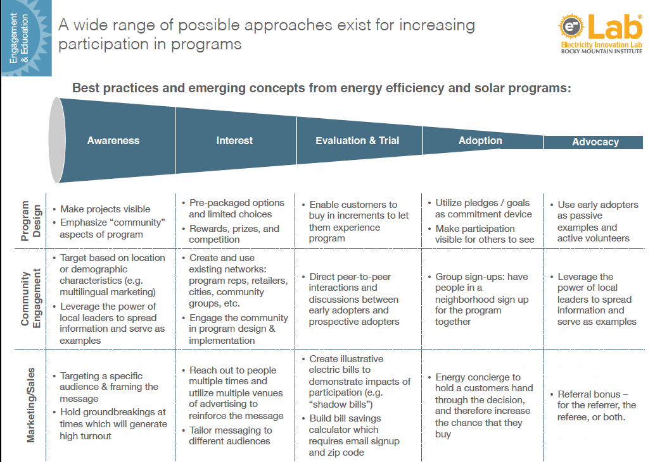
Source: eLab LEAP Pre-Read

Slide 18
Community-Level Programs
Tuned to the unique situation, goals, and needs of the community
Shared Ownership
  Localized energy systems & resources, e.g. district heating, microgrids
  Shared systems & resources, e.g. remote net metered solar
Community Aggregation
  Group buying programs
  Community Choice Aggregation

Slide 19
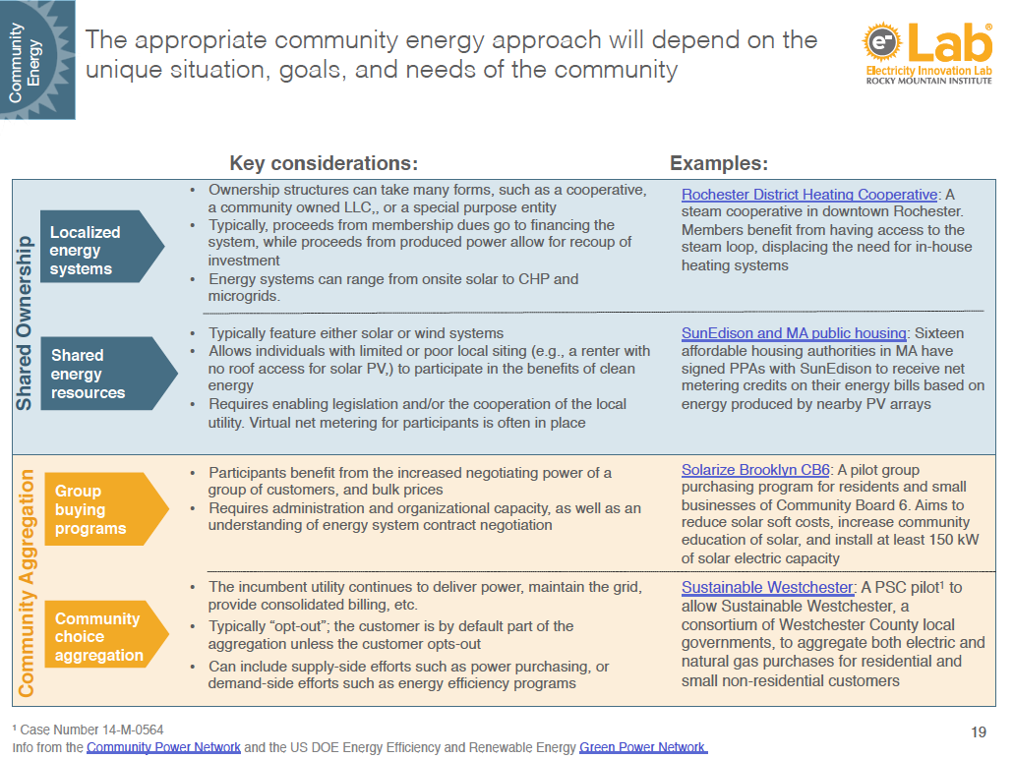
Source: eLab LEAP Pre-Read

Slide 20
Rate Design, Discounts, and Incentives
First, ”do no harm”
  Declining blocks
  Fixed, demand charges
NY PSC Case 14-M-0565
  Discounts, arrearage forgiveness, reconnection fee waivers
  Percentage discounts, low-use discount, PIPP
Other Ideas
  Block pricing
  Other methods of calculating support levels

Slide 21
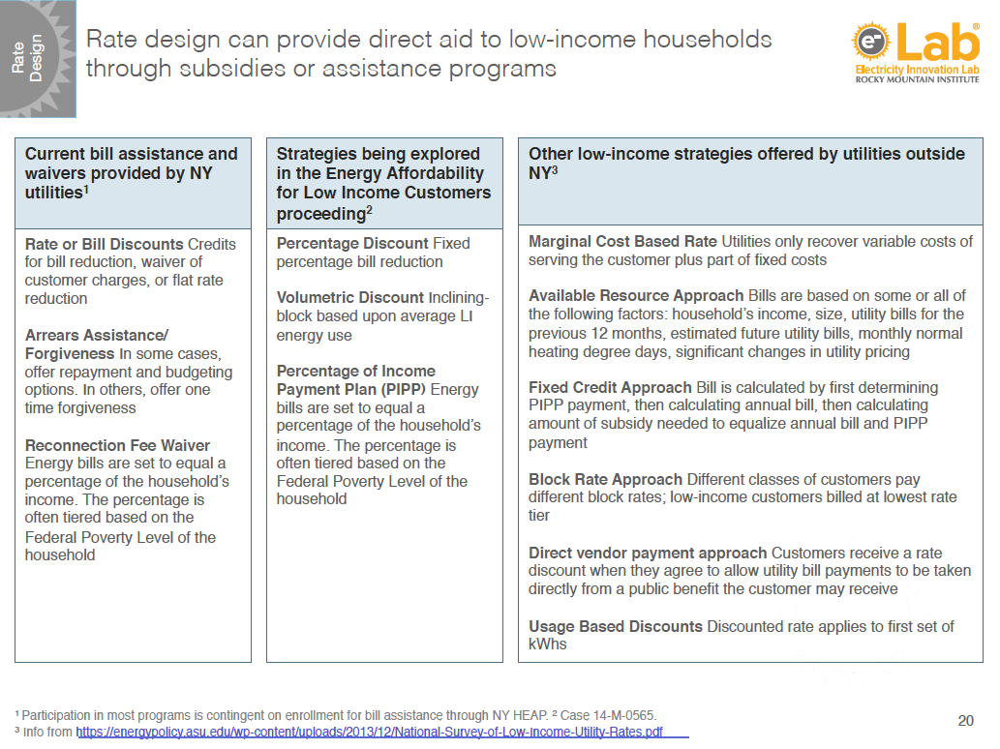
Source: eLab LEAP Pre-Read

Slide 22
Financing Innovation
Interest Rate Buy-Down
Credit Enhancement
Alternative Underwriting
Property-Assessed Clean Energy
On-Bill Financing
Deferred Loans
Paycheck-Deducted Loans
Loan Guarantees

Slide 23
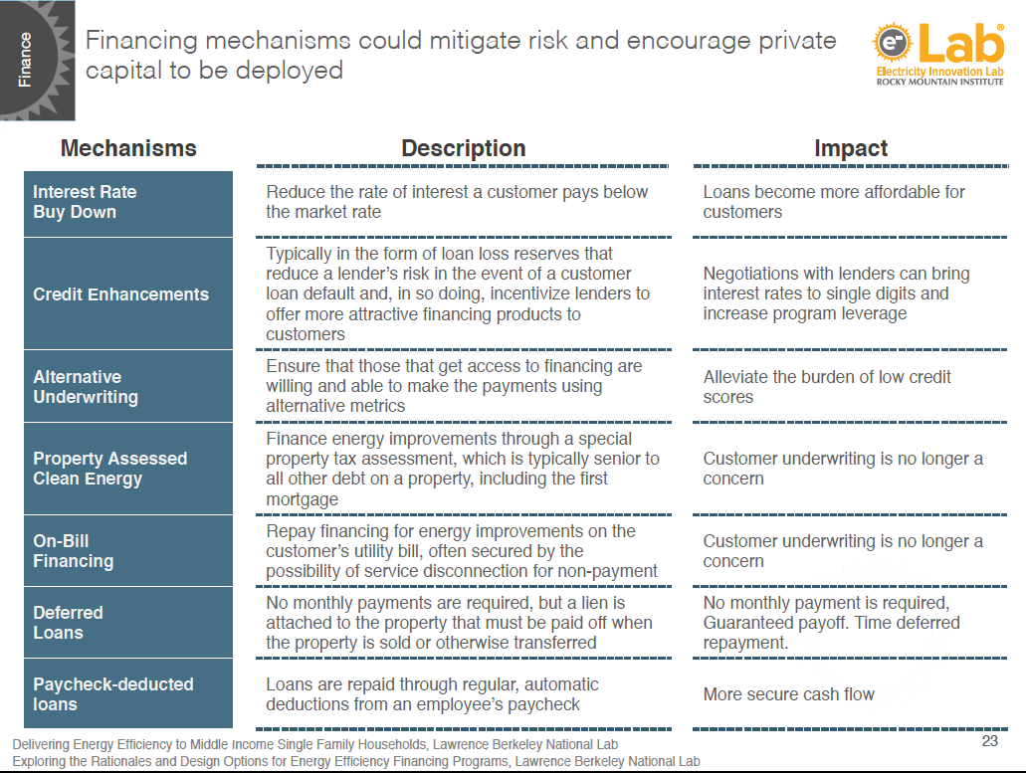
Source: eLab LEAP Pre-Read

Slide 24
Additional resources

Slide 25
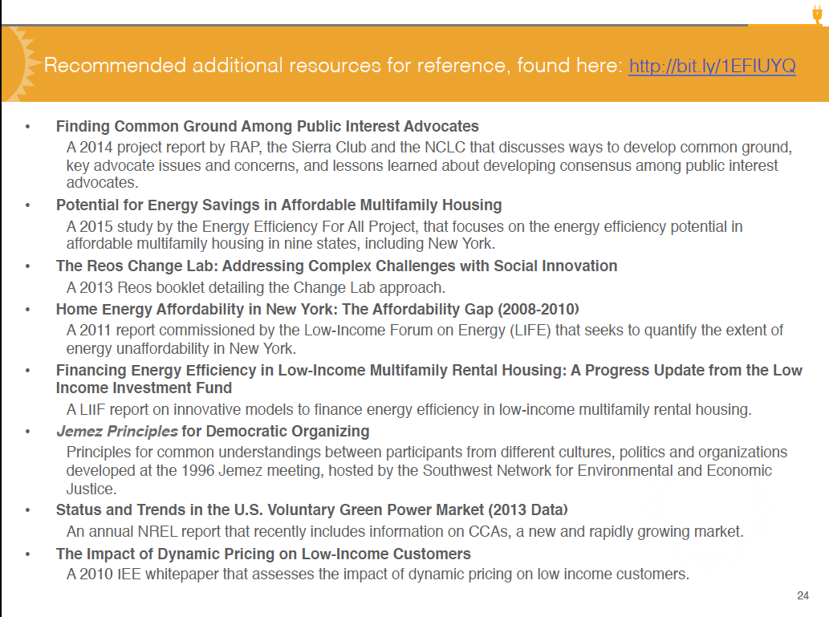
Source: eLab LEAP Pre-Read

Slide 26
Karl R. Rábago
Executive Director
krabago@law.pace.edu
914.422.4082
c/SMS: 512.968.7543

Slide 27
Let’s MAKE Something!
Out of nothing, nature makes something.
First there is hard rock planet; then there is life, lots of it. First barren hills; then brooks with fish and cattails and red-winged blackbirds. First an acorn; then an oak tree forest.
Distribute being
Control from the bottom up
Cultivate increasing returns
Grow by chunking
Maximize the fringes
Honor your errors
Pursue no optima; have multiple goals
Seek persistent disequilibrium
Change changes itself.
Kevin Kelly, “Out of Control”
http://kk.org/mt-files/outofcontrol/ch24-a.html

