Slide 1

Batten Down the Hatches:
Examining the Role of Critical
Infrastructure/Cybersecurity in Electric Regulation
National Conference of Regulatory Attorneys
Mary Beth O’Hara Osborne
Director of Regulatory Affairs
Pennsylvania Public Utility Commission

Slide 2

Why Is Cybersecurity Important?
Cybersecurity affects all of us – every industry, every company, every agency and every consumer
More than 500 million devices are connected to the Internet, and cyber-attacks occur every day – they are occurring as we speak

Slide 3
Why Is Cybersecurity Important?
According to the U.S. Director of National Intelligence:
No. 1 security threat worldwide, ranking higher than terrorism, espionage and weapons of mass destruction

Slide 4
Current Threat Environment
More than 100,000 U.S. incidents in 2015
  3,141 confirmed data breaches
  Affecting organizations in 82 countries across many industries
  Breaches with financial motive are dominant
  Phishing, point-of-sale, ransomware
  63% of confirmed breaches involved weak, default or stolen passwords
Incident: A security event that compromises the integrity, confidentiality or availability of an information asset
Breach: An incident that results in the confirmed disclosure (not just potential exposure) of data to an unauthorized party
(Verizon 2016 Data Breach Investigations Report)

Slide 5
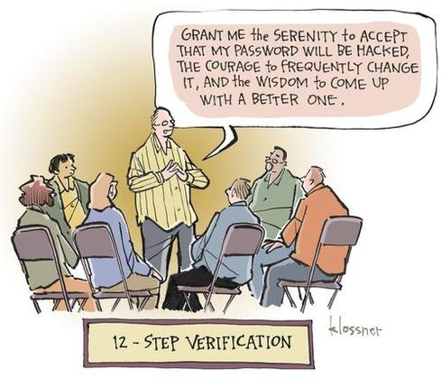
Notes:
Headed to Conclusion Section
When we deal with cyber………
We must be……

Slide 6
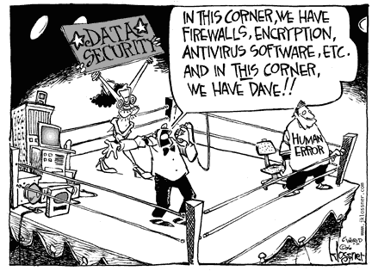
Notes:
Recommendation #4 Leadin:
Cybersecurity education and awareness of PUC staff.
We have had a Christmas tree phone home
We have had staff click phishing links that phoned home and connections were cut
Statistics on Training Effectiveness
Cybersecurity education and awareness of PUC staff. Industry experts continue to state that one of the best defenses against an attack after your environment has been hardened is the education of your staff. Education works to eliminate the possibility of a user falling for a phishing attack or inadvertently sending out improper or unprotected documentation. For example, many users are unaware of their ability to encrypt priority email in Microsoft Outlook. There are a number of governmental organizations that offer free online cybersecurity training, and there are a host of vendors who offer training, as well. Implementation of this recommendation will not involve significant cost.

Slide 7
Current Threat Environment
Armerding, T. (2014). Energy sector a prime target for cyber-attacks.
http://www.csoonline.com/article/2134407/fraud-prevention/energy-sector-a-prime-target-for-cyber-attacks.html

Slide 8
Current Threat Environment
Physical infrastructure is a growing target
  Utility and power companies’ industrial control systems (ICS) and supervisory control and data acquisition (SCADA) systems under increasing attack
An ICS or SCADA attack could lead to extended and large-scale service outages
A cyber-attack could cripple a utility and have a dangerous domino effect for consumers
  Fortunately, in the utility industry, these breaches have not resulted in any significant repercussions in the U.S. – yet

Slide 9
Current Threat Environment
In 2014, utilities and energy sector suffered monetary damage from cybercrimes and cyber-attacks
Each compromised utility lost an average of $13.2 million
  More than the average in the financial sector, $12.97 million
Power and utility companies had 500% more incidents in 2014 than 2013
Average cost for each lost or stolen record was $145, up 15% from 2013
- The Ponemon Institute’s “Global Report on the Cost of Cyber Crime”
- 2015 “Global State of Information Security Survey by PwC, CIO and CSOs Report”

Slide 10
Cyber Events:
State Government
August 2014 – “Hacktivism” group Anonymous, following fatal police shooting in Ferguson, Mo., released St. Louis County Police Chief Jon Belmar’s home address, phone number and a photo of his house – in addition to other attacks and phishing campaigns launched against Missouri state government, law enforcement and regional government
October 2012 – South Carolina Department of Revenue was hacked, exposing 3.6 million Social Security numbers and 387,000 credit and debit card numbers
March 2012 – Utah Department of Health experienced a data breach on a Medicaid server exposing the personal information of 780,000 residents

Slide 11
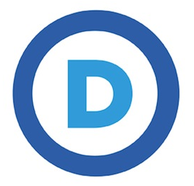
Recent Cyber Events: 2016
June – Confirmed that two Russian espionage groups hacked into computer system of the Democratic National Committee (DNC) and accessed information about Democratic candidates, Trump
  Hackers had access for one year
  Fortunately, no personal, financial or donor information was accessed or taken

Slide 12
Recent Cyber Events: 2015
December – Ukraine experiences a power loss of 80,000 customers for several hours – attributed to a cyber-attack utilizing malicious code
October – Cyber-attack on Experion, compromising personal data of up to 15 million T-Mobile customers
July – Ashley Madison was the victim of a high-profile compromise that exposed 100 GB of stolen (very personal) data

Slide 13
Recent Cyber Events: 2015
June – U.S. Office of Personnel Management (OPM) experiences a compromise of more than 21 million personnel records, including detailed information of intelligence personnel
March – Cyber-attack on Premera (Blue Cross health insurance member company), compromising data of 11 million people
February – Anthem (another Blue Cross company) victim of data breach impacting 80 million people

Slide 14
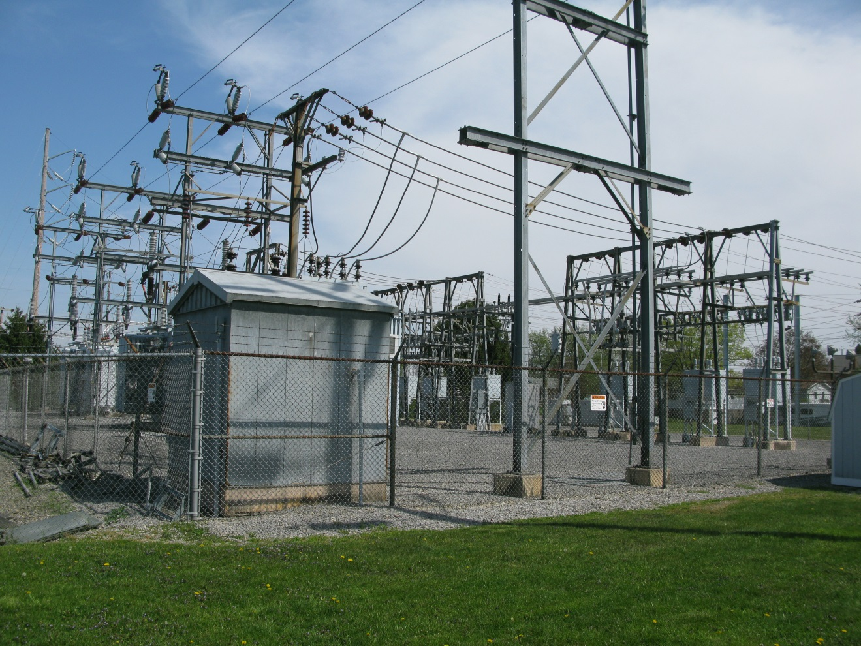
Regulatory Responsibilities:
Why do Public Utility Commissioners have a role?

Slide 15
Regulatory Responsibilities
Mission statement:
The Pennsylvania Public Utility Commission balances the needs of consumers and utilities; ensures safe and reliable utility service at reasonable rates; protects the public interest; educates consumers to make independent and informed utility choices; furthers economic development; and fosters new technologies and competitive markets in an environmentally sound manner.
State regulatory, statutory and interagency obligations

Slide 16
Regulatory Responsibilities: General
66 Pa. C.S. §§ 501, 504-506 & 1501
“Every public utility shall furnish and maintain adequate, efficient, safe, and reasonable service and facilities, and shall make all such repairs, changes, alterations, substitutions, extensions, and improvements in or to such service and facilities as shall be necessary or proper for the accommodation, convenience, and safety of its patrons, employees, and the public. Such service also shall be reasonably continuous and without unreasonable interruptions or delay.

Slide 17
Regulatory Responsibilities: Preparedness
52 Pa. Code §§101.1-101.7
  Addresses public utility preparedness through self-certification
  Established in 2005 covering cyber and physical security, emergency response and business continuity plans
  At minimum, all jurisdictional utilities must have a documented, updated and annually tested cybersecurity plan

Slide 18
Regulatory Responsibilities:
After an Event
52 Pa. Code §§ 57.11(d), 59.11(d) and 65.2(d)
  A telephone report must be made immediately by the utility once it becomes aware of an occurrence
    Involving monetary damages of $50,000 or more or any service outage
    Telephone utilities are exempt
52 Pa. Code §§ 57.11(e), 59.11(e) and 65.2(e)
  A written report of the occurrence must also be made on Form UCTA-8 within thirty (30) days; however, utilities may redact from Form UCTA-8 information that would compromise the security of the utility or hinder an active criminal investigation

Slide 19
Regulatory Functions
Compliance / oversight
Cyber event response
Investigation of a cyber event
Cyber cost-recovery review
  Prudency and reasonableness

Slide 20
Public Utility Preparedness
Self-Certification Regulations
Bureau of Technical Utility Services (TUS) – ensures minimum compliance of fixed utilities through self-certification
  52 Pa. Code §§ 101.1-101.7
  Actual plans are not reviewed
  Reviews information on self-certification forms – if a utility fails to indicate that it has a particular plan in place or if there is a discrepancy, reviewer will send form to appropriate TUS section for further review and action as necessary

Slide 21
Regulatory Function –
Compliance/Oversight
Bureau of Audits – reviews utility plans through Management Audits and Management Efficiency Investigations
  66 Pa. C.S. § 516 companies (utilities with $10 million or more in plant and excluding municipal utilities)
  Reliance on utility expertise; review is not in-depth; many utilities are exempt from Management Audits
    Telecommunications
    Small utilities (< $10 million in utility plant)
    Wastewater
    Transportation (non-fixed utilities)

Slide 22
Regulatory Function –
Cyber Event Response
Responsibilities under the State Emergency Operations Plan to provide support to PEMA during an event
  TUS – Lead Emergency Preparedness Liaison Officer (EPLO) communicates with utility and state/federal partners (Pennsylvania Criminal Intelligence Center – PaCIC, Pennsylvania Emergency Management Agency – PEMA, Homeland Security, etc.)
  Reliance on utility and state/federal partners for cyber expertise

Slide 23
Regulatory Function –
Cyber Investigation
Standard procedure for incident reviews/investigations
  TUS (or possibly Bureau of Consumer Services – BCS) initiates a review
  Review involves data requests, facility site visits, interviews of utility and response staff
  Possible violations are referred to Bureau of Investigation and Enforcement (I&E), or I&E initiates an investigation
  No internal cyber expertise – limited review
  Reliant on information provided by utilities

Slide 24
Regulatory Function –
Cyber Cost-Recovery Review
Cyber expenditures reviewed as any other expenditure
  Rate case process
  Possible Distribution System Improvement Charge (DSIC) and Long Term Infrastructure Improvement Plan (LTIIP) tie-in
  Smart Meter plans
  Emergency rate relief
No expertise on cybersecurity expenditures
Limited ability to effectively review costs

Slide 25
Cybersecurity Challenges
Faced by Utilities
Cyber threats to utility systems
  Data breaches of customer information
  Data breaches of operational information
  Loss of control of Industrial Control Systems (ICS) and/or Supervisory Control and Data Acquisition (SCADA) systems
Interconnectedness of utility systems
  Reliance on power and communications systems

Slide 26
Cybersecurity Challenges
Faced by Utilities
Legal costs
  Legal guidance during crisis management/forensics investigations is where most cash goes (followed by breach notification and credit monitoring)
  Many cyber insurance policies do not cover remediation costs or judgments to pay punitive damages
  Attorneys and investigators don’t charge by record breached – but typically hourly basis, on demand or by pre-existing retainer

Slide 27
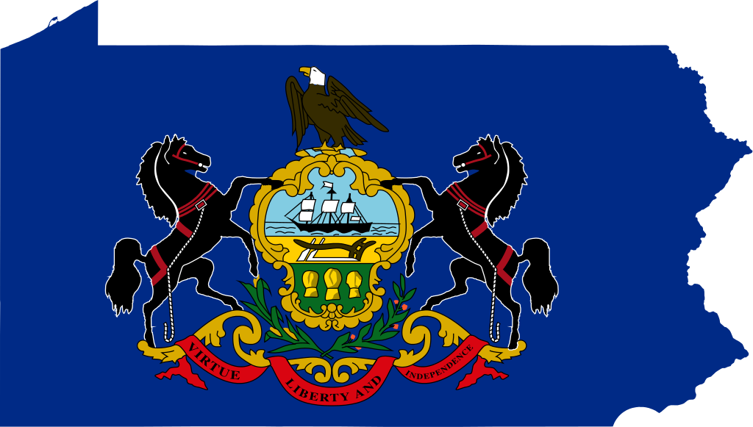
PA PUC Efforts:
What Has Pennsylvania Done to Address
These Challenges?

Slide 28
PA PUC Efforts
Work with utilities on all-hazards approach to security – physical and cyber
Since 2013, PUC has worked with federal agencies including U.S. Department of Homeland Security and the Federal Energy Regulatory Commission (FERC) on education, training and exercises with the private sector

Slide 29
PA PUC Efforts
Finalized a policy statement in March 2014 regarding Utility Service Outage Response, Recovery and Public Notification Guidelines and established the Critical Infrastructure Interdependency Working Group (CIIWG) to further develop best practices to address the needs of all customers during major outages
Mid-Atlantic collaborative with other state commissions to share information and best practices

Slide 30
PA PUC Efforts
In September 2015, the Commission finalized a Memorandum of Understanding with the State Police Fusion Center which will further enhance the security awareness of each organization
Worked with delegation from Federal Energy Regulatory Commission (FERC)’s Office of Energy Infrastructure Security (OEIS) to train in-house staff and assess capabilities in 2015
Contributing to a statewide response plan being developed by the PA Office of Homeland Security in 2015-2016
Currently creating Cyber Event Communications Plan
Ongoing meetings with stakeholders, utility CEOs and CIOs
Security clearances for certain staff
List of critical infrastructure

Slide 31
PA PUC Efforts
Hosted Electric Infrastructure Security (EIS) Council “Black Sky” exercise with Office of the Governor on June 3, 2016
  More than 135 participants representing key leaders in local and state government; law enforcement; utility companies; and other key organizations
  Highlighted preparedness and potential for cascading effects across utility sectors, including long-term electric grid outages
  Need to identify and develop a prioritized list of critical infrastructure

Slide 32
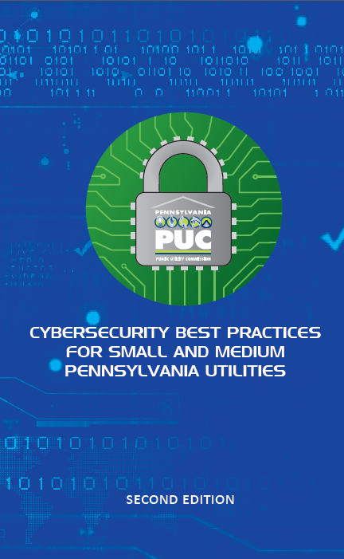
PA PUC Efforts
Published document in October 2015, Cybersecurity Best Practices for Small and Medium Pennsylvania Utilities (second edition – Link)
Urge utility leaders to read guide and recommend conducting company workshops to review with employees
Also encourage utilities to use tools that have been developed by the National Institute of Standards and Technology (NIST), U.S. Department of Homeland Security, etc.

Slide 33
PA PUC Staff Review
PUC multi-bureau Cyber Team undertook a comprehensive review and developed recommendations in January 2016
  Regulatory functions
    Compliance/oversight
    Cyber event response
    Investigations of a cyber event
    Cost recovery/utility expenditures on cyber-related activities and investments
  Internal (MIS) functions
    Assessed capabilities
    Identified cybersecurity vulnerabilities
    Provided options to address vulnerabilities

Slide 34
Ongoing PA PUC Efforts
Internal PUC training
  Annual online training
  Phishing exercises
  Cybersecurity tips of the day
  Presentations
  Creating desktop reference

Slide 35
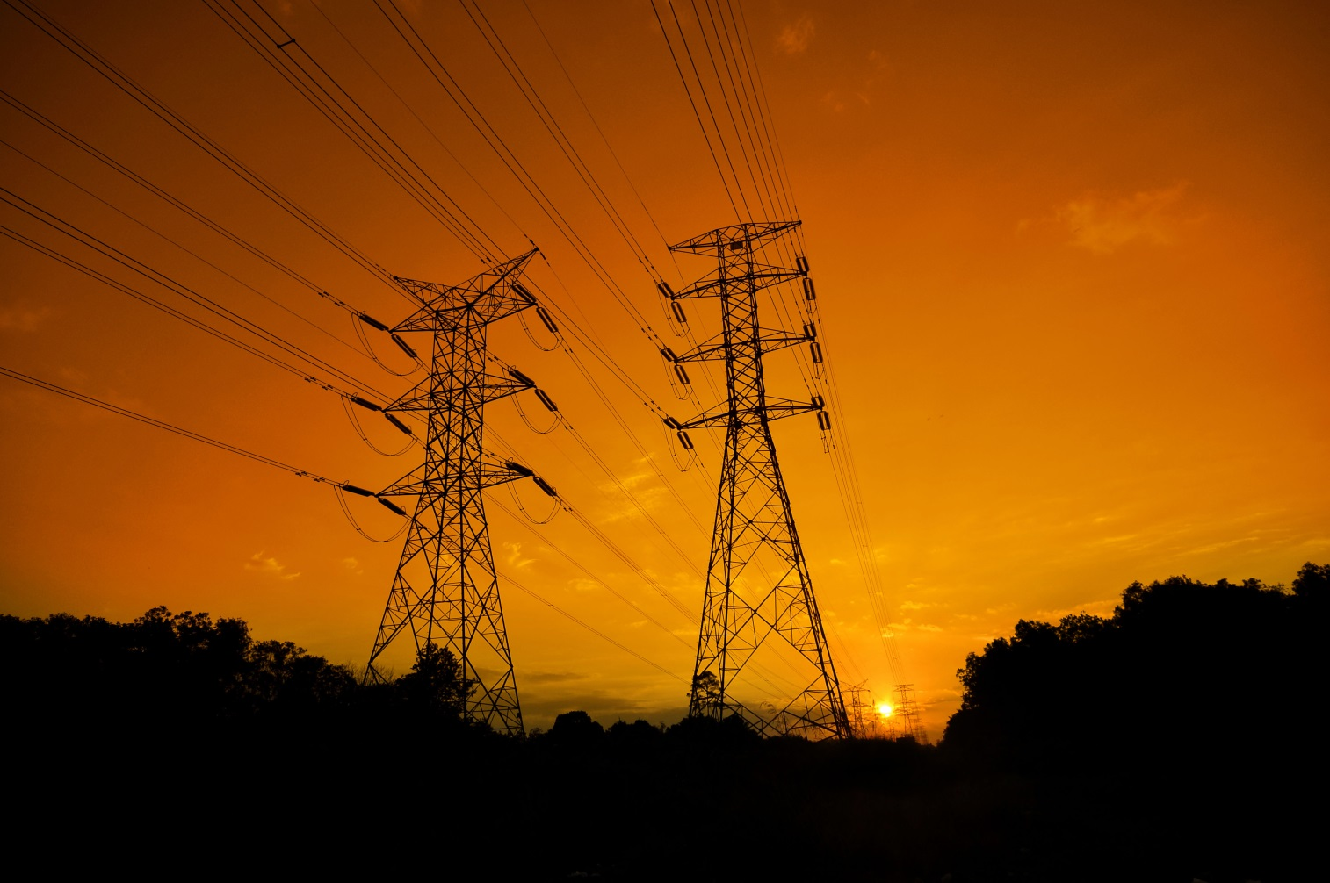
State and Federal Efforts:
What is Being Done?

Slide 36
State Confidential Security Legislation
Public Utility Confidential Security Information Disclosure Act (CSI Act)
  Requires a public utility to notify a Commonwealth agency when it submits a record to the agency that contains confidential security information and prohibits the agency from releasing that information
  (35 P.S. §§ 2141.2-2141.5)

Slide 37
Federal Legislation and Efforts
2013 White House Executive Order – Improving Critical Infrastructure Cybersecurity
  Objective is to create a partnership between the federal government and owners and operators of critical infrastructure to improve cybersecurity information and develop risk-based standards

Slide 38
Federal Legislation and Efforts
Cybersecurity Information Sharing Act of 2015 (CISA)
  Purpose is to protect against cyber attacks by creating reciprocal information sharing process between private sector and federal government – 6 U.S.C. §§1501-1510
  A private entity, including a “State, tribunal or local government performing utility services,” that shares cybersecurity information in accordance with the CISA is granted liability protection in a cause of auction for monitoring information systems or for the sharing or receipt of cybersecurity information – 6 U.S.C. §1501 (15)(B), § 1505(a)-(b)
  Consistent with Commission regulations and CSI Act

Slide 39
Federal Legislation
Securing Energy Infrastructure Act of 2016
(S 3018) – new legislation to protect U.S. electric grid
  “would examine solutions to defend the U.S. energy grid by replacing key devices like computer-connected operating systems that are vulnerable to cyber-attacks with analog and human-operated systems – a ‘retro’ approach that has shown promise as a safeguard against cyber attacks”

Slide 40
Key Resources
Executive Order 13636 – Issued in February 2013, permits the development of voluntary standards for improving critical infrastructure cybersecurity, policy coordination, information sharing, private and civil liberty protections, etc.
NIST Standards – Issued in February 2014, National Institute of Standards and Technology (NIST) issued the Cybersecurity Framework, a voluntary set of industry standards and best practices to help organizations manage cybersecurity risks (NIST Framework for Improving Critical Infrastructure Cybersecurity)
Verizon’s 2016 Data Breach Investigation Report – Issued every year and provides information on cyber breaches (Report)
NRRI 2015 Report on States, issued in February 2015 at the request of the Mid-Atlantic Collaborative. Provides information on states’ cybersecurity efforts
CSRIC IV Report – Issued in March 2015 (Report)

Slide 41
Other States’ Cyber Actions
Connecticut
  Public Utilities Regulatory Authority (PURA) recently published compliance standards and oversight procedures – April 2016
New Jersey
  Desktop flip chart with cybersecurity tips and resource information
New York
  New York Electric and Gas Corporation/
  Rochester Gas and Electric Corporation Security Breach (2012)
  NY Public Service Commission investigation and order directing a report on implementation of best practices recommendations

Slide 42

Current Threat Environment:
Black Sky Event
Notes:
Black Sky video

Slide 43
Questions?
Notes:
Conclusion

