Slide 1
Raise the Sails!
Taxi & Uber Transportation Issues
A case study in Bureau of Investigation and Enforcement v. Uber Technologies, Inc., et al. Docket No. C-2014-2422723
Michael L. Swindler
Deputy Chief Prosecutor
Pennsylvania PUC
Bureau of Investigation and Enforcement

Slide 2
Pa. Code Title 66
"Common carrier." Any and all persons or corporations holding out, offering, or undertaking, directly or indirectly, service for compensation to the public for the transportation of passengers or property, or both, or any class of passengers or property, between points within this Commonwealth by, through, over, above, or under land, water, or air, and shall include forwarders, but shall not include contract carriers by motor vehicles, or brokers, or any bona fide cooperative association transporting property exclusively for the members of such association on a nonprofit basis.
"Common carrier by motor vehicle." Any common carrier who or which holds out or undertakes the transportation of passengers or property, or both, or any class of passengers or property, between points within this Commonwealth by motor vehicle for compensation, whether or not the owner or operator of such motor vehicle, or who or which provides or furnishes any motor vehicle, with or without driver, for transportation or for use in transportation of persons or property as aforesaid, and shall include common carriers by rail, water, or air, and express or forwarding public utilities insofar as such common carriers or such public utilities are engaged in such motor vehicle operations, but does not include:
(1) A lessor under a lease given on a bona fide sale of a motor vehicle where the lessor retains or assumes no responsibility for maintenance, supervision, or control of the motor vehicles so sold.
(2) Transportation of school children for school purposes or to and from school-related activities whether as participants or spectators, with their chaperones, or between their homes and Sunday school in any motor vehicle owned by the school district, private school or parochial school, or transportation of school children between their homes and school or to and from school-related activities whether as participants or spectators, with their chaperones, if the person performing the school-related transportation has a contract for the transportation of school children between their homes and school, with the private or parochial school, with the school district or jointure in which the school is located, or with a school district that is a member of a jointure in which the school is located if the jointure has no contracts with other persons for the transportation of students between their homes and school, and if the person maintains a copy of all contracts in the vehicle at all times, or children between their homes and Sunday school in any motor vehicle operated under contract with the school district, private school or parochial school. Each school district shall adopt regulations regarding the number of chaperones to accompany students in connection with school-related activities.
(3) Any owner or operator of a farm transporting agricultural products from, or farm supplies to, such farm, or any independent contractor or cooperative agricultural association hauling agricultural products or farm supplies exclusively for one or more owners or operators of farms.
(4) Any person or corporation who or which uses, or furnishes for use, dump trucks for the transportation of ashes, rubbish, excavated and road construction materials. This paragraph does not include the use or furnishing of five-axle tractor trailers.
(5) Transportation of property by the owner to himself, or to purchasers directly from him, in vehicles owned and operated by the owner of such property and not otherwise used in transportation of property for compensation for others.
(6) Transportation of voting machines to and from polling places by any person or corporation for or on behalf of any political subdivision of this Commonwealth for use in any primary, general, municipal or special election.
(7) Transportation of pulpwood, chemical wood, saw logs or veneer logs from woodlots.
(8) Transportation by towing of wrecked or disabled motor vehicles.
(9) Any person or corporation who or which furnishes transportation for any injured, ill or dead person.
"Motor carrier." A common carrier by motor vehicle, and a contract carrier by motor vehicle.
"Motor vehicle." Any vehicle which is self-propelled, excepting power shovels, tractors other than truck tractors, road rollers, agricultural machinery, and vehicles which solely move upon or are guided by a track, or travel through the air.

Slide 3
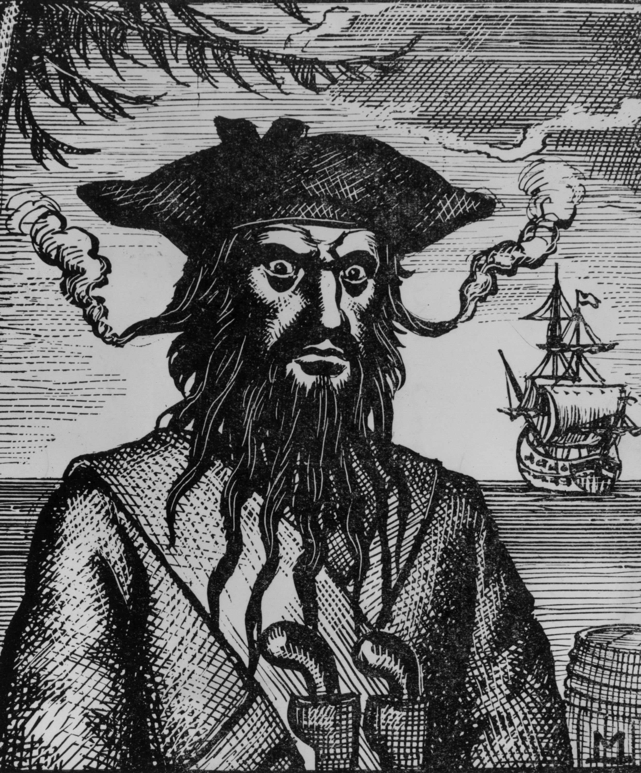

Slide 4
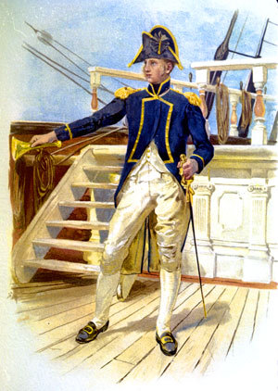

Slide 5
Pennsylvania Public Utility Commission
The PA PUC regulates 5 basic utility types: (1)Electricity, (2)Natural Gas, (3)Water, (4)Telecommunications and (5)Transportation.
The PUC’s mission is to balance the needs of consumers and utilities, ensure safe and reliable utility service at reasonable rates, protect the public interest, educate consumers, further economic development & foster new technologies and competitive markets in an environmentally sound manner.

Slide 6
I&E is Prosecutory
The Bureau of Investigation and Enforcement is a separate and independent prosecutory bureau of the PA PUC.

Slide 7
I&E is Prosecutory
I&E litigates matters before the Commission’s Office of Administrative Law Judge and the Judges’ decisions are then reviewed by the Commission which they can approve, modify or reject and/or remand.
Since I&E is a prosecutory bureau, our functions are bifurcated from any advisory function that the Commission and other bureaus within the Commission perform.

Slide 8
2014 Proceedings before the PA PUC
In 2014, there were several proceedings initiated at the Commission regarding Transportation Network Companies.
Among the criteria that the Commission uses to decide in granting or denying motor carrier applications is whether the service will serve a useful public purpose and be responsive to a public demand or need.

Slide 9
2014 Proceedings before the PA PUC
I&E has never once disputed, that the public could benefit from services like Uber and Lyft.
Instead, the focus for I&E was whether any transportation network company violated the Public Utility Code by operating without authority.

Slide 10
2014 Proceedings before the PA PUC
I&E instituted formal proceedings before the Commission against both Uber and Lyft.
I&E was able to settle the Lyft proceeding.
The Uber proceeding was fully litigated.

Slide 11


Slide 12
Procedural History
The proceeding began with I&E motor carrier enforcement officers conducting an investigation in downtown Pittsburgh where ride sharing service had been launched.

Slide 13
Procedural History
Beginning on March 31, 2014 through April 21, 2014, I&E motor carrier enforcement officers in Pittsburgh, obtained transportation for compensation using the Uber app on 11 occasions.
At this time, Uber did NOT have PUC authority to operate, which formed the basis of I&E’s Formal Complaint filed on June 5, 2014 against Uber Technologies Inc.

Slide 14
Procedural History
I&E alleged that Uber violated one of two provisions of the public utility code, by acting as either an uncertificated motor carrier or an unlicensed broker of transportation.

Slide 15
Procedural History
Motor Carrier v. Broker
Motor carriers are public utilities. The Public Utility Code defines common carrier by motor vehicle, in pertinent part, as one “who or which holds out or undertakes the transportation of passengers or property, or both, . . . between points within this Commonwealth by motor vehicle for compensation.”
A motor carrier is required to obtain a Certificate of Public Convenience prior to offering transportation services.

Slide 16
Procedural History
Brokers
The Public Utility Code defines broker, in pertinent part, as “[a]ny person or corporation not included in the term ‘motor common carrier’ . . . who or which, as principal or agent, sells or offers for sale any transportation by a motor carrier, . . . or holds out by solicitation advertisement, or otherwise, as one who sells, provides, furnishes, contracts, or arranges for such transportation.”

Slide 17
Procedural History
Brokers
The key is that brokers must arrange transportation with already certificated motor carriers.

Slide 18
Procedural History
Initial Complaint
I&E sought a civil penalty of $1,000 for each of the 11 trips taken by the motor carrier enforcement officers and $1,000 per day for each day since March 13, 2014 – which was the date that I&E alleged Uber launched its service in Pittsburgh.
As such, this initial complaint sought a total civil penalty of $95,000.

Slide 19
Procedural History
Cease and Desist Petition
I&E’s Formal Complaint seemingly had no effect on Uber’s operations.
On June 16, 2014, I&E filed a Petition for Interim Emergency Relief seeking an order directing Uber to immediately cease and desist from operating its passenger transportation service.

Slide 20
Procedural History
Public Safety Concerns
Why cease and desist?
Commission was not inspecting the vehicles of Uber drivers.
Commission was not reviewing the records pertaining to the driving history or criminal background of Uber drivers.
The Commission could not verify that adequate insurance coverage existed.

Slide 21
Procedural History
Emergency Hearing
An emergency hearing was held and on July 1, 2014, the presiding ALJs entered an Order determining that I&E met the standard for granting emergency relief and ordered that Uber immediately cease and desist from using its digital platform to facilitate transportation to passengers using non-certificated drivers until it secured appropriate authority from the Commission.

Slide 22
Procedural History
ALJs’ Order
This Order was immediately effective.
Thus, as of July 1, 2014, Uber was directed to stop using its transportation service in the Commonwealth of Pennsylvania until the Commission granted it operating authority.

Slide 23
Procedural History
Commission Order
On July 24, 2014, the Commission upheld the ALJs’ Order and also directed Uber to cease and desist.

Slide 24
Procedural History
Secretarial Letter
By Secretarial Letter, dated July 28, 2014, the parties were directed to address specific questions regarding the number of trips provided.

Slide 25
Procedural History
First Set of Interrogatories
In accordance with the Secretarial Letter, I&E propounded a first set of interrogatories to Uber intending to elicit information regarding, among other things, Uber’s trip data.

Slide 26
Procedural History
Uber’s Refusal to Provide Data
Uber objected to I&E’s request for data and I&E filed a Motion to Compel.
ALJs granted I&E’s Motion to Compel.
Uber took the issue up to the Commissioners.
Commission denied Uber’s Petition, but Uber still refused to provide data, thus resulting in I&E filing a Motion for Sanctions.
ALJs granted I&E’s Motion for Sanctions.

Slide 27
Procedural History
Uber’s Continued Refusal to Provide Data
Uber ignored the Motion for Sanctions and still refused to provide data.
I&E propounded a second set of interrogatories in which Uber objected; which resulted in I&E filing a Motion to Compel.
ALJs granted I&E’s Motion to Compel.
Uber’s Petition for interlocutory review was denied.
No trip data had been provided thus far.

Slide 28
Procedural History
Amended Complaint
On January 9, 2015, I&E filed an Amended Complaint that named all known affiliates of Uber and sought a civil penalty based on each trip alleged to have been taken while Uber or a subsidiary lacked authority to operate.

Slide 29
Procedural History
Amended Complaint
I&E made an educated guess of the number of trips that occurred from February 11, 2014 (the exact date that Uber launched) up to August 20, 2014 (the date that an Uber subsidiary first obtained authority).
The updated civil penalty requested in I&E’s Amended Complaint was $19 million.

Slide 30
Procedural History
Production of Partial Discovery & Evidentiary Hearing
Uber finally provided partial responses to I&E’s discovery on March 6, 2015 - but which still did not include the trip data.
Evidentiary Hearing held on May 6, 2015.
Uber finally provided trip data for the first time at the hearing as part of the proprietary record.

Slide 31
Procedural History
ALJs’ Initial Decision
The ALJs issued an Initial Decision in November 2015.
The ALJs agreed with I&E that Uber violated the Public Utility Code. They also agreed with I&E that a civil penalty may be imposed for each unauthorized trip.

Slide 32
Procedural History
ALJs’ Initial Decision
The ALJs’ Initial Decision separated the unauthorized trips into two sets of violations:
Trips from launch to July 1; and
Trips after July 1 (when the Cease & Desist Order was entered) until authority granted.

Slide 33
Procedural History
ALJs’ Initial Decision
The ALJs reasoned that Uber’s conduct was deliberate and calculated, but especially egregious with regard to operating in defiance of their and the Commission’s Cease and Desist Orders.
The egregious nature of this 2nd set of violations warranted a higher civil penalty per trip and resulted in the ALJs recommending a cumulative civil penalty of nearly $50 million from the $19 million sought by I&E.

Slide 34
Commission Order
At its April 21, 2016 Public Meeting, the Commission voted 3-2 to adopt the ALJs’ Initial Decision, as modified, and directed Respondents to pay the following civil penalty:
$11,292,236
+ 72,500 discovery sanction
$11,364,736

