Slide 1


Pipeline Safety Updates
National Conference of Regulatory Attorneys
Don’t Walk the Plank – PHMSA & Safety Panel
June 22, 2016
Arthur O. Buff, P.E.
CATS Program Manager
PHMSA, Southern Region
- 1 -

Slide 2
Presentation Overview
PHMSA/OPS - Pipelines Regulated
NPRMs
Excavation Damage Prevention Rules

Slide 3
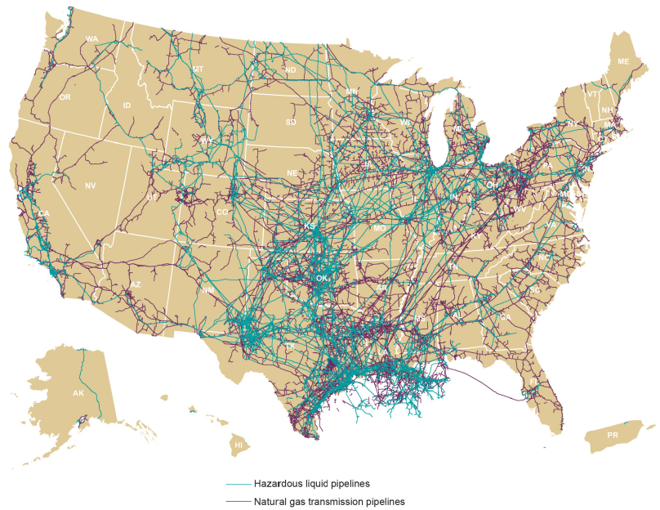
PHMSA Office of Pipeline Safety
Transmission Pipelines, Sept. 2012
To protect people and the environment
by advancing the safe transportation of energy and
other hazardous materials that are essential to our daily lives

Slide 4
Notice of Proposed Rulemaking (NPRM)
May 21, 2015 - Plastic Pipe
July 10, 2015 - OQ, cost recovery, notification
July 15, 2015 - Gas distribution EFV
October 13, 2015 - Safety of HL pipelines
April 8, 2016 - Gas transmission and gathering Lines
http://www.phmsa.dot.gov/pipeline/regs

Slide 5

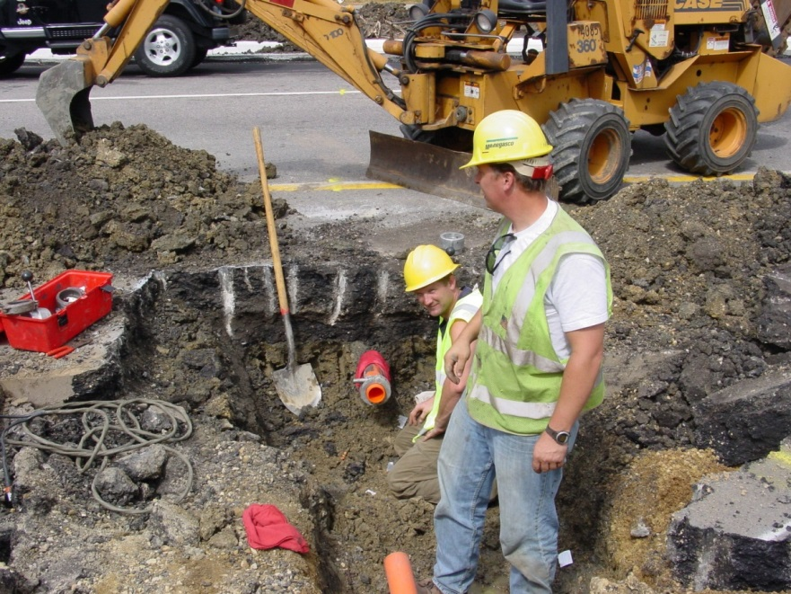
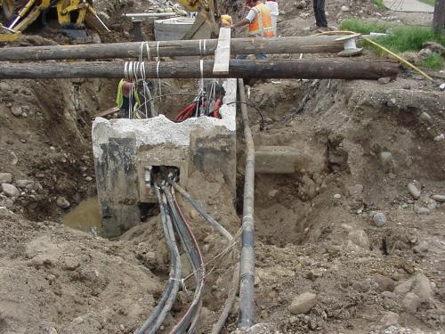
Excavation Damage

Slide 6

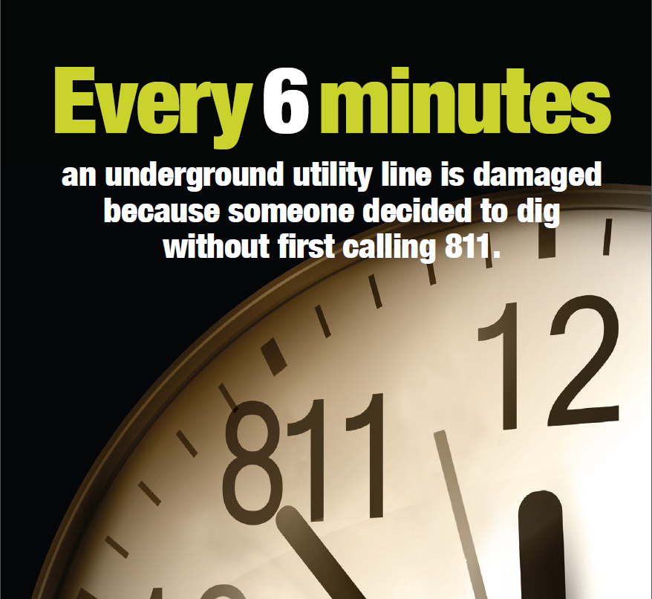
Excavation Damage to Pipelines
                32.3% injuries
1995-2015: 16.8% incidents
37.7% fatalities
S. Res. 151 – A resolution supporting the goals and ideals of National Safe Digging Month (4/23/2015)

Slide 7
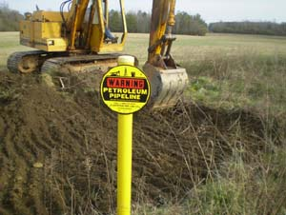

What is an Excavation Activity?
Excavation
Blasting
Boring
Backfilling
Tunneling
Removal of aboveground structures
by explosive or mechanical means
Other earthmoving operations
Excavation: “covers all excavation activity involving both mechanized and non-mechanized equipment, including hand tools”
Excavator: “any person or legal entity, public or private, proposing to or engaging in excavation”

Slide 8
Damage Prevention Rules
Part 192.614 and 195.442
damage prevention program for operators
written DP program
participate in qualified one-call
PIPES Act 2006
excavators must: 1) use one-call; 2) pay attention to marks; 3)report damage
operators must: 1) respond to locate request; 2) accurately mark
damage prevention grants to states
enforcement by PHMSA
ANPRM - October 29, 2009
NPRM - April 2, 2012
Final Rule
Published FR: July 23, 2015
Effective date: January 1, 2016
need rules published in FR

Slide 9
Cost Benefit Analysis
“if this regulatory action prevents just one average reportable incident per year, this final rule would be cost beneficial”
“over the past 24 years, the average reportable incident caused $282,930 in property damage alone”

Slide 10
The New Rule
New Part 196
  Standards for excavators digging near pipelines
Part 198, added Subpart D
  Seven criteria for assessing the adequacy of State DP enforcement programs; assessment process
  Administrative procedures for States to contest a notice of inadequacy

Slide 11
Does Part 196 Apply to Homeowners?
YES!
“PHMSA has eliminated the homeowner exemption originally proposed ….….. because homeowners excavating on their own property without first calling 811 poses a significant risk of excavation damage to pipelines”.

Slide 12


Part 196, Subpart C – Enforcement
PHMSA can assess civil and criminal penalties for violations of Part 196, but only in States that have an inadequate enforcement program.
$
  Adjudication process for excavators cited by PHMSA – Same as for operators cited by PHMSA for violations of pipeline safety regulations
$200,000 per day
up to $2,000,000
Note: PHMSA collected fines go to U.S. Treasury

Slide 13

Arthur O. Buff, P.E.
CATS Program Manager
PHMSA – Office of Pipeline Safety
Southern Region
arthur.buff@dot.gov
404-832-1155

