Slide 1

Effective Damage Prevention Programs
Craig Hoeferlin
June 22, 2016

Slide 2
Agenda
Spire at a glance
Effective damage prevention program in Missouri
Efforts in Alabama
Questions

Slide 3
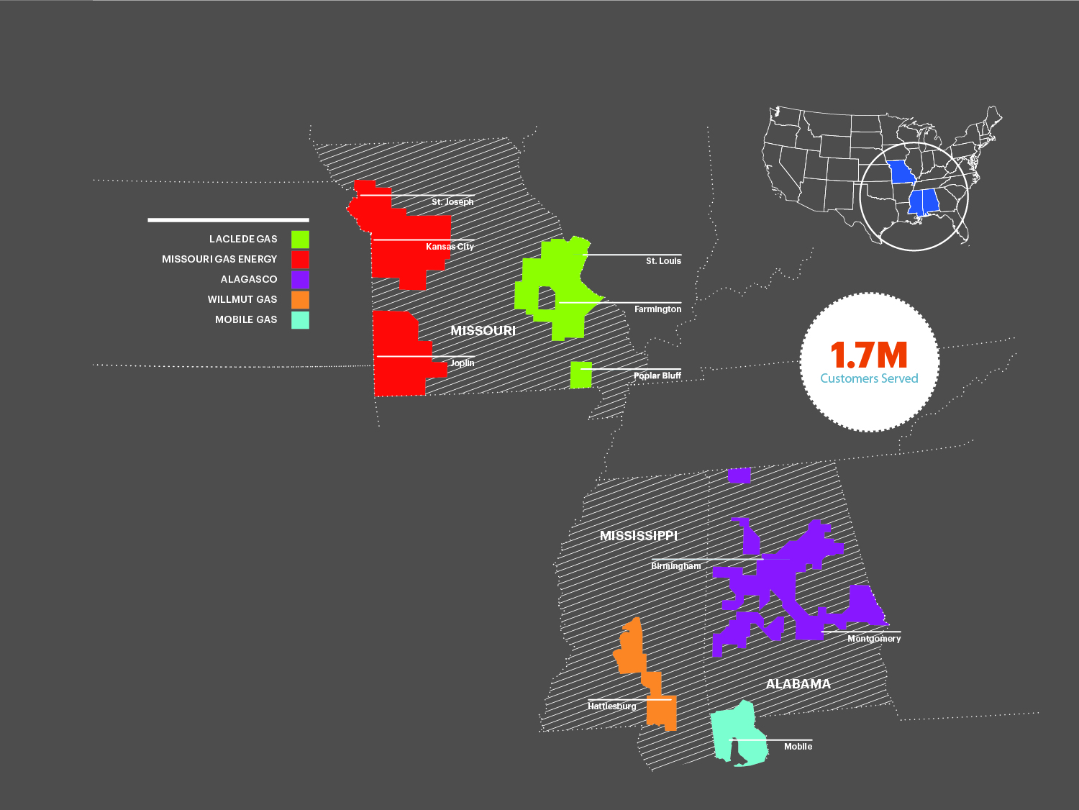
We are a gas company at our core
¹
  Five gas utilities¹ across three states
  Largest gas company in Missouri
  and Alabama
  Focus on safe and reliable service, community development and growth
¹Gives effect to the pending acquisition.

Slide 4
Our utility portfolio
 | Alagasco | Laclede Gas | MGE | Mobile Gas | Willmut Gas
Founded | 1852 | 1857 | 1867 | 1836 | 1933
Primary Office | Birmingham, AL | St. Louis, MO | Kansas City, MO | Mobile, AL | Hattiesburg, MS
Employees | 909 | 1,614 | 555 | 219 | 45
Customers | 420,000 | 647,000 | 501,000 | 85,000 | 19,000
Pipeline Miles | ~23,000 | ~16,000 | ~14,000 | ~4,300 | ~1,200
Metro Population | 1.1M | 2.8M | 2.0M | 615K | 124K
State Population | 4.9M | 6.1M | 6.1M | 4.9M | 3.0M

Slide 5
Key components of an effective damage prevention program
Partnerships and collaboration
Damage prevention coordinators
Data collection and risk analysis
Communication
Balanced damage prevention laws

Slide 6
Partnerships and collaboration
Develop a partnership among stakeholders
  Public
  Excavators
  Elected officials
  Utility commissions and other regulators
  Public agencies (fire, police, public works)
  One call centers
  Locate contractors
  Other facility owners

Slide 7
Damage prevention coordinators
  Key to an effective program
  On site field investigation and root cause determination
    Fair, consistent and timely investigation
    Relationship building with excavators, public officials, contract locators and community
  Auditing of contract locators and awareness within excavation community
  Safety meetings with excavators
    Target excavators with high damage rates
  Follow through on damages
    Invoicing, collection, notification of violations, legal remedies, etc.

Slide 8
Data collection and risk analysis
Data collection system
CGA DIRT reporting
Effective reporting and risk analysis
  What are the trends
  What is working
  What is not working
Key metrics
  Damage rates
  No-call damages
Locator performance measures
  On time
  Accuracy
Proactive involvement based on risk analysis
  Focus on excavators/locators with high damage rates
  Attorney General involvement

Slide 9
Communication
Enhanced communication
  Damage prevention safety meetings
  Attendance at local and state events (MOCGA, call center safety meetings)
  Public outreach
    Website and social media
    Brochure mailings
    811 day
    Dig safe month
    Arbor Day
Notes:
.

Slide 10
Key provisions to Missouri’s Damage Prevention Law
  Underground Facility Safety and Damage Prevention Act
  Minimal exemptions to mandatory call center membership
    Railroads
  CGA marking standards
  Positive response
  Hand digging
  Use of DIRT (electric, natural gas and pipeline facilities)
  Enforcement
    The Missouri Attorney General’s office is ramping up enforcement efforts to encourage compliance with the Missouri law
      Failure to call
      Locating standards
      Unauthorized repairs
      Escalation of fines on repeat offenders

Slide 11
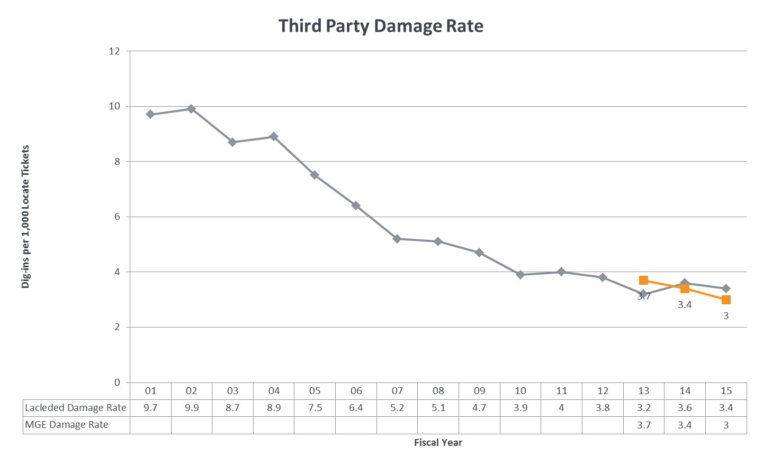
Damage Prevention Program
Missouri - Laclede Gas and MGE

Slide 12
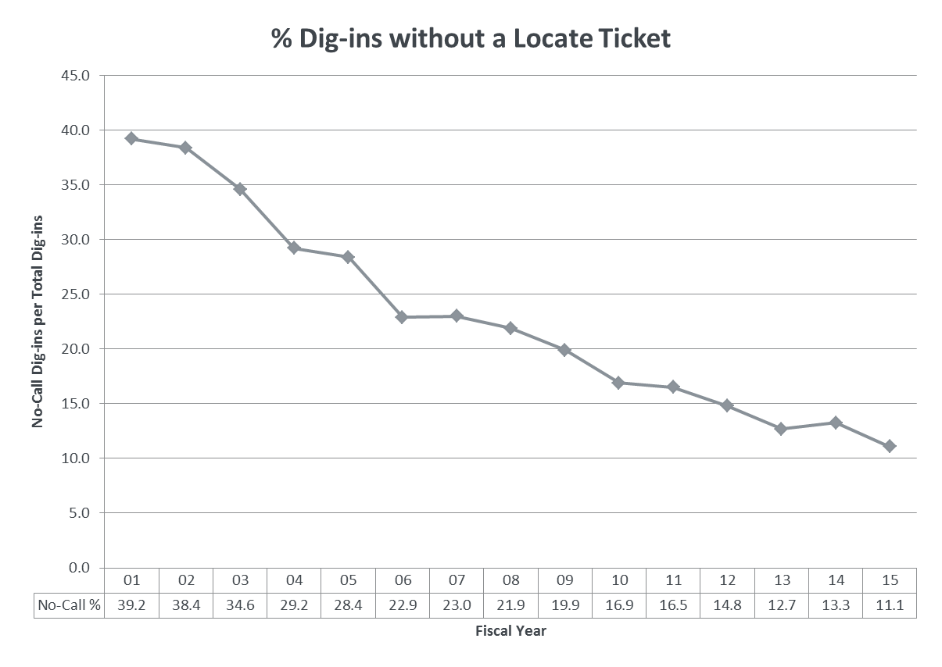
Damage Prevention Program
Missouri - Laclede Gas Only

Slide 13
Alabama One Call Study Commission
One Call Center
Expedience & validity of a single one call center in AL
Other Items
To improve safety
Enforcement
Adequacy of current provisions
Report for Governor & Legislative Leaders
SJR 76 - Improve Legislation
13
Spire | National Conference of Regulatory Attorneys

Slide 14
Questions?

