Slide 1
Natural Gas Facilities Relocation Cost Recovery Clause Rule Development Workshop
December 16, 2024

Slide 2
Thank you and Introductions

Slide 3
Safety Tip
HOLIDAY SHOPPING SAFETY
KEY TAKEAWAY:
Awareness – online and IRL – is key to staying safe and not being a victim this season.
Shopping Online
Check your devices
Before making any online purchases, make sure the device you’re using to shop online is up-to-date. Use strong passwords or two-factor authentication.
Only shop through trusted sources
Be careful when searching online. Are you searching from home, on public wi-fi? How are you finding the deals? Are you clicking on links in emails? Going to trusted vendors? Clicking on ads on web pages? If it looks suspicious, something’s probably not right.
Use Safe Methods for Purchases
Before providing personal or financial information, check the website’s privacy policy. Make sure you understand how your information will be stored and used.
SHOPPING AT THE STORE
Park Safely
Be mindful when you park – it may be dark when you leave the store or mall. Park in well-lit areas and near entrances. Approach your car carefully, have your keys or fob ready, and walk the circle of safety.
Hide Your purchases
Packages and bags in plain sight can be tempting to thieves. Place items in your trunk or hide them under a towel or blanket in your backseat.
Keep a handle on your personal items
During the holidays, stores are crowded, and many shoppers are often distracted. This environment makes it easy for someone to steal your purse, wallet, or cell phone. When shopping, take only what you need. Be cautious in dressing rooms—never leave your purchases or personal items unattended. Additionally, make sure to keep an eye on your purse or wallet while paying at the cashier or using the self-checkout.

Slide 4

Agenda
Why is the clause important?
Facility Relocation Overview
  Types of Facility Relocation Projects
  How Notification Processes Differ
Thoughts on the Rule and Other Questions
Other Questions
Next Steps

Slide 5
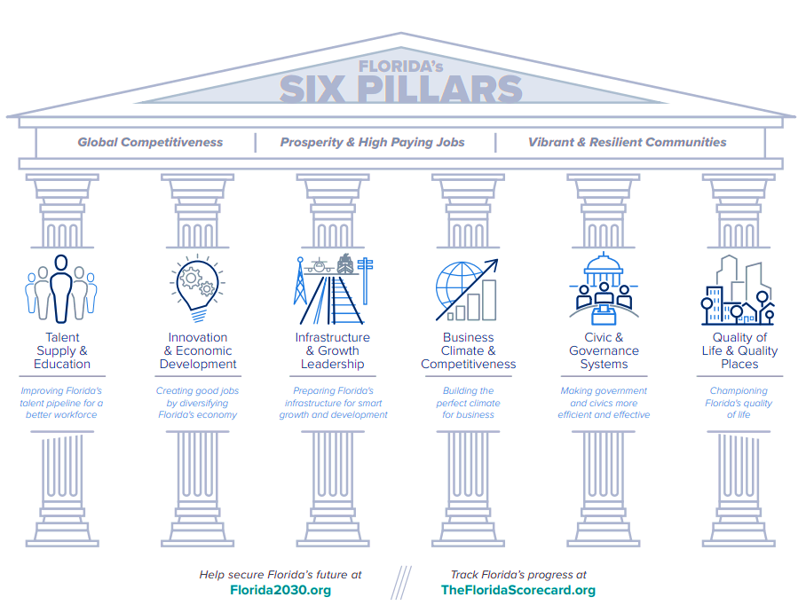
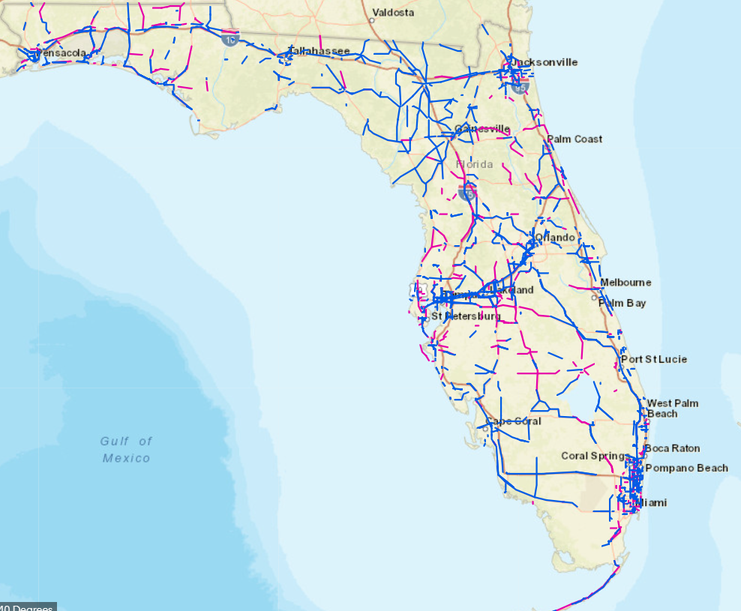

Why is the Clause Important?
As one of the fastest-growing states, Florida will need to improve its transportation infrastructure for years to come. These projects place significant stress on utility companies due to the unpredictability and cost associated with relocating pipelines, especially since there is no corresponding increase in revenue to offset these expenses.
PGS understands that qualifying facilities under the statutes include gas mains, laterals, service lines used to distribute natural gas, and ancillary equipment such as regulating stations, meters, and pressure monitoring equipment.
Predictable cost recovery of these non-discretionary relocation projects through a clause will allow the LDCs to serve customers more efficiently.

Slide 6



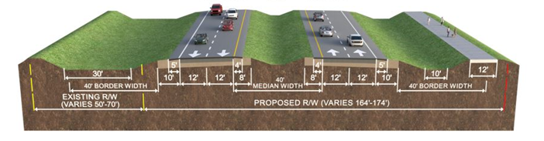

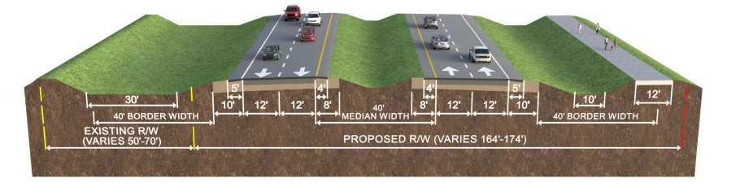
Facility Relocation Overview
The table below outlines the three primary types of facility relocation projects conducted by PGS. PGS works within a wide range of processes to safely relocate facilities in the mandated timeframes. The time from design to construction commencement is often measured in weeks to months.
Mandating Authority
Notification Formality
Notification Timing
Project Schedule
State of Florida
Provided a formal Notice to Proceed Letter & Executed Utility Work Schedule
Notification occurs at 60-90% of the Design Phase.
Formal
Counties
PGS may be provided a formal letter or an informal email
Varied and typically depends upon the size of the county.
Weeks to Months.
Formal or informal, depending on the County
Cities
PGS often receives informal notice via email notification or phone call
PGS usually receives limited advance notice. Often, PGS is notified after the design is complete or when locates are called in, which is typically days before construction begins.
Typically, informal

Slide 7
Thoughts on Rule and Other Questions
The company believes that many of the procedural aspects of its CI/BSR Rider make sense for the Natural Gas Facilities Relocation Cost Recovery Clause.
Projection Based on Forecast: Given the unpredictability and timing of notifications, we can’t always predict the specific relocation projects each year, but we can reasonably forecast the total annual capital amount. Can we base our projection on a general forecast, or must it be project-specific?
Annual True-up: This will enable the company to recover costs or refund any excess charges to customers. The true-up will be influenced by whether sales are lower or higher than projected, the number and timing of specific projects being less or more than anticipated, and actual project costs.
Capital Additions: New capital should be included for cost recovery. The cost of removal associated with the retired assets would not be included because the cost of removal is part of depreciation rates and is recovered through base rates. Will the cost of removal be recovered through the clause or base rates?
Depreciation Savings: Depreciation recovered through this clause should be offset by the depreciation the company would have expensed if the asset had not been retired. The retired asset was included in the rate base, meaning its depreciation was previously recovered through base rates. Should the cost recovery through the clause be reduced by depreciation expense savings on the retired assets?
Allocation of Revenue Requirement: The revenue requirement for the clause should allocated to the rate classes according to the cost-of-service study conducted in the most recent rate case.

Slide 8
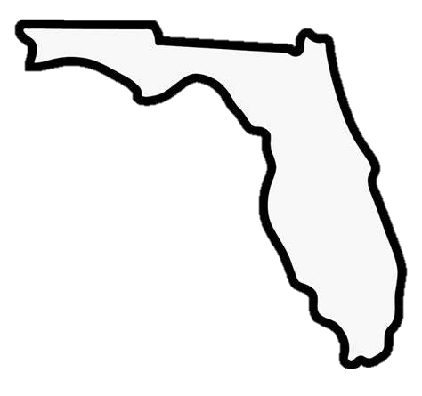
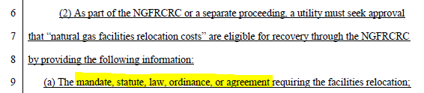
Other Questions
As one of the fastest-growing states, Florida must continually improve its transportation infrastructure. Different levels of government, including the state, counties, cities, and towns, have various notification processes for facility relocations.
Natural Gas Facilities Relocation Cost Recovery Clause
Section 25-7.150(2)
Notifications
Given the variety of notification types across different entities, what form of notification satisfies this requirement?

Slide 9
Implementation Schedule

Slide 10
Next Steps
Questions
Additional information required

