Slide 1

Overview of Draft Rule 25-6.0131 F.A.C., Regulatory Assessment Fees;
Investor-Owned Electric Companies, Municipal Electric Utilities,
Rural Electric Cooperatives
Apryl C. Lynn, MBA, PhD
Florida Public Service Commission u Deputy Executive Director – Administrative

Slide 2

Regulatory Assessment Fees
The Florida Public Service Commission (“PSC”) is a trust funded agency, whose revenues are derived solely from Regulatory Assessment Fees (“RAFs”).
Industry-wide RAFs, which meet statutory requirements as set out in Chapters 350, 364, 366, 367, and 368, F.S., are adopted and levied by rule by the Commission, and therefore subject to the rulemaking process under Chapter 120, F.S. The maximum allowable fees are set by statute, with the actual assessed fee established by rule.
The RAFs funding structure has existed for over 40 years. The RAF rate by rule for Electric Investor – Owned Utilities (IOUs) has not changed since 1999. The RAF rate by rule for Electric Municipals/Cooperatives has not changed since 1989.
RAFs for large investor-owned utilities are collected twice a year and are based on the utilities’ revenues from the previous six months, while others are collected once a year.
During the 2023 legislative session, the Legislature passed a law in the Budget Implementing Bill which exempted the PSC RAF function from the legislative
ratification and SERC requirements of s. 120.541 for one year.

Slide 3
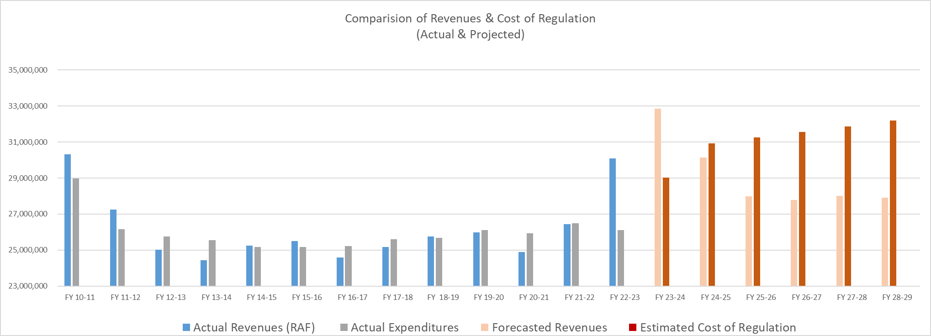
Revenues & The Cost of Regulation
Revenues (based on current RAF rates) are projected to be well under the cost to operate, i.e. the cost of regulation.
In the past, management has used internal controls to offset the difference in revenues and expenditures.
The Cost of Regulation includes known operational cost and legislative mandates for more immediate years and a projected growth rate of 2.6% for the out years.

Slide 4
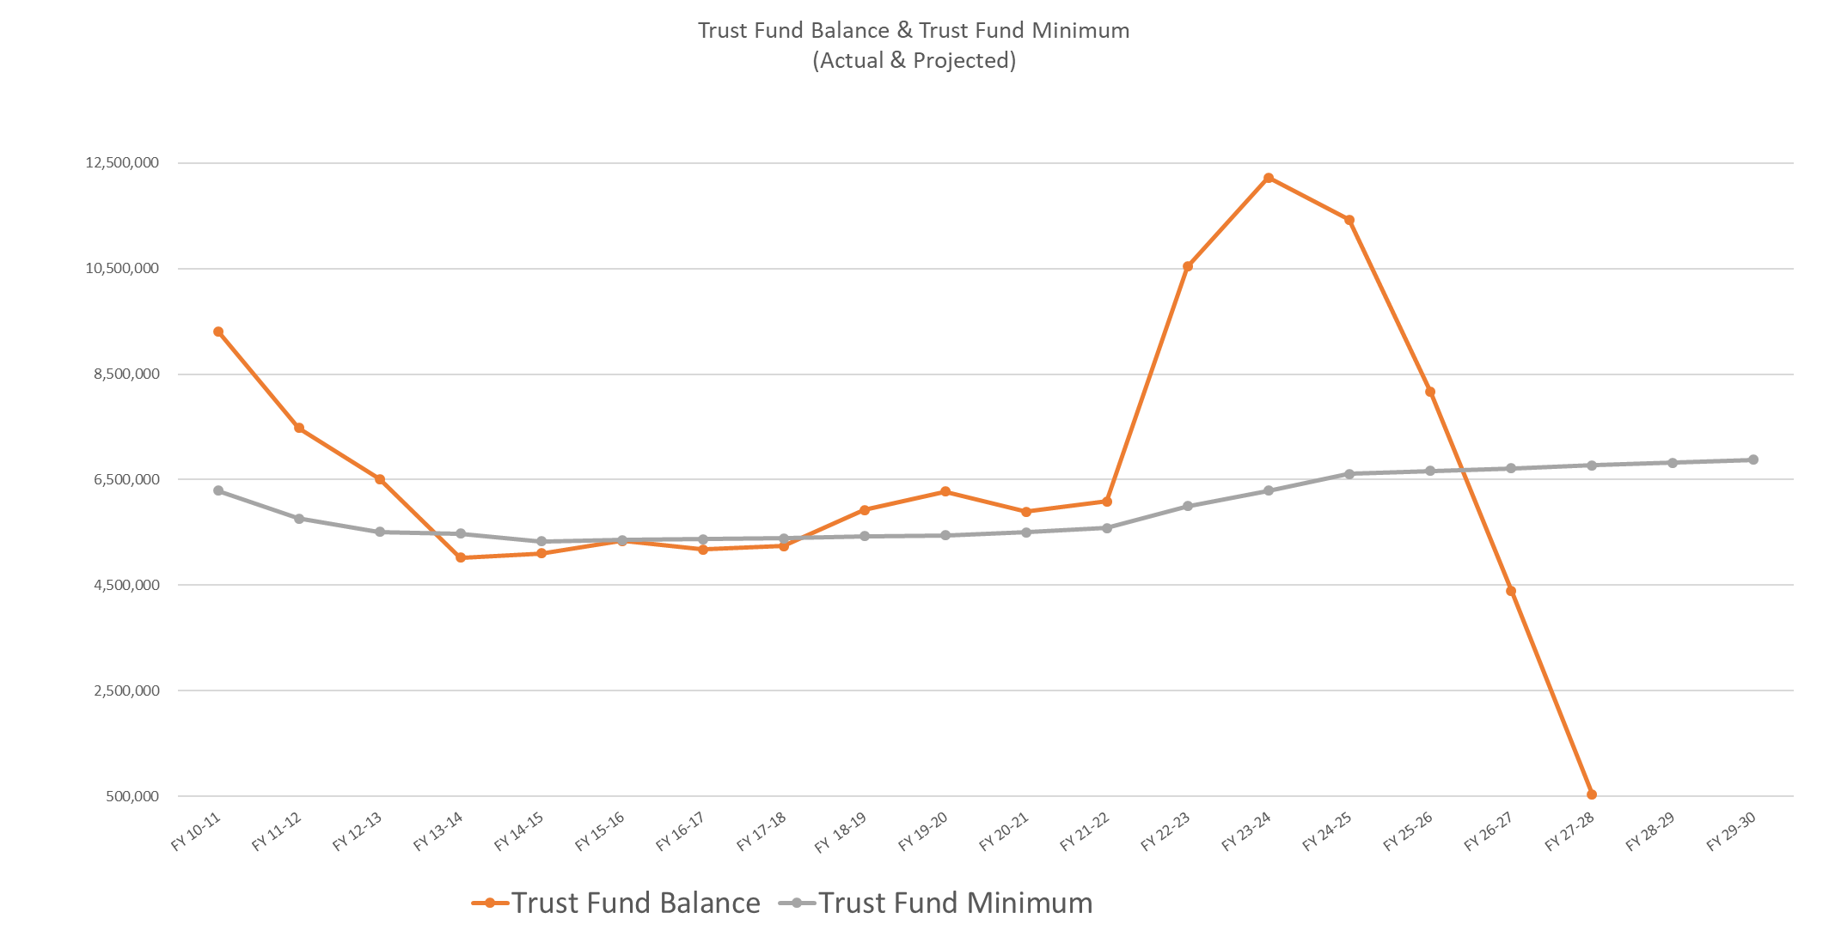
Impact of the Regulatory Trust Fund
The relationship between revenues and expenditures directly affects the Regulatory Trust Fund balance.
When expenditures are higher than revenues collected, the trust fund is used to offset excess operational costs.

Slide 5
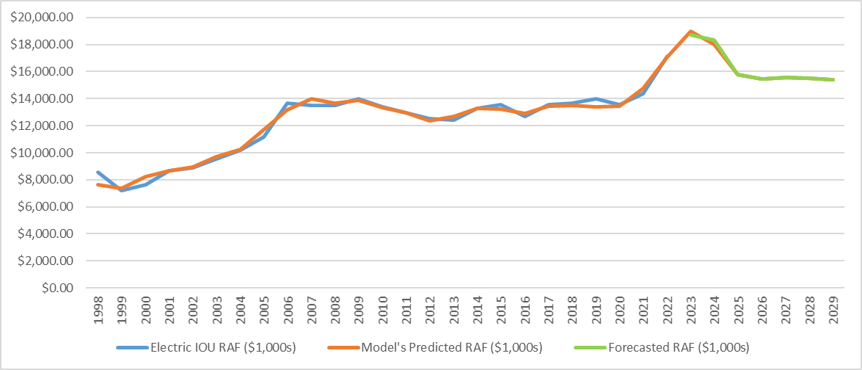
The Analysis of the Proposed RAF Rates
Projected Revenues - Electric Investor-Owned

Slide 6
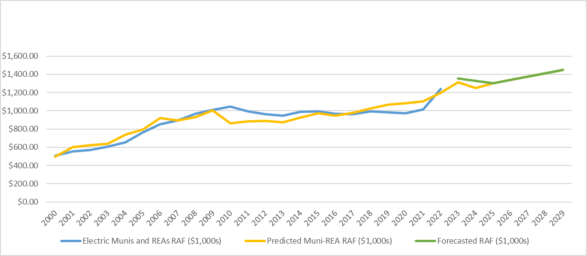
The Analysis of the Proposed RAF Rates
Projected Revenues - Electric Municipals/Cooperatives

Slide 7
The Analysis of the Proposed RAF Rates
Projected Cost of Regulation
Cost of Regulation is the ability for the agency to prudently manage resources to their authorized limits in order to meet the needs of the agency under normal operating circumstances.
The Cost of Regulation considers these major factors:
Anticipated future events (e.g. legislative mandates and other changes in law affecting operations, etc.)
Presumes the agency’s ability to fully and effectively access and prudently manage the resources authorized by the Legislature through the budget process.
Projected expenditure growth rate of 2.6% that captures a realistic estimate of natural growth in the cost of regulation.
Projected Cost of Regulation

Slide 8
Proposed Regulatory Assessment Fee Rates
Based on the current rate of 0.0720%, the projected revenues for FY 26/27 for Electric IOUs would be $15,473,309, potentially creating a shortfall of $2.8M.
Based on the current rate of 0.0156%, the projected revenues for FY 26/27 for Electric Municipals/Cooperatives would be $1,339,666, potentially creating a overage of $490K.

Slide 9
Overview of Draft Rule 25-6.0131 F.A.C., Regulatory Assessment Fees;
Investor-Owned Electric Companies, Municipal Electric Utilities,
Rural Electric Cooperatives
Apryl C. Lynn, MBA, PhD
Florida Public Service Commission u Deputy Executive Director – Administrative

