Slide 1
Florida Relay Updates
Jeffrey Branch
Client Director
April 30, 2020

Slide 2
Agenda
Florida Relay Conference Captioning (RCC)
Florida TRS statistics
Florida CapTel statistics
Florida Quality Report
Florida Outreach expense Report

Slide 3
Communication and Planning
During this unprecedented time, Sprint is working to ensure that our relay services are available for all relay users. We have implemented extension cleaning and social distancing practices in all call centers. In addition, Sprint’s IT and Operations teams are working together to develop a work from home solution that can be used to back up services. While this is applicable given today’s environment, our efforts will also help provide continuity of service for other types of natural disasters. Sprint has communicated and worked with State Telecommunication Administrators of Relay by Sprint (STARS) and the Federal Communications Commission (FCC), and we will continue to provide updates as events occur.

Slide 4
Florida RCC Minutes

Slide 5
Florida RCC Minutes – Usage to Date

Slide 6
Billable TRS Minutes

Slide 7
Florida French – Session Minutes

Slide 8
Florida Spanish to English – Session Minutes

Slide 9
Billable STS Minutes

Slide 10
Billable Intrastate CapTel Minutes

Slide 11
Florida Quality Report
TRS State Report
2017-2018
2018-2019
2019-2020

Slide 12
Florida Quality Report
CapTel State Report
2017-2018
2018-2019
2019-2020

Slide 13
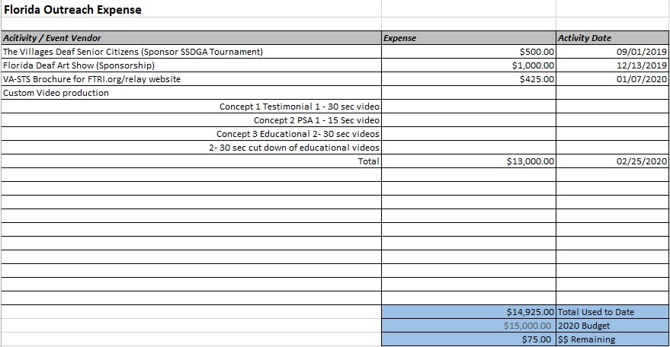
Florida Outreach Expense Report

