Slide 1
Telecommunications access in Florida
integrating statewide systems to improve outcomes and efficiency

Slide 2
History of relevant public policy
1973
Title VII of the Rehabilitation Act of 1973
The first legislation to require equal access to programs and activities funded by Federal agencies. Adjunct to that mandate, the Centers for Independent Living were established to provide local tools, resources and supports for integrating people with disabilities fully into their communities.
1988
Technology-Related Assistance Act of 1988 (P.L. 100-407)
This legislation provided financial assistance to States to fund needs assessments that would inform the development and implementation of a consumer-responsive statewide program of technology-related assistance for individuals with disabilities.
1991
Telecommunications Access Systems Act of 1991 (Ch. 427, F.S)
To comply with FCC regulations pursuant to Title IV of the ADA, Florida statutes were amended to charge the Public Service Commission with responsibility for overseeing a statewide telecommunications network for individuals who are deaf, hard-of-hearing, deaf-blind, or speech impaired.

Slide 3
History of relevant public policy
1994
1994 Amendments to the AT Act of 1988, (P.L. 103—218)
1998
Assistive Technology Act of 1998 (P.L. 105—394)
Recurring federal financial assistance was provided to States to maintain and strengthen a permanent, comprehensive statewide program of technology-related assistance for individuals with disabilities of all ages.
2004
2004 Amendments to the AT Act of 1998 (P.L.108-364)
To increase program consistency across states and improve access to and acquisition of assistive technology for individuals with disabilities, the law established new required core services for AT programs: device demonstration, device lending, state financing and device reuse.
States received federal financial assistance to support systems change and advocacy activities designed to increase access to assistive technology through policy advocacy, technical assistance and similar activities.

Slide 4
History of relevant public policy
2010
21st Century Communications & Video Accessibility Act
To ensure that people with disabilities would have equal access to “advanced” communications – namely, digital, broadband and mobile products and services, the Act specified how and where these technologies must be made accessible to people with disabilities such as deafness and blindness.
2012
No Wrong Door (NWD) Model Adopted
In 2012, the Administration on Community Living (ACL), the Centers for Medicaid & Medicare Services & the Veterans Health Administration adopted the NWD model to allow seniors and individuals with disabilities to be seamlessly connected to the full range of community-based options available.
2014
Workforce Innovation & Opportunity Act (WIOA)
WIOA transferred administration of the Centers for Independent Living and the state Assistive Technology programs from the Dept. of Education to the Administration on Community Living (ACL) to align with ACL’s mission to maximize the independence, well-being and health of older adults and people with disabilities through a seamless, no wrong door system.

Slide 5
Current situation in florida
The number of consumers served by the Florida Telecommunications Relay (FTRI) has decreased by more than 75 percent since 2010. The FTRI service delivery model is centralized out of Tallahassee and does not take advantage of the statewide network of federally funded, non-profit, disability-serving organizations charged with ensuring access to assistive supports and technology related to communication.
Regional Distribution Centers (RDCs) are not incentivized to conduct robust outreach because the FTRI reimbursement rates do not cover their costs. The results are evident in the declining numbers of individuals served by the FTRI program every year for the past 10 years.
FTRI was established in 1991, prior to the law creating assistive technology programs in every state (1994). The continuation of a separate entity to provide accessible telecommunications technology duplicates the work and investment that has already been made in the state assistive technology program.

Slide 6
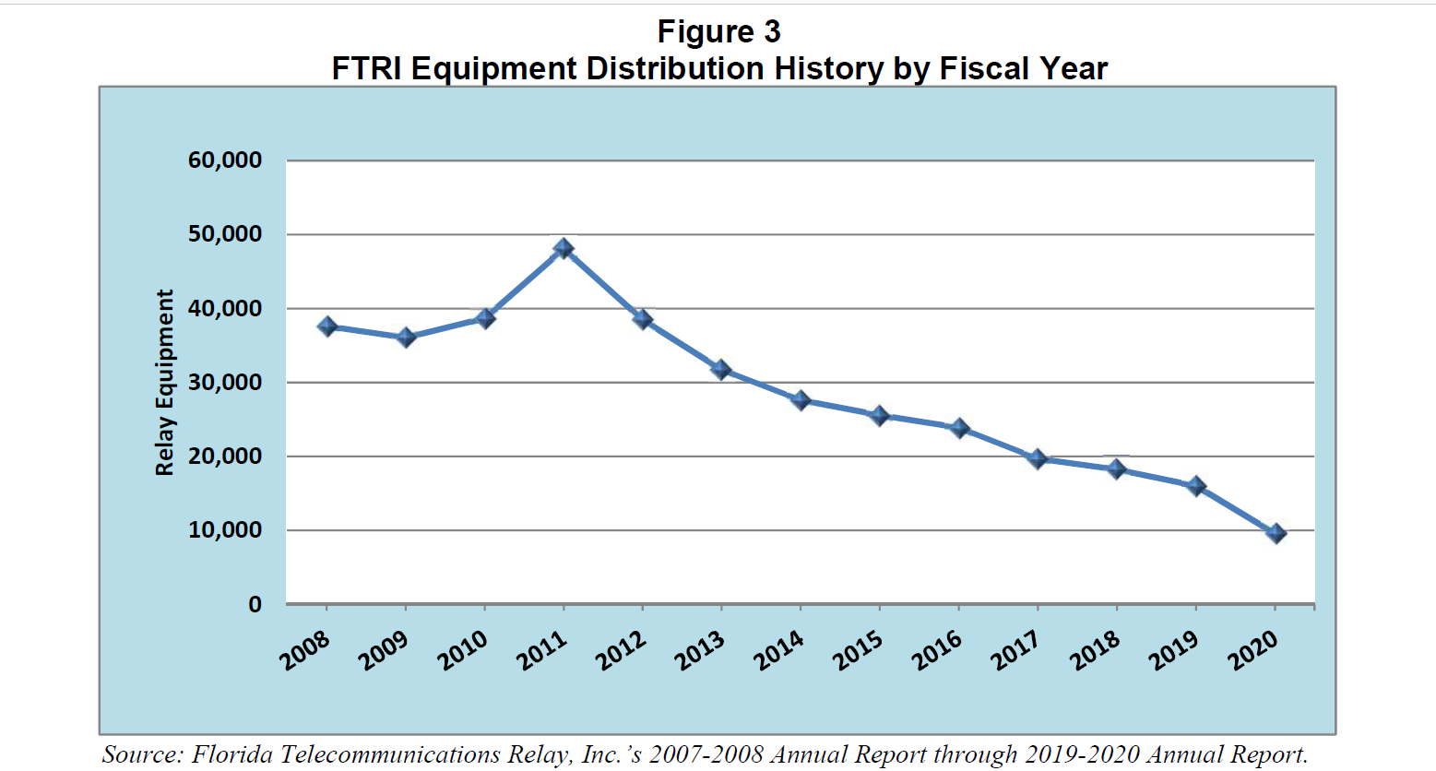

Slide 7
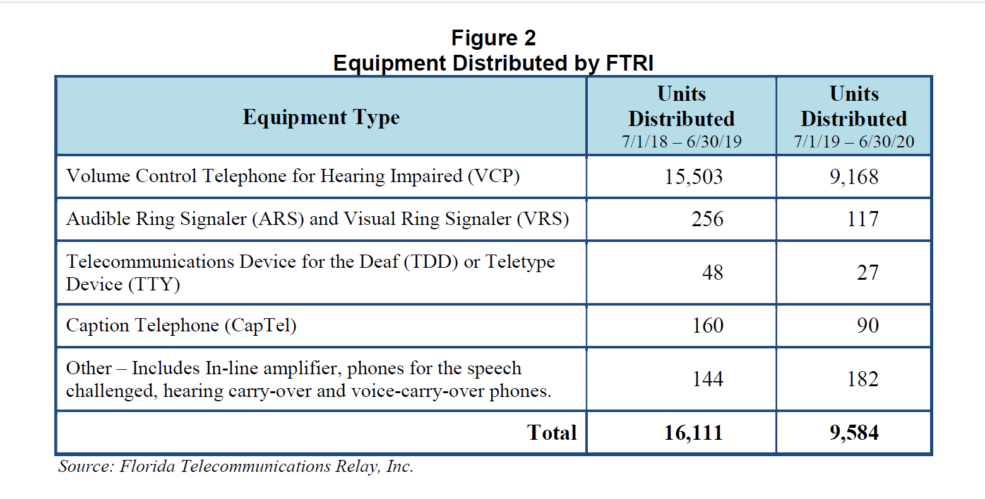

Slide 8
Proposal to improve service delivery
State Assistive Technology Program as Administrator
As the official Assistive Technology Program for the state of Florida, the Florida Alliance for Assistive Services & Technology (FAAST) has unparalleled experience and expertise in the purchase, maintenance, use and reuse of assistive technology equipment. FAAST can leverage its significant resources to improve consumer access to services and reduce administrative costs by eliminating the need for a stand-alone agency for the FTRI program.
Centers for Independent Living as Statewide Regional Distribution Center Network
As federally funded disability service providers serving all 67 counties in Florida, the state’s network of Centers for Independent Living (CILs) are uniquely equipped to deliver a decentralized, consumer-centric service model that is responsive to local needs, demographics, geography and all disabilities. The decentralized approach can reduce administrative overhead by spreading costs across the network of established CILs.
The CILs will contract with current FTRI deaf and hearing service providers to ensure continuity of local services for consumers.
Moving from the FTRI RDC model to a fixed rate contract with CILs with specific, measurable deliverables and increased RDC responsibilities will ensure more consumers are served and will ensure a more dependable and accessible community resource for individuals who are deaf, speech impaired, and/or hard of hearing.

Slide 9
