Slide 1
Florida Relay Updates
Jeffrey Branch
Account Executive
May 2023

Slide 2
Agenda
Florida Relay Conference Captioning (RCC)
Florida TRS statistics
Florida CapTel statistics
Florida Quality Report
Florida Outreach Expense Report
Voice Response Unit (VRU)

Slide 3
RCC Minutes

Slide 4
RCC Minutes – Usage to Date

Slide 5
Billable TRS Minutes

Slide 6
Spanish to English Session Minutes

Slide 7
Billable STS Minutes

Slide 8
Billable Intrastate CapTel Minutes

Slide 9
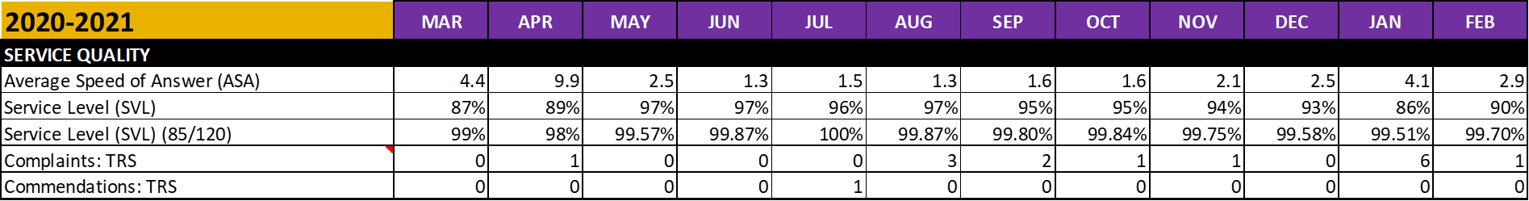
TRS State Quality Report

Slide 10
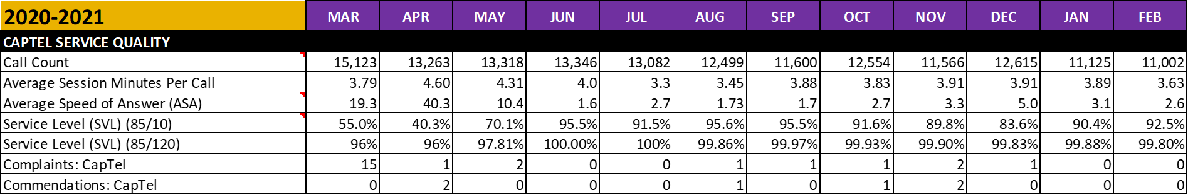
CapTel State Quality Report

Slide 11
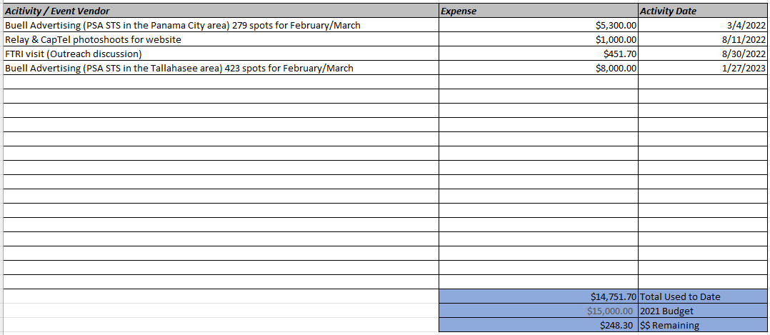
Outreach Expense Report

Slide 12
Voice Response Unit (VRU)
Solutions

Slide 13
Voice Response Unit (VRU) solutions
What is Voice Response Unit?
  VRU is an automated telephone answering system that provides callers with a prerecorded messages.
T-Mobile Accessibility implemented the VRU to address the issue of a growing number of misdials and robocalls that reach Florida Relay Service.

Slide 14
Voice Response Unit (VRU) solutions (continued)
Friday April 29, 2022, the VRU for Florida was implemented on the voice number (800-955-8770) only.
Successfully implemented the VRU messages for all 34 TRS States’ call types (i.e., Voice (dedicated and blended), Spanish, VCO, STS, 711, etc.) -1st quarter 2023.
There are multiple benefits for using the new VRU Message for the Florida relay’s voice toll free number:
Educate the customers on how to use service without CA involvement.
Allow CA to handle relay calls more efficiently.
Improves service levels.
Observed significant decrease on number of misdialed calls.

