Slide 1

Florida Relay Updates
Jeffrey Branch, Account Executive
November 14, 2023

Slide 2
Agenda
Florida Relay Conference Captioning (RCC)
Florida TRS statistics
Florida CapTel statistics
Florida Quality Report
Florida Outreach expense Report

Slide 3
Florida RCC Minutes

Slide 4
Florida RCC Minutes – Usage to Date

Slide 5
Billable TRS Minutes

Slide 6
Florida Spanish to English – Session Minutes

Slide 7
Billable STS Minutes

Slide 8
Billable Intrastate CapTel Minutes

Slide 9
TRS Florida Quality Report

Slide 10
CapTel Florida Quality Report

Slide 11
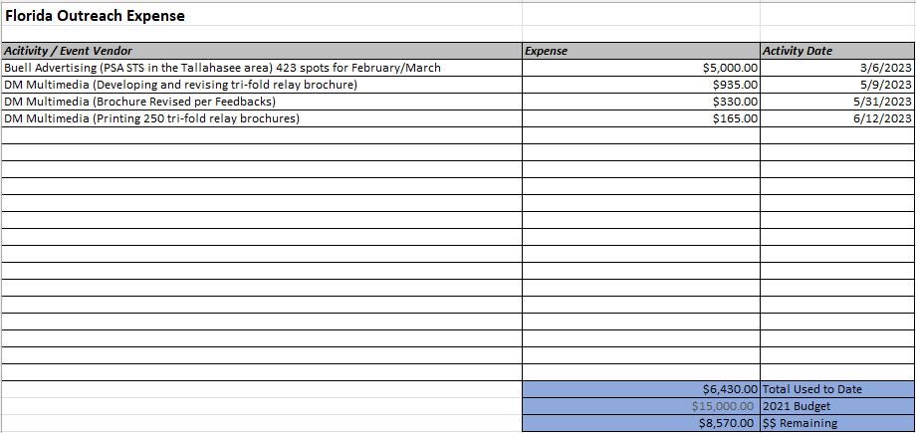
Florida Outreach Expense Report

Slide 12
Let’s Talk

