Slide 1

Florida Relay Updates
Jeffrey Branch, Account Executive
October 29, 2024

Slide 2
Agenda
Florida Relay Conference Captioning (RCC)
Florida TRS statistics
Florida CapTel statistics
Florida Quality Report
Florida Outreach expense Report
T-Mobile Updates

Slide 3
Florida RCC Minutes

Slide 4
Florida RCC Minutes – Usage to Date

Slide 5
Billable TRS Minutes

Slide 6
Florida Spanish to English – Session Minutes

Slide 7
Billable STS Minutes

Slide 8
Billable Intrastate CapTel Minutes

Slide 9
TRS Florida Quality Report

Slide 10
CapTel Florida Quality Report

Slide 11
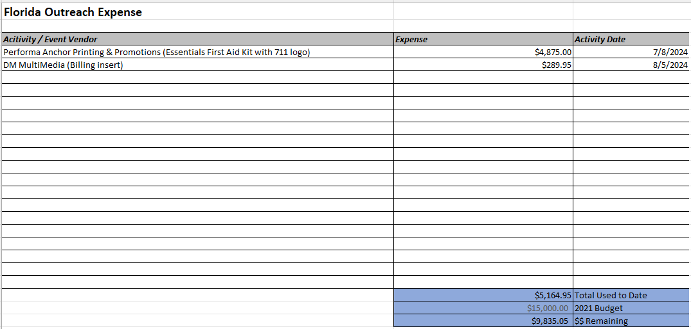
Florida Outreach Expense Report

Slide 12
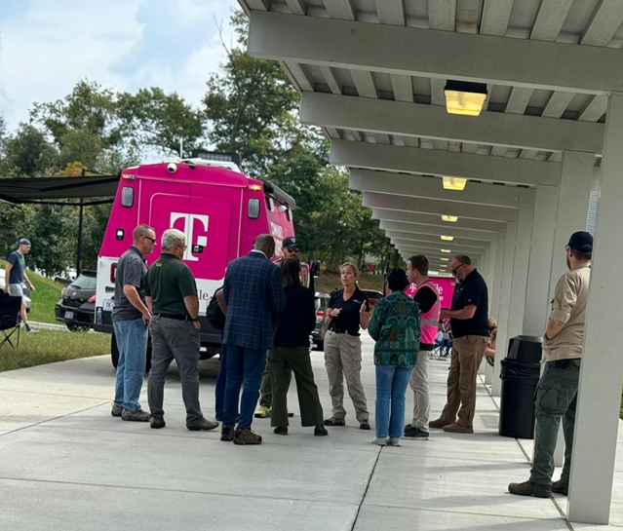
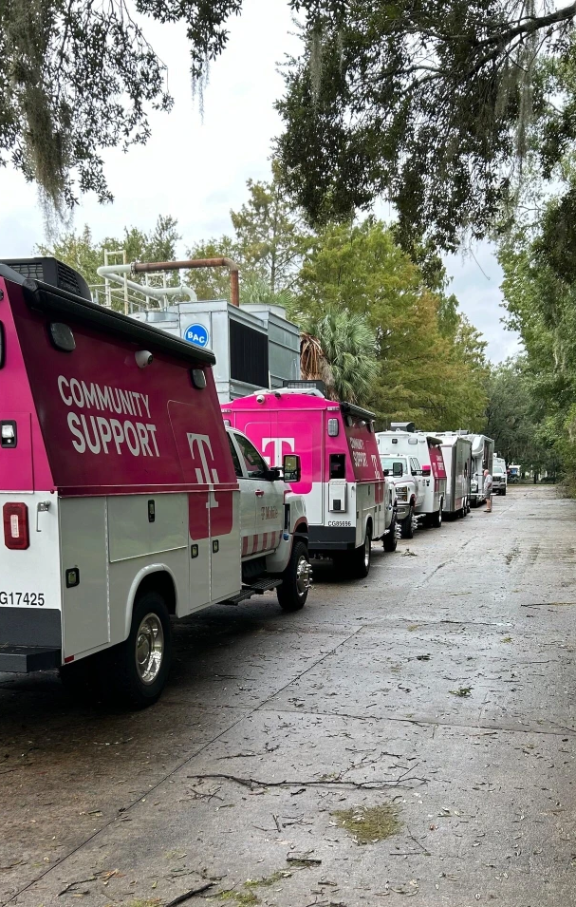
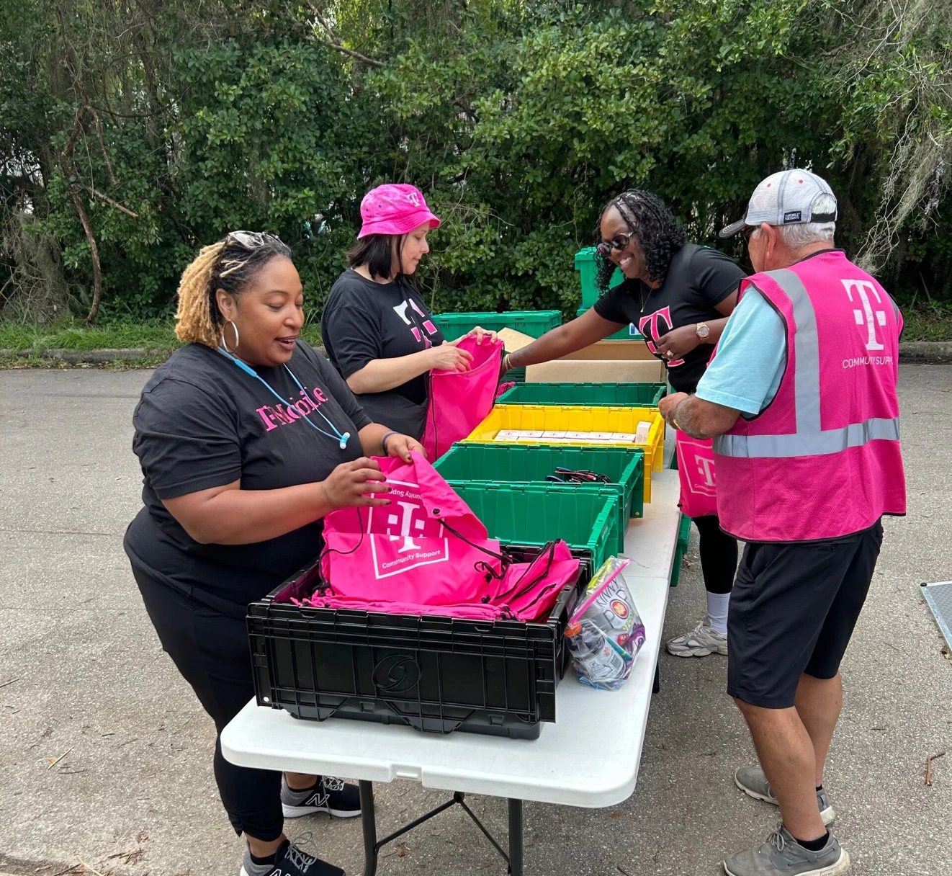

Hurricane Helene & Milton
ERT & TFG Support
  Our T-Mobile for Business and Government team is stationed in the Florida State Emergency Operations Center, actively supporting and coordinating efforts to connect first responders, public safety, and relief organizations at federal, state, and local levels. This includes deploying connectivity solutions like SatCOLTs to emergency vehicle staging locations, delivering hotspots and activated SIM cards to areas where coverage may not be available from other providers, and assessing other real-time and urgent needs.
Public Safety ISA Team Efforts
  Worked 16-20 hour days since the beginning of emergencies
  Traveled to three different states
  Staffed EOCs for seven different states (virtually or in-person)
  Met with FCC Chairwoman Rosenworcel in North Carolina
  Received a personal note from FEMA Region VI Director

Slide 13
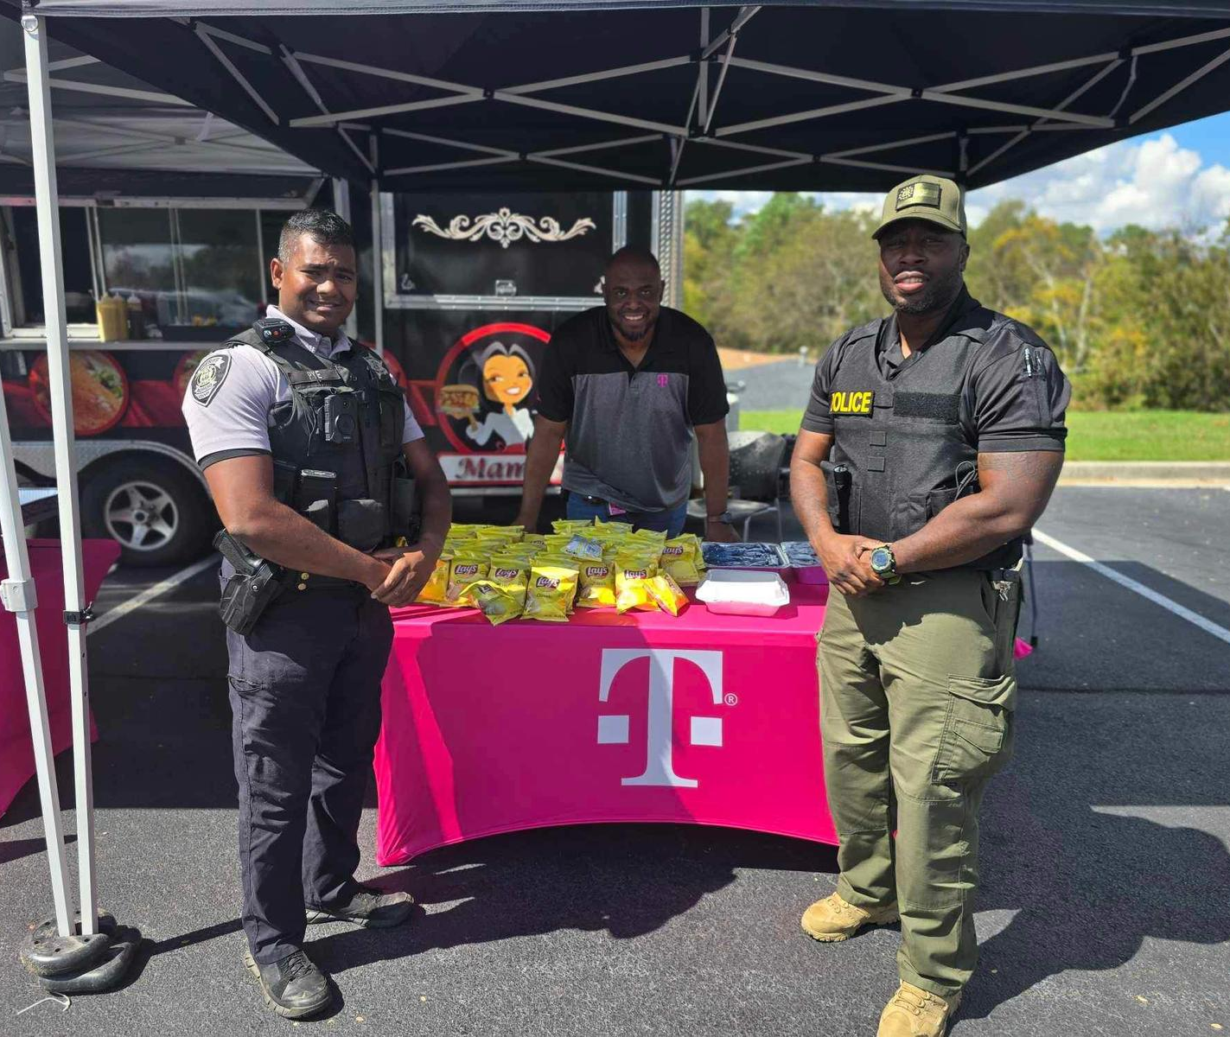
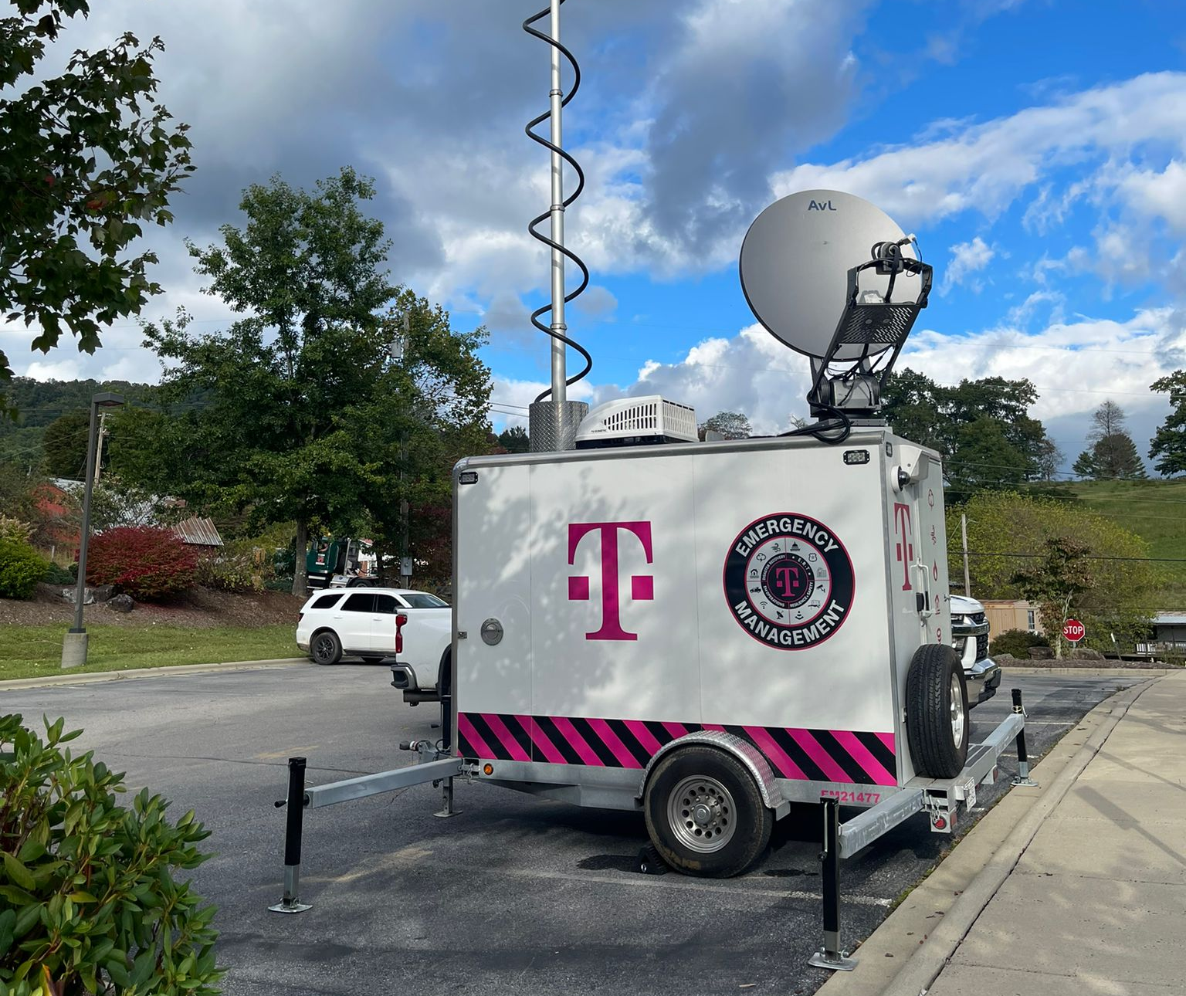
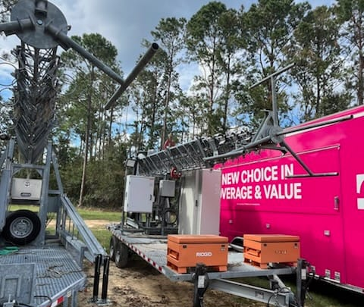
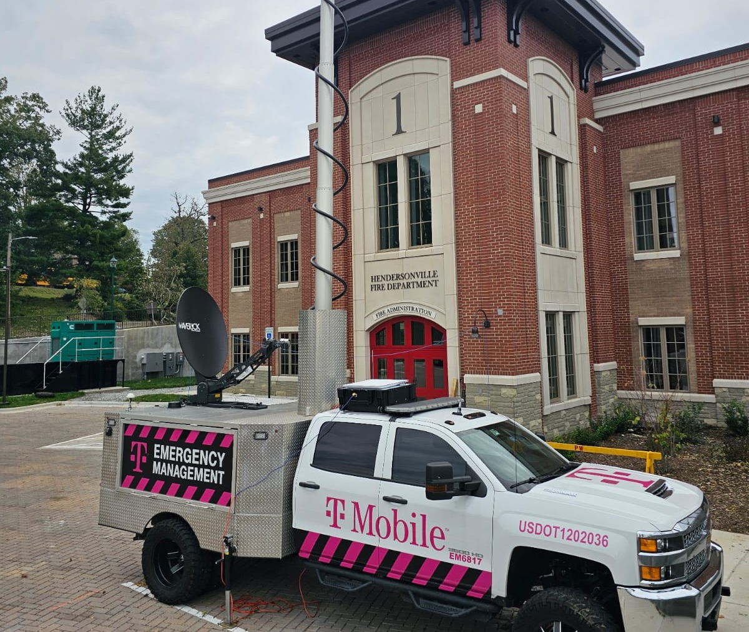
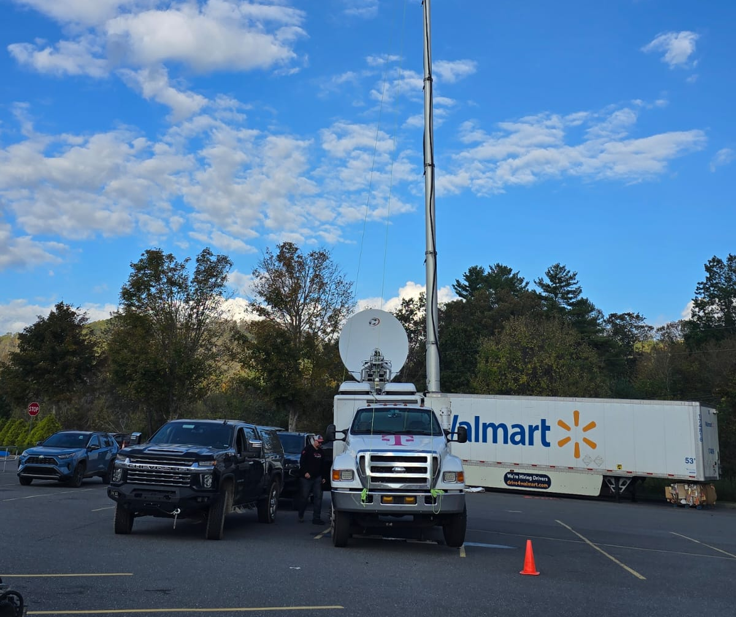
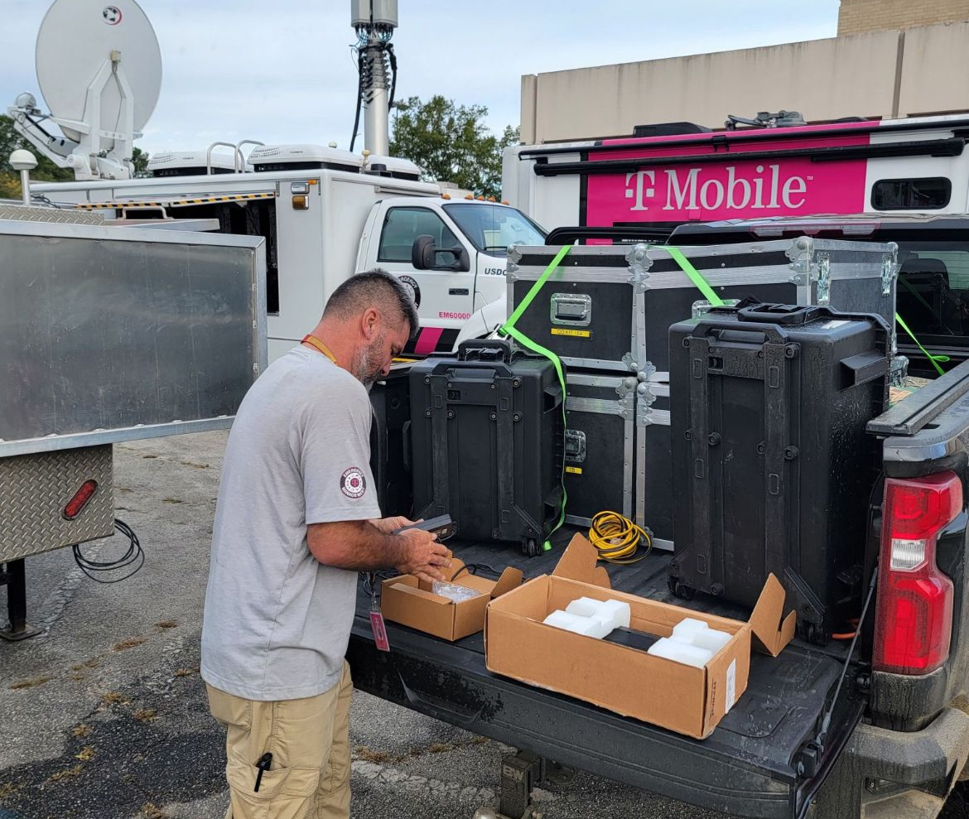

Slide 14
Let’s Talk

