Slide 1

Florida Relay Updates
Jeffrey Branch, Account Executive
October 27, 2025

Slide 2

Partnership
Excited to be partnered with the Florida Public Service Commission (FPSC), FTRI, TASA and the citizens of Florida in enhance accessibility for all! Looking forward to making a meaningful impact together!

Slide 3
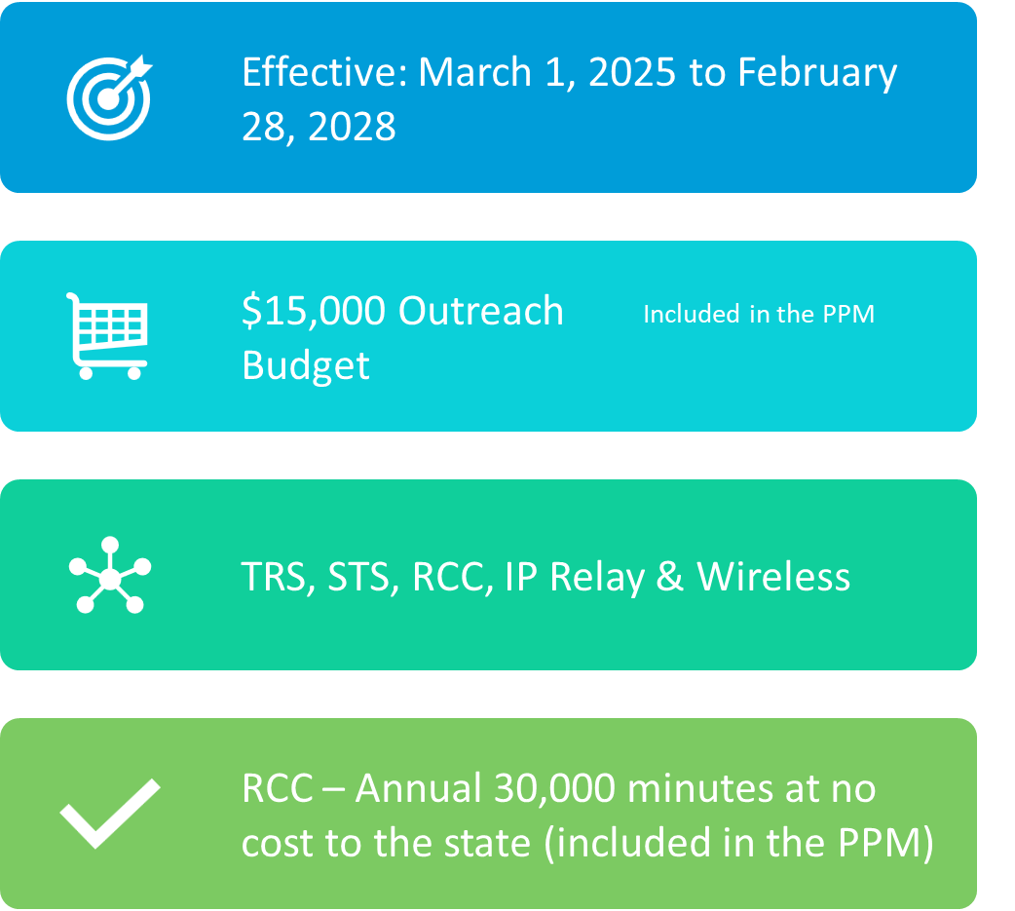
New Contract

Slide 4

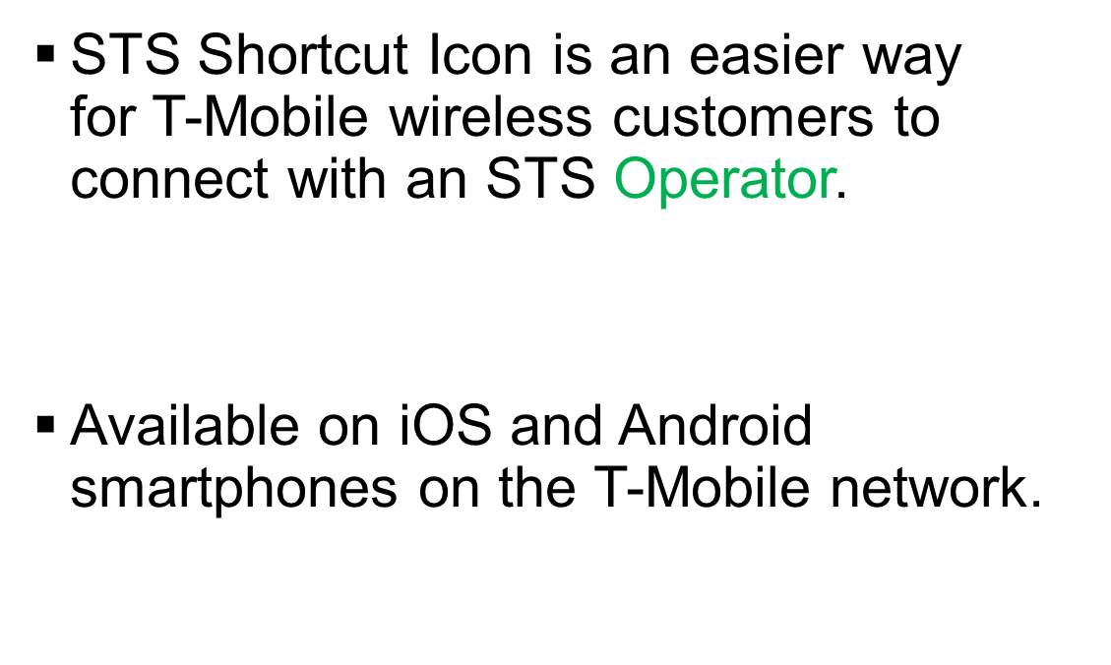
NEW: STS Shortcut Icon

Slide 5
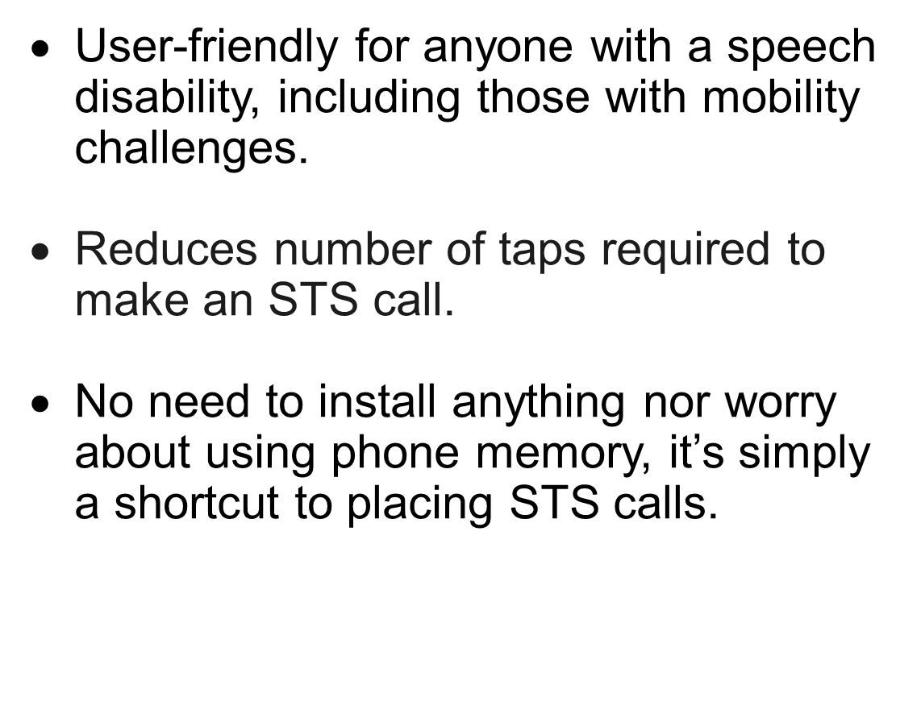
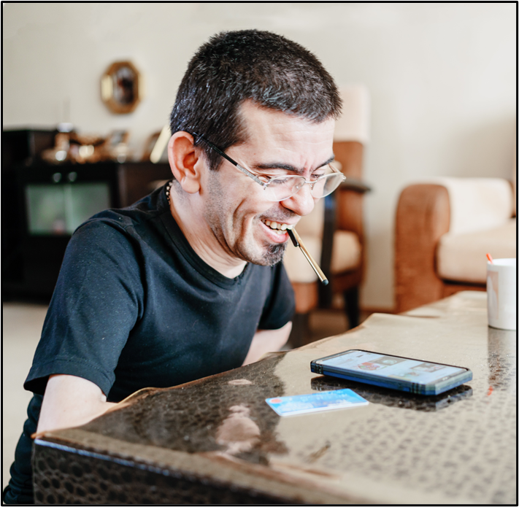

Benefits of STS Shortcut Icon

Slide 6
Florida RCC Minutes – Usage to Date

Slide 7
Billable TRS Minutes

Slide 8
Florida Spanish to English – Session Minutes

Slide 9
Billable STS Minutes

Slide 10
TRS Florida Quality Report

Slide 11
Let’s Talk

