Slide 1

TASA Meeting
November 2019

Slide 2
Client Services
The total number of EDP services provided by FTRI for fiscal year 2018/2019 was 19,788.

Slide 3
Total Client Services
FY 15/16 – 28,919
FY 16/17 – 23,995
FY 17/18 – 22,107
FY 18/19 – 19,788

Slide 4
New Client Services
FTRI served 9,863 new clients during the reporting period. Clients certified as eligible for the FTRI program are classified into four distinct groups:
Group | New Clients
Deaf | 49
Hard of Hearing | 9,756
Speech Impaired | 58
Dual Sensory Impaired | 0
Total | 9,863

Slide 5
New Client Services
FY 15/16 – 12,620
FY 16/17 – 11,024
FY 17/18 – 10,378
FY 18/19 – 9,863

Slide 6
Distributed Equipment
FTRI distributes both new and refurbished equipment. Equipment
distributed during fiscal year 2018/2019 numbered 16,032 units.

Slide 7
Total Equipment Distributed
FY 15/16 – 23,876
FY 16/17 – 19,715
FY 17/18 – 18,233
FY 18/19 – 16,032

Slide 8
Outreach
FTRI conducted 1,690 outreach activities, 1,298 were off-site distribution during fiscal year 2018/2019.
Distribution – 1,298
Dual Events - 263
BPP - 8
Other - 121

Slide 9
Total Outreach / Distribution
FY 15/16 – 1,877
FY 16/17 – 1,410
FY 17/18 – 1,399
FY 18/19 – 1,690

Slide 10
Some of the other services provided…
  Processed 18,452 customer service calls
  Received 2,917 online inquiries through the FTRI website
  Processed more than 62,369 EDP forms
  Provided 715 hours of training and support services to RDCs
Other important facts…
  Continued to place a high priority on protecting the integrity of client information by making security enhancements to the system
  Operated within budget requirements
  Received high marks from the external auditors for financial records and internal controls

Slide 11

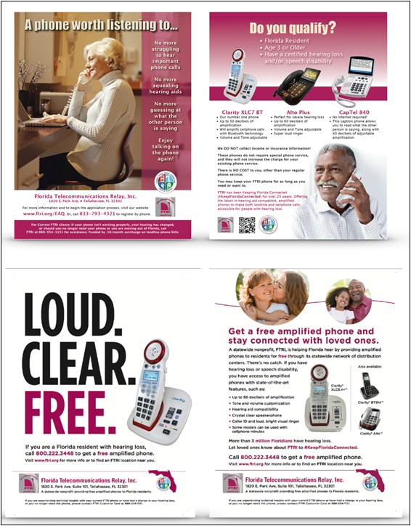
FTRI advertised in major daily and other community newspapers using 8½ x 11 insert ads throughout the state. Designs were updated during the year. Spanish ads were not published because some RDCs were not staffed to serve the Spanish speaking population.

Slide 12
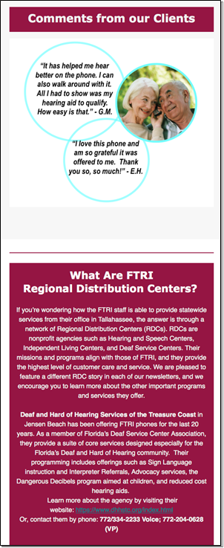
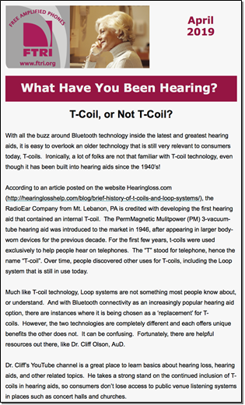
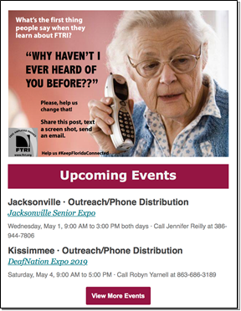
FTRI Newsletter
The FTRI Newsletter was launched in electronic format. Sent to over 30,000 subscribers registered in FTRI’s database. The newsletter generated positive responses along with requests to unsubscribe. During the latter half of the fiscal year the writing, composing and publishing were brought in-house and performed by the Outreach Manager.

Slide 13

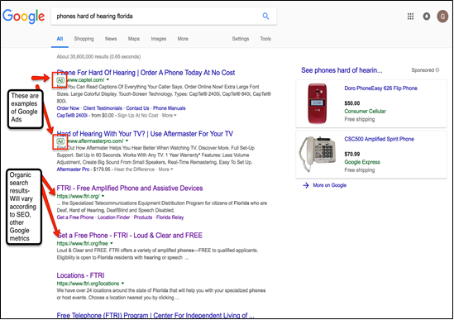
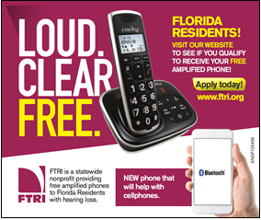
Social Media & Display Ads
People who conducted online searches using words/phrases such as “phones for hard of hearing” or “hearing loss” had a good chance of seeing FTRI listed in the search results.

Slide 14
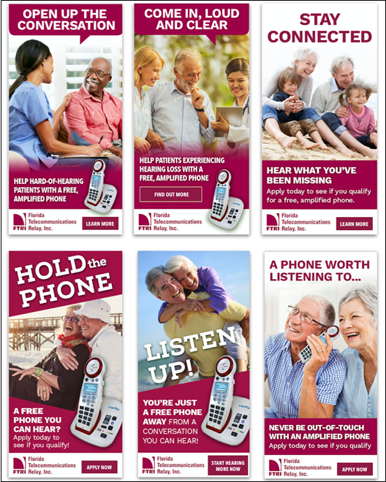
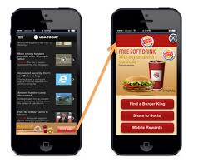
Geofence Campaign
Geofencing allows FTRI to draw an invisible electronic ‘fence’ around a physical location such as a library or senior center so people who enter the area are targeted (via a series of Google algorithms) to be served an FTRI digital ad up to 30 days after.

Slide 15
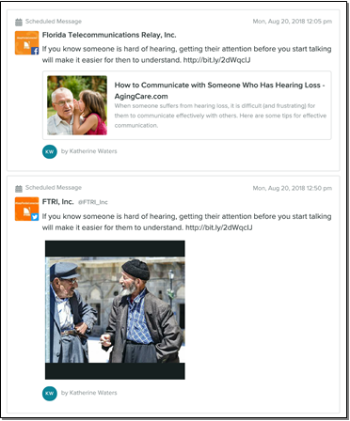
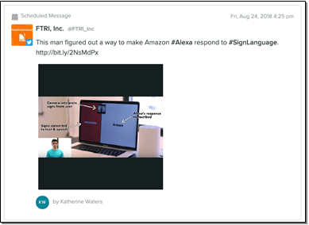
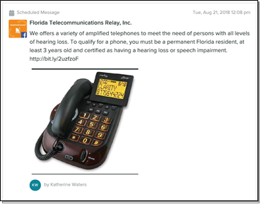
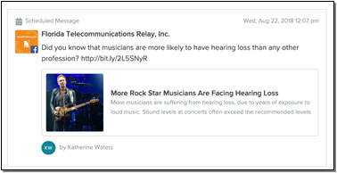
Social Media Posts
At the start of the fiscal year, FTRI posted on Facebook, Twitter, LinkedIn, and Instagram. During the second half of the fiscal year, LinkedIn postings were dropped to reduce expenses. Facebook has proven to be the most effective in terms of reach
and engagement.

Slide 16
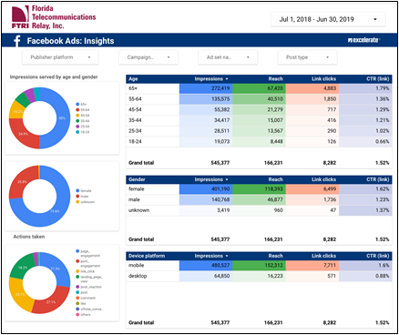
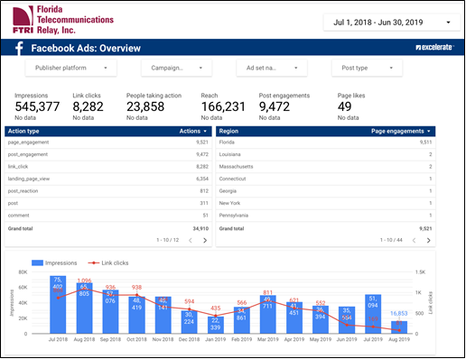
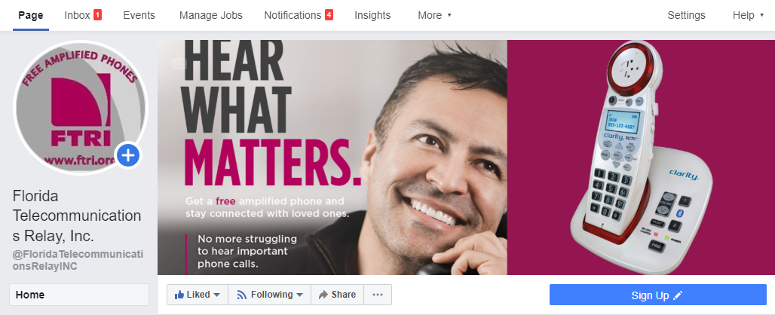
Facebook Statistics
Statistical Overview:
Impressions: 545,377
Link clicks: 8,282
People taking action: 23,858
Reach: 166,231
Post engagements: 9,472

Slide 17
Quality Assurance
FTRI maintains a quality assurance system to monitor the services, training, and equipment provided by contracted agencies.
Postcard questionnaires are mailed to a random selection of clients served by each Regional Distribution Center or the FTRI office. Three hundred and eight (318) questionnaires were mailed during this fiscal year and FTRI received 68 responses for a nearly 21 percent return rate. Ninety-eight percent of the responses were positive. Negative responses are resolved by either contacting the client directly or referring to the RDC for follow-up.
Reduction in postcard mailing is due to limited staffing.

Slide 18
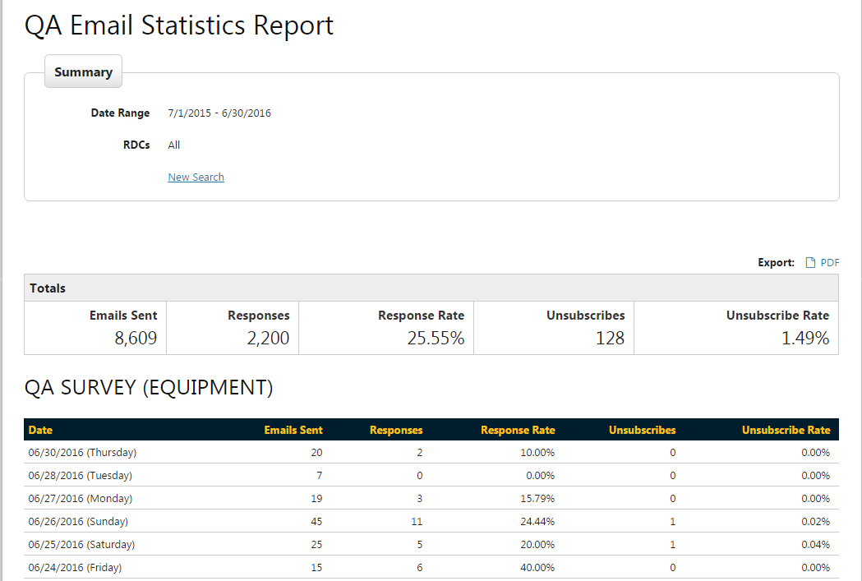
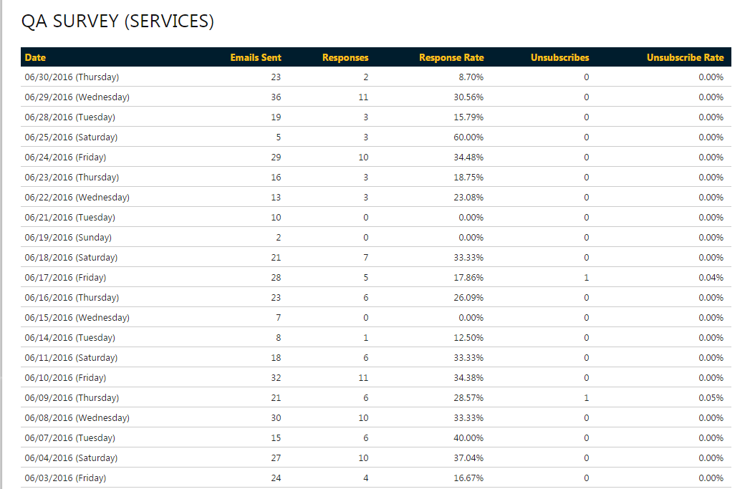
Quality Assurance
FTRI’s automated email system sent quality assurance surveys to 3,785 new clients the subsequent day after receiving services and received 665 responses for a 17.57 percent response rate. Clients requesting follow-up were contacted by FTRI Customer Care.

Slide 19
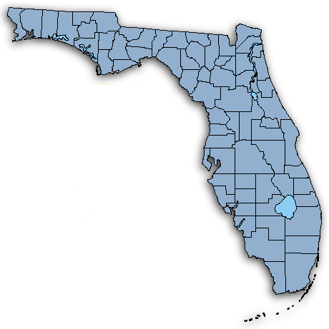


FTRI Regional Distribution Centers
FTRI Headquarters
RDC # 24
RDC # 2 – Center for Hearing and Communication (Ft. Lauderdale)
RDC # 4 – ES Deaf & Hard of Hearing Services (Daytona Beach)
RDC # 5 – Independent Living Resource Center (Jacksonville)
RDC # 7 – Center for Independent Living in Broward County (Ft. Lauderdale)
RDC # 9 – Citrus Hearing Impaired Program Services (Crystal River)
RDC # 10 – Deaf & Hard of Hearing Services of Pasco/Hernando (Port Richey)
RDC # 14 –Center for Independent Living of North Central Florida (Gainesville)
RDC # 16 – Deaf & Hard of Hearing Services of the Treasure Coast, Inc. (Jensen Beach)
RDC # 17 – Deaf Service Center of SW Florida (Ft. Myers)
RDC # 18 – Center for Independent Living of Central Florida (Winter Park)
RDC # 19 – Central Florida Speech & Hearing Center (Lakeland)
RDC # 20 – Space Coast Center for Independent Living (Rockledge)
RDC # 21 – Hearing Impaired Persons in Charlotte County (Port Charlotte)
RDC # 22 – Deaf Service Center of Lake & Sumter Counties (Leesburg)
RDC # 24 – CIL – Disability Resource Center (Pensacola)
RDC # 25 – Disability Resource Center (Panama City)
RDC # 26 – Hearing and Speech Center of Florida (Miami/Kendall)
RDC # 27 – Family Center on Deafness (Largo)
RDC # 28 – Self Reliance CIL (Tampa)
RDC # 29 – Ability 1st CIL (Tallahassee)
RDC # 30 - Audiology with a Heart (West Palm Beach)
RDC # 33 – Suncoast CIL (Sarasota)
RDC # 34 – Sertoma (Port Richey)
RDC # 35 – S&HC of Jacksonville
RDC # 36 – The Bridge Outreach (Fort Lauderdale)
RDC # 98 – FTRI (Tallahassee)
RDC # 5 & 35
RDC #25
RDC #29
RDC # 14
RDC # 4
RDC # 9
RDC # 22
RDC # 10 & 34
RDC # 18
RDC # 20
RDC # 27
RDC # 19
RDC #28
RDC #33
RDC # 16
RDC # 21
RDC # 17
RDC # 30
RDC # 32
RDC # 2, 7 & 36
RDC #26
  *Hours of operation varies from RDC to RDC.

Slide 20
Questions

