Slide 1

Florida TASA Meeting
Jeff Branch, Customer Relations Manager

Slide 2
Agenda
  Relay Conference Captioning (RCC)
  French Gate
  Spanish Gate
  Spanish to English Translation
  TRS Utilization
  CapTel Utilization
  IP CapTel
  Quality Report
  Outreach Report

Slide 3

Relay Conference Caption (RCC)
Notes:
See a pattern Total RCC minute increased
5 total subscribers from March 1 – February 29
90.3% of total minutes were used.
March 1st, 2016 Sprint reset back to 0 giving 15,000 minutes remaining for 2016-2017

Slide 4


French Gate
Notes:
Inbound calls is consistent with an average of 200 calls
Few outbound calls with an average of 1
I suspect the larger number of inbound calls are due to wrong number or question about the service using French relay.

Slide 5

Spanish to English Translation
Notes:
Continue to see an increase of usage from inbound, outbound and session minutes as well.
I talked with some customers in Miami during my visit there and they were grateful to have this service available to them in Florida
5% increase inbound calls
4% increase outbound calls completed
3% increase in session minutes

Slide 6
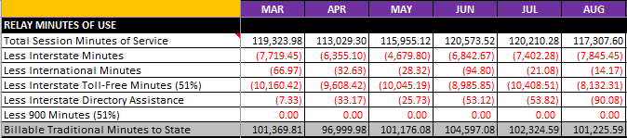
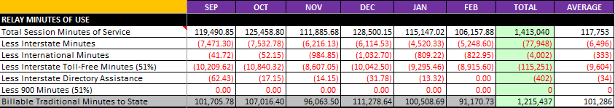
TRS Utilization
Notes:
We average 117,753 session minutes
TRS is decreasing slowly this year if you look at each month comparing the average
February has the lowest session minutes but it is also a short month

Slide 7
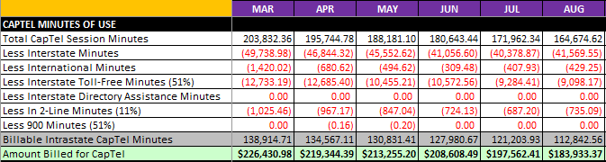
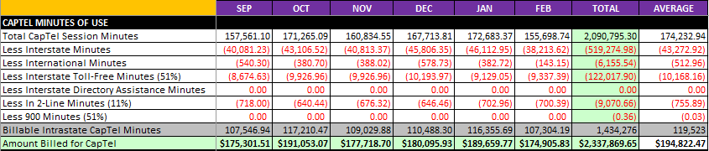
CapTel Utilization
Notes:
CapTel continue to decline about 3% this year
IP CapTel grew 10%
One of the factors for the decline is because customers are switching from analog to IP CapTel as well as having Web CapTel available on their computers.
We do have open market competition such as Caption Call (Sorenson) and Purple

Slide 8
Quality Reports
Graph of TRS State report
Graph of CapTel State report
Notes:
We constantly test agents to ensure that we provide top quality of service to our customers.
TRS – average is 83 % with 99% verbatim.
Small number of complaints but we continue to follow up within 24 hours.
CapTel – Received positive comments about CapTel service. I am hearing customers are grateful they can use the phone again after some period of time where they were not able to hear well and with caption it helps a lot.

Slide 9
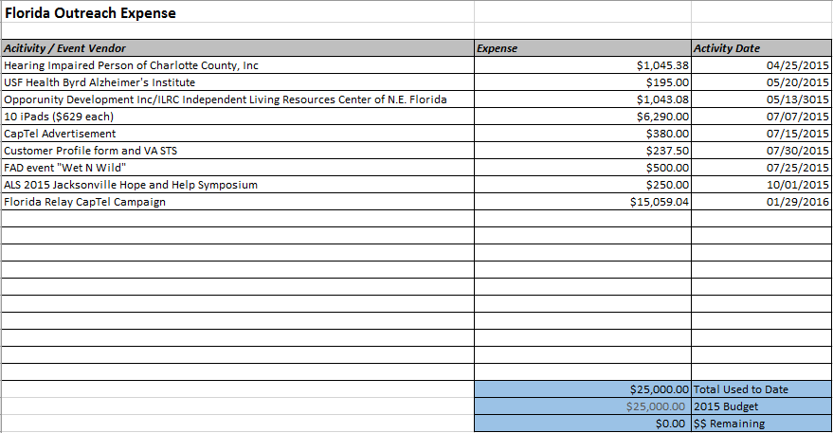
Outreach Report
Notes:
Continue to work with FTRI and assist with outreach effort and tracking the expense.
CapTel campaign was done with FTRI including CapTel information on the inserts that were put in the newspaper in specific cities.

