Slide 1
Florida Relay Updates
Jeffrey Branch
October 31, 2017

Slide 2
Agenda
Florida Relay Conference Captioning (RCC)
Florida TRS statistics
Florida CapTel statistics
Florida Quality Report
Florida Outreach expense Report
Hurricane Updates

Slide 3
Florida RCC Minutes

Slide 4
Florida French Gate

Slide 5
Florida Spanish to English Translation

Slide 6
Florida Utilization
TRS Minutes of Use
CapTel Minutes of Use

Slide 7
Florida Quality Report
TRS State Report
CapTel State Report

Slide 8
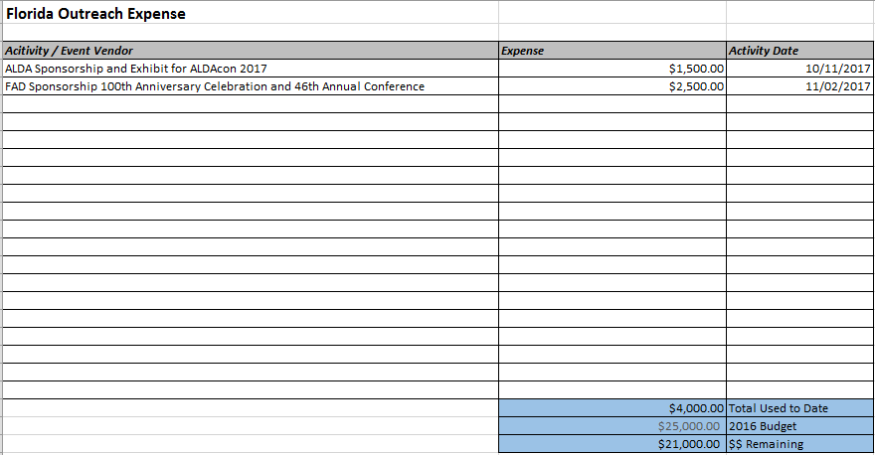
Florida Outreach Expense Report

Slide 9

Hurricane Updates
Hurricane Harvey
  Sprint Accessibility/Relay Texas – FEMA Stakeholder Team
  CapTel Phones installed at Shelters – Houston, Austin and Dallas
Hurricane Irma
  FEMA resources contacted 10 days prior to impact in Florida
  Electrical Grid outages caused all Telecommunication Systems to fail
  FEMA located CapTel Phones & TTYs in storage for use
Hurricane Staffing/Emergency Preparedness
  Sprint Operations begins planning 7+ days in advance of Hurricanes (Sole natural disaster that provides warning)
  Staffing increased 20% for elevated call volumes during emergency situations
  Sprint did not miss any Florida or FCC service levels during the month of September.
  Sprint transported staff from other locations to CapTel call centers in Texas during Irma.
Future Planning
  CapTel expansion at Dayton and Austin centers

