Slide 1
Florida Relay Updates
Jeffrey Branch

Slide 2
Agenda
  Florida Relay Conference Captioning (RCC)
  Florida TRS statistics
  Florida CapTel statistics
  Florida Quality Report
  Florida Outreach Report
  Sprint Accessibility

Slide 3
Florida RCC Minutes

Slide 4
Florida French Gate

Slide 5
Florida Spanish to English Translation

Slide 6
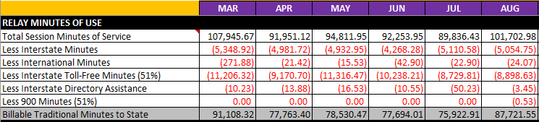
Florida TRS Utilization

Slide 7
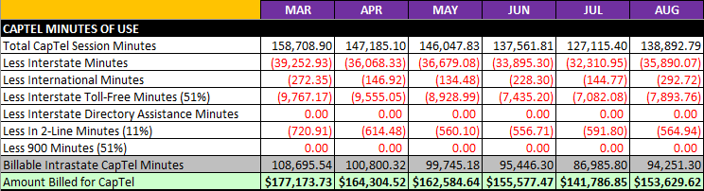
Florida CapTel Utilization

Slide 8
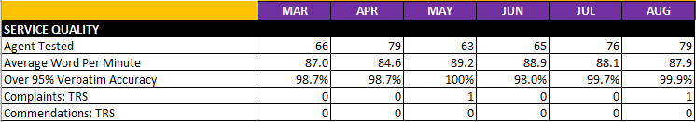
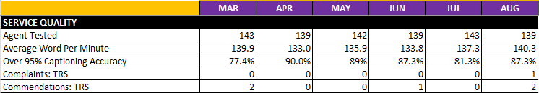
Florida Quality Report
Graph of TRS State Report
Graph of CapTel State Report

Slide 9
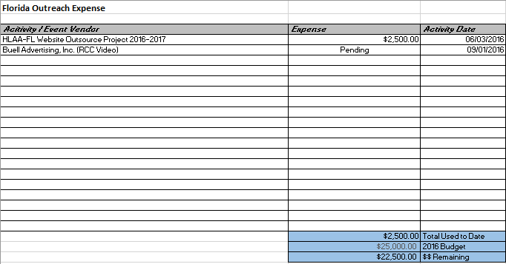
Florida Outreach Expense Report

Slide 10
Sprint Accessibility
New Brand Name

Slide 11
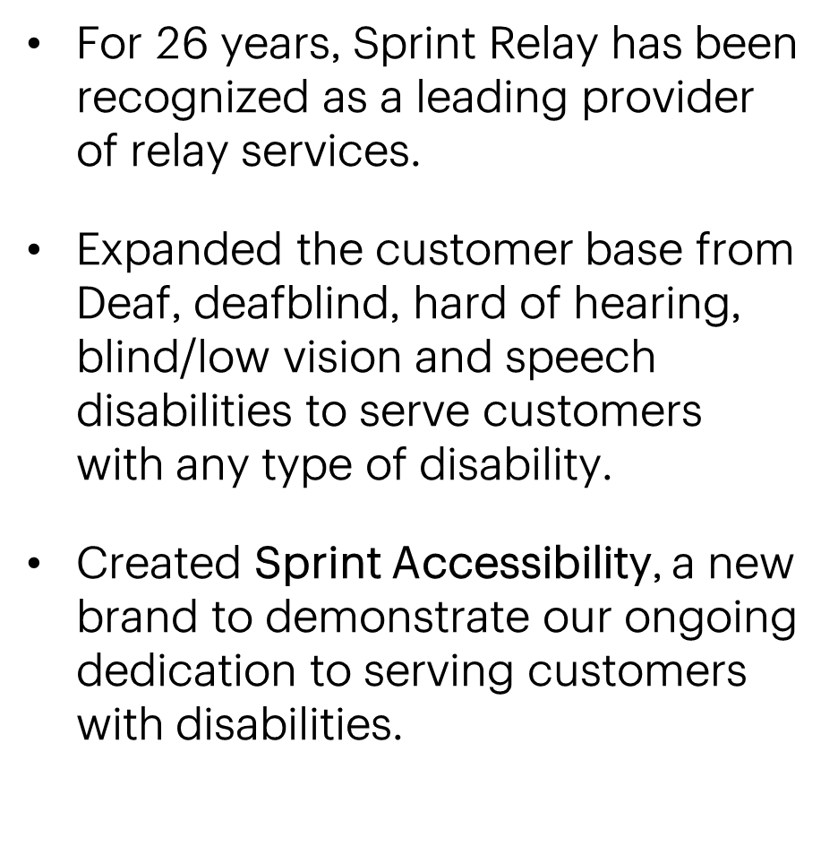

Sprint Accessibility

Slide 12
Sprint Accessibility (cont.)
Our commitment to people with disabilities
Our mission at Sprint is to provide communication products and services for customers with a disability. Sprint Accessibility is committed to reducing or removing barriers by enabling equipment, software, and services for all of our customers, either directly or in combination with assistive technology, in order to enhance people's everyday lives.

Slide 13
Sprint Accessibility (cont.)
Sprint Accessibility programs include, but are not limited to:
        Sprint Relay
        Sprint CapTel (Captioned Telephone)
        Wireless Sprint Relay Store
        Wireless Sprint Vision Store
        Video Customer Service (VCS) for customers who use American Sign Language (ASL)

Slide 14
Sprint Accessibility (cont.)
No impact to State Relay programs.
Only change is to replace Sprint Relay with the Sprint Accessibility logo on websites and/or marketing materials.
Everything else remains the same for State Relay programs.

Slide 15
Thank YOU for your continued support!

