Slide 1
Florida Relay Updates
Jeffrey Branch
Client Director
April 24, 2019

Slide 2
Agenda
Florida Relay Conference Captioning (RCC)
Florida TRS statistics
Florida CapTel statistics
Florida Quality Report
Florida Outreach expense Report

Slide 3
Florida RCC Minutes

Slide 4
Florida RCC Minutes – Usage to Date

Slide 5
Billable TRS Minutes

Slide 6
Florida French – Session Minutes

Slide 7
Florida Spanish to English – Session Minutes

Slide 8
Billable STS Minutes

Slide 9
Billable Intrastate CapTel Minutes

Slide 10
Florida Quality Report
TRS State Report
2016-2017
2017-2018
2018-2019

Slide 11
Florida Quality Report
CapTel State Report
2016-2017
2017-2018
2018-2019

Slide 12
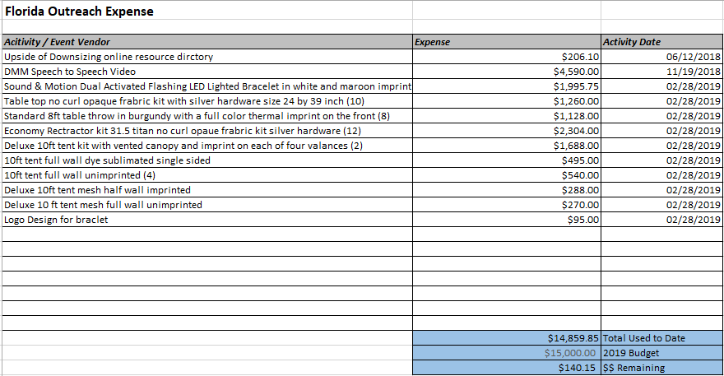
Florida Outreach Expense Report

