Slide 1
Florida Relay Updates
Jeffrey Branch
November 19, 2019

Slide 2
Agenda
Florida Relay Conference Captioning (RCC)
Florida TRS statistics
Florida CapTel statistics
Florida Quality Report
Florida Outreach expense Report
Map TRS Info

Slide 3
Florida RCC Minutes

Slide 4
Florida RCC Minutes – Usage to Date

Slide 5
Florida French – Session Minutes

Slide 6
Florida Spanish to English – Session Minutes

Slide 7
Billable TRS Minutes

Slide 8
Billable STS Minutes

Slide 9
Statistics – Summary of Trends
These decreases in traditional relay services are typical nationwide due
Consumers migrating to IP Relay-based products and services that are currently not required to be paid for by the State of Florida.
Consumers utilizing more advanced technological products and services.

Slide 10
Billable Intrastate CapTel Minutes

Slide 11
Florida Quality Report
TRS State Report
TRS State Report

Slide 12
Florida Quality Report
CapTel State Report
CapTel State Report

Slide 13
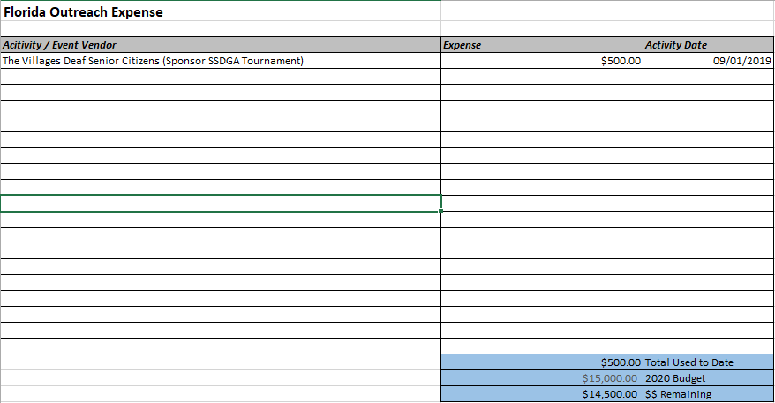
Florida Outreach Expense Report

Slide 14
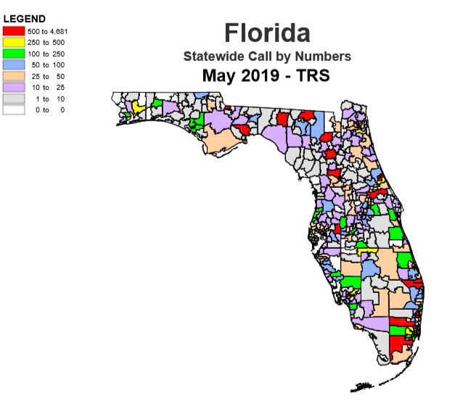
Florida Map TRS Info Call by Numbers

Slide 15
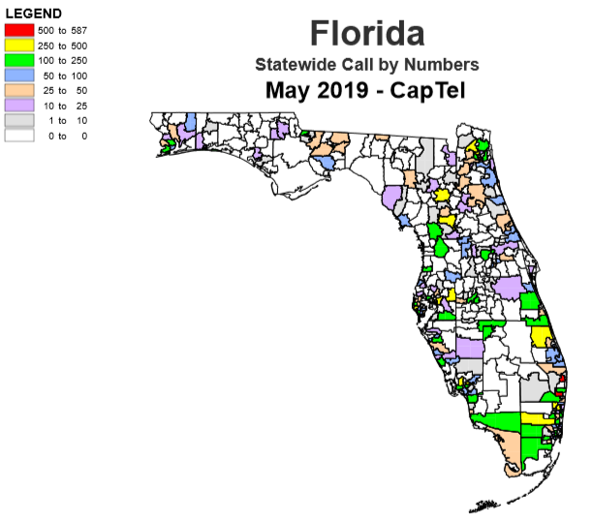
Florida Map CapTel Info Call by Numbers

