Slide 1
Florida Relay Updates
Jeffrey Branch
April 18, 2018

Slide 2
Agenda
Updates – Sprint Accessibility
Florida Relay Conference Captioning (RCC)
Florida TRS statistics
Florida CapTel statistics
Florida IP CapTel statistics
Florida Quality Report
Florida Outreach expense Report

Slide 3
Nationwide Misdial Solutions for Sprint TRS States included Florida TRS
  Successfully Implemented – January 1, 2018
  Florida was the first state to conduct a misdial trial . Thank you!!
  Inbound Callers Who May Have Unintentionally Connected to Relay Service
Transferred callers will hear the following informational recording:
You have dialed the phone number for State Relay Services. State Relay services are intended to facilitate telephone communications for people who have a hearing loss or speech difficulty. Please hang up and look for the correct phone number for the agency or company you are attempting to reach. Additional information about State Relay services is available at www.sprintrelay.com. Thank you. Good bye.

Slide 4
Nationwide Misdial Solutions
Benefits include:
Improves answer time
Agents no longer need to explain the service
Agents no longer need to address additional questions from the caller
Allows agents to focus on legitimate relay calls
Reduces call set up times
Very few customer inquiries as to why calls were transferred to the recordings

Slide 5
FCC TRS Recertification – status
On January 26, 2018, the Consumer and Governmental Affairs Bureau (CGB) of the FCC released a Public Notice announcing the deadlines for filing comments and reply comments on applications for renewal of certification for state telecommunications relay service (TRS) programs.
GROUP 1: The deadlines for filing comments and reply comments on applications for the states of Alabama, Arizona, Arkansas, Delaware, Georgia, Idaho, Iowa, Kansas, Maine, Maryland, Michigan, Minnesota, Missouri, Montana, Nevada, New Jersey, New Mexico, New York, Ohio, Oklahoma, South Dakota, Utah, and Vermont, the Commonwealths of Kentucky, Massachusetts, and North Dakota, the District of Columbia, and Saipan are:
Comments: February 22, 2018
Reply Comments: March 9, 2018
GROUP 2: The deadlines for filing comments and reply comments on applications for the states of Alaska, California, Colorado, Connecticut, Florida, Hawaii, Indiana, Louisiana, Mississippi, Nebraska, New Hampshire, North Carolina, Rhode Island, South Carolina, Tennessee, Texas, Washington, West Virginia, and Wisconsin, and the Commonwealth of Virginia are:
Comments: February 23, 2018
Reply Comments: March 12, 2018
To view the applications for state certification, visit: https://www.fcc.gov/general/trs-state-and-territories

Slide 6
Florida RCC Minutes

Slide 7
Florida RCC Minutes – Usage to Date

Slide 8
Florida French – Session Minutes

Slide 9
Florida Spanish to English – Session Minutes

Slide 10
Billable Intrastate CapTel Minutes

Slide 11
Billable TRS Minutes

Slide 12
IP CTS Conversation Minutes

Slide 13
Florida Quality Report
TRS State Report

Slide 14
Florida Quality Report
CapTel State Report

Slide 15
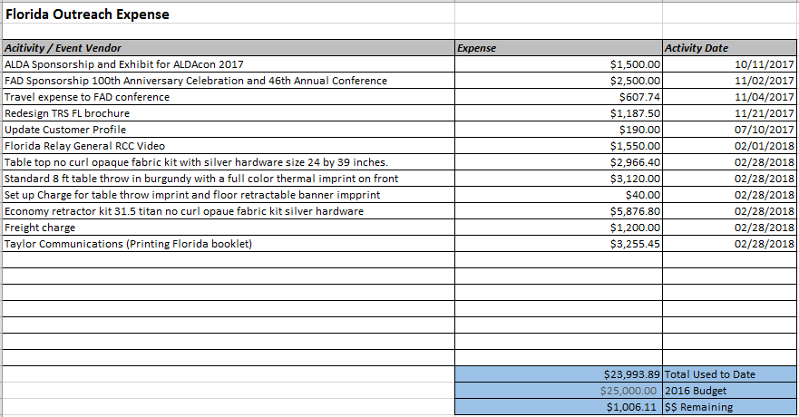
Florida Outreach Expense Report

