Slide 1
Florida Relay Updates
Jeffrey Branch
October 25, 2018

Slide 2
Agenda
Hiring Updates – Sprint Accessibility
Disaster Recovery Plan
Florida Relay Conference Captioning (RCC)
Florida TRS statistics
Florida CapTel statistics
Florida Quality Report
Florida Outreach expense Report

Slide 3

Sprint Accessibility Hiring Update
  Position Filled
    Tracy Goddard, IPCTS Branch Manager (Kansas)
    Orlando Freese, IPCTS Customer Relationship Manager (Florida)
    Olivia Dominguez, IPCTS Customer Relationship Manager (Texas)
  Position Open
    Relay Texas Customer Relationship Manager
    IPCTS Customer Relationship Manager
    Wireless Sales Account Manager (West)
https://www.livecareer.com/career/advice/interview/9-essential-items-to-bring-to-a-job-interview

Slide 4
Disaster Recovery Plan
  What is Business Continuity?
  Business Continuity (BC) is the process of planning and developing arrangements and procedures that enable an organization to respond to a debilitating crisis in a way that allows critical business processes to continue. Sprint incorporates BC as part of its business philosophy which promotes utilizing BC principles, guidelines, and standards to assure continuation of Sprint's mission critical business operations and services. The program is reviewed and approved annually.

Slide 5
Potential Threats to Business Continuity
Act of Nature
  Tornadoes
  Hurricane
  Earthquakes
  Floods
  Blizzards
  Wildfires
  Volcanic Eruptions
  Land/Mudslides
  Avalanches
Man-Made
  Fire
  Explosion
  Hazardous Materials
  Terrorist Acts
  Civil Disorder
  Work Stoppages
  Criminal Activity
Infrastructure/Technology
  Widespread Power Outage
  Telecomm Grid Outage
  Water/Sewage System Issues
  Major Computer Processing Disruption

Slide 6
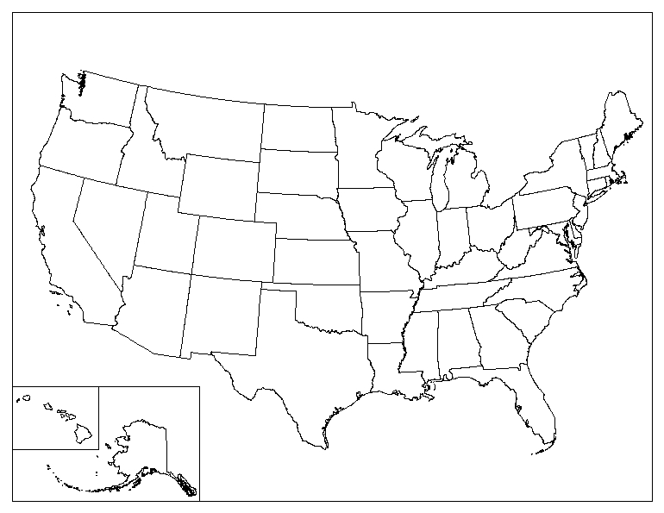




Call Center Map
Call Centers and Sprint Accessibility Customers
CT
DE
U.S. Federal
NH
NJ
RI
VT
New Zealand
Alaska
Hawaii
Puerto Rico
U.S. Virgin Islands

Slide 7
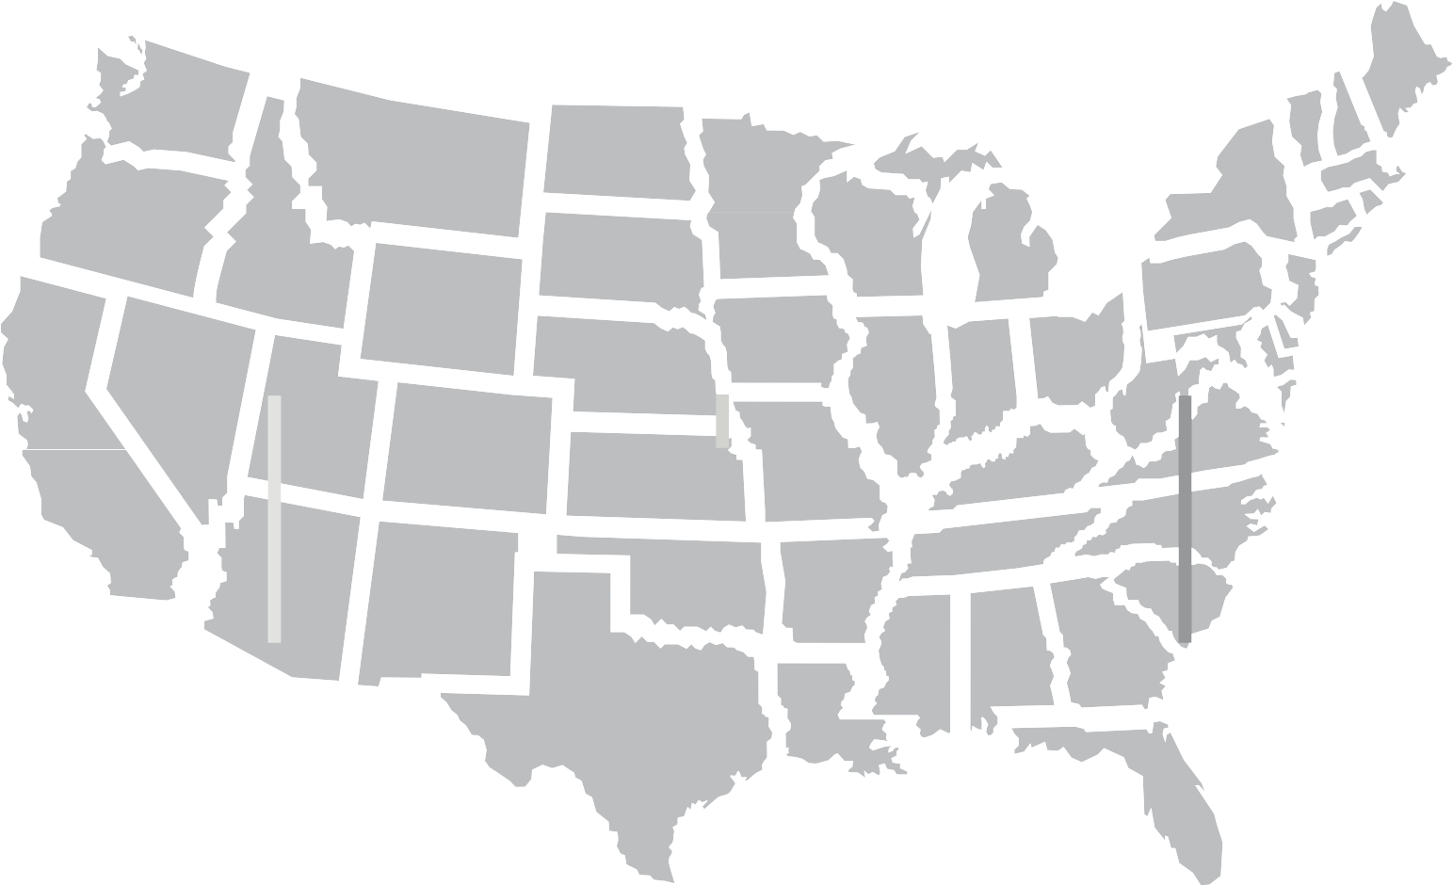
Sprint Relay Disaster Recovery Teams and
Tools
Superior TRS Platform
Secure Switch Site Locations
Cisco’s Intelligent Contact Manager (ICM) Router
Local Call Center Resources
Experienced call center management structures
Calls are sent to first available CA. Each center handles distributed traffic.
13 Domestic Relay Call Centers
Geographically dispersed throughout the U.S. to handle TRS, CTS, and/or Customer Service
TRS Platform Support
Automated Alarming
On-call Support
Customer Service
Live 24/7
Available in Spanish
Traffic Management Control Center
Staffed 7 am-8 pm CT, 7 days a week
On Call 24/7
Responds to traffic fluctuations, makes CA adjustments for every 15 minute period
Sprint Relay is supported by the proven Sprint network, superior platform technology, and a large support staff to provide uninterrupted service to Relay users.

Slide 8

Call Center Business Continuity Plans for
TRS and CapTel
Weather Events
Early detection/active monitoring
Proactive planning by Traffic Management Control Center
Estimate Impact
Offer Overtime incentives
Implement back-up specialty gates (Spanish, STS, Customer Service)
Extend hours of un-impacted centers
Implement emergency routing

Slide 9
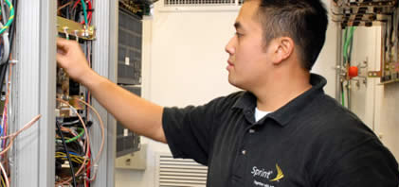
Call Center Business Continuity Plans for
TRS and CapTel
Technology and Personnel
TRS and CTS platform with automated alarming
Uninterruptible Power Supplies and Generators to support:
  Switch system and peripherals
  Switch room environments
  CA positions (consoles/terminals, emergency lights)
  Emergency lights (with self-contained batteries)
  System alarms
  Call Detail Record recording
Spare Positions and Platform Components
On-call support 24/7

Slide 10
Florida RCC Minutes

Slide 11
Florida RCC Minutes – Usage to Date

Slide 12
Florida French – Session Minutes

Slide 13
Florida Spanish to English – Session Minutes

Slide 14
Billable Intrastate CapTel Minutes

Slide 15
Billable TRS Minutes

Slide 16
Florida Quality Report
TRS State Report

Slide 17
Florida Quality Report
CapTel State Report

Slide 18
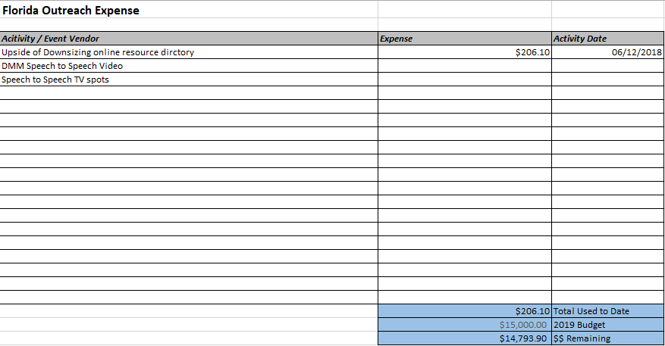
Florida Outreach Expense Report

