Slide 1
Limited Proceedings

Slide 2
Initiation of a Limited Proceeding
A Limited Proceeding is a procedure whereby a utility can seek an increase in rates for specifically identified costs.
Limited Proceedings can be initiated by a utility or the Commission.

Slide 3
Scope of Limited Proceeding
A Limited Proceeding is typically narrow in scope and not a substitute for a full rate case.
Unlike a rate case, it is usually not a full make-whole proceeding.
A Limited Proceeding has no statutory time frame limitation to process the request.

Slide 4
Scope of Limited Proceeding
A Limited Proceeding may be an appropriate course to take if the utility had a recent rate case.
A utility may need to file a rate case if the change(s) are broad in scope and the utility has not had a recent rate case.

Slide 5
Limited Proceeding Considerations
When evaluating the utility’s request for a Limited Proceeding, the Commission will consider:
Whether the filing includes more than four separate projects for which recovery is sought and the requested rate increase exceeds 30 percent.
If the utility has not had a rate case in the last seven years and the requested rate increase exceeds 30 percent.
Whether the filing is the result of the complete elimination of the water or wastewater treatment process and the requested rate increase exceeds 30 percent.

Slide 6
Common Uses
A Limited Proceeding is used to address issues such as the following:
Plant improvements (e.g. storage tanks, percolation pond, replacement or relocation of lines, major plant damage, construction or relocation of wells)
Material increases to expenses (e.g. new chemical costs, additional operator, major maintenance costs)
Rate restructuring (e.g. flat to measured service, conservation rates).

Slide 7
Pertinent Rules
Rule 25-30.445, F.A.C., General Information and Instructions Required of Water and Wastewater Utilities in an Application for a Limited Proceeding.
Rule 25-30.446, F.A.C., Notice of and Publication Information for Application for Limited Proceeding Rate Increase.

Slide 8
Filing Requirements
The utility must include the following in its filing:
Rate base components
Plant in service, accumulated depreciation, depreciation expense, and supporting detail shall be provided by primary account
Calculation of the weighted average cost of capital
Reason(s) why the Limited Proceeding has been requested
Detailed description of the expense(s) requested

Slide 9
Filing Requirements (cont.)
The utility must include the following in its filing (cont.):
Calculations of all items that will create cost savings or revenue impacts
Supporting documentation of calculations or assumptions made
Revenue increase requested, including regulatory assessment fees and income taxes, if appropriate, and annualized revenues
Current and proposed rates
If the utility is requesting a change in rate structure, it must provide a copy of all work papers and calculations

Slide 10
Filing Requirements (cont.)
The utility must include the following in its filing (cont.):
The rule or order from the governmental or regulatory agency mandating the investment or increased expense
An estimate by a professional engineer supporting the projected cost and the construction time of any improvements
Adjustments to rate base, net operating income, and cost of capital schedules that reflect adjustments consistent with the utility’s last rate proceeding

Slide 11
Achieved Rate of Return
The utility must show that for the most recent 12-month period, without increased rates, it will earn below its authorized rate of return in accordance with Section 367.082, F.S., Interim rates; procedure.

Slide 12
Rate of Return
Rate of return is not changed unless it is specifically addressed.
The Commission may update the return on equity to the most recent leverage formula.

Slide 13
Additional Requirements
The utility must provide a statement as to whether rate base has declined or whether any expense recovery sought is offset by one of the following:
Customer growth since last rate proceeding
Future customer growth expected to occur within one year of the date new rates are implemented

Slide 14
Limited Proceeding Filing Fees
Equivalent residential
connections (ERCs) Fee capacity of the system
$100 up to 100 ERCs
$200 from 101 to 200 ERCs
$300 from 201 to 500 ERCs
$1,000 from 501 to 2,000 ERCs
$1,750 from 2,001 to 4,000 ERCs
$2,250 more than 4,000 ERCs

Slide 15
Notice Requirements
Rule 25-30.446, F.A.C., Notice of and Public Information for Application for Limited Proceeding Rate Increase sets forth the noticing requirements.

Slide 16
Notice to County
Upon filing for a Limited Proceeding, the utility must mail a copy of application to CEO of governing body of each county within service areas.
The governing body may intervene in the rate change proceeding.

Slide 17
Other Notice Requirements
The utility must adhere to the following noticing requirements:
Petition and MFRs at business offices in service area
Newspaper notice in the service area
Initial customer notice 50 days after the official date of filing
Customer meeting notice – no less than 14 days and no more than 30 days prior
PAA and other order notices required by a rate change

Slide 18
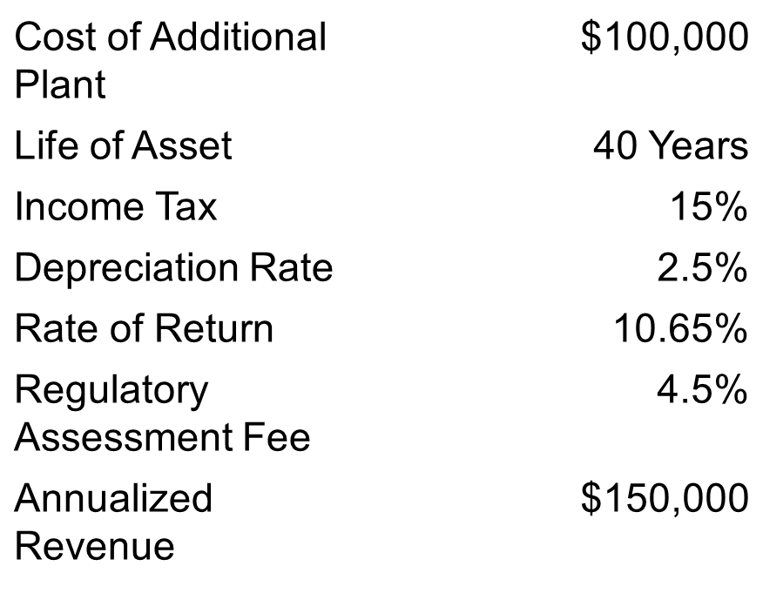
Example No.1 Change in Rate Base
Assumption:

Slide 19
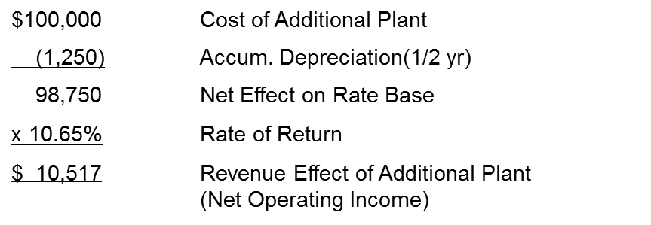
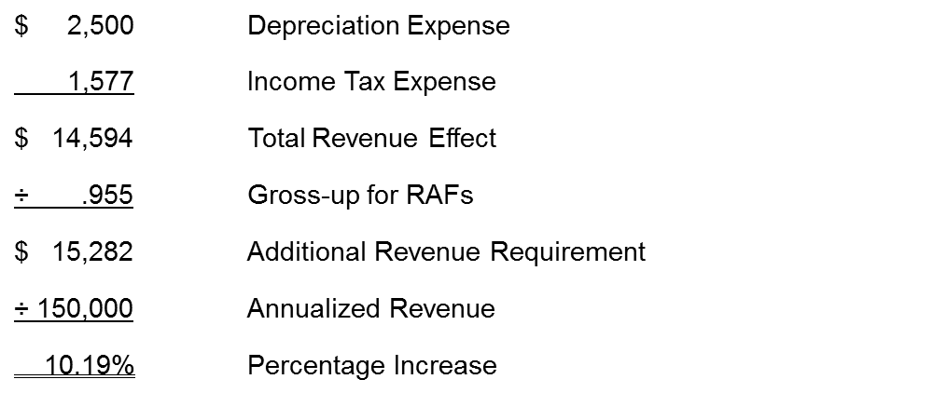
Computation
Other Adjustments:

Slide 20
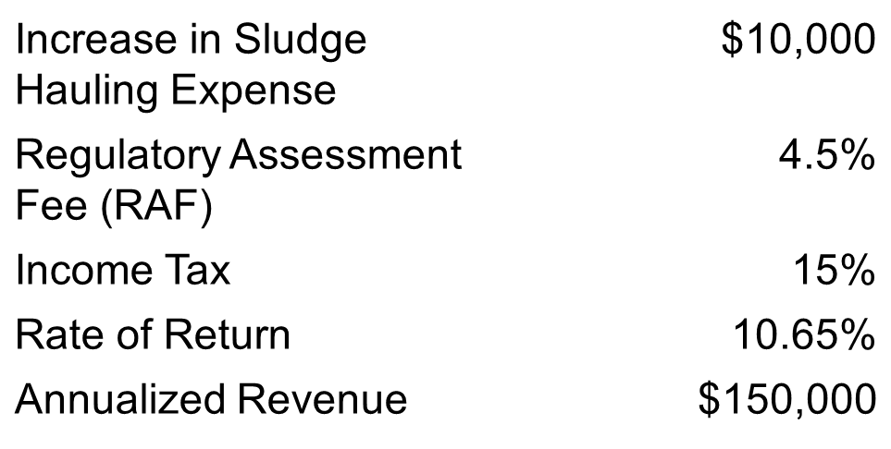
Example No. 2 Effect of a Change to Operating Expenses
Assumption:

Slide 21
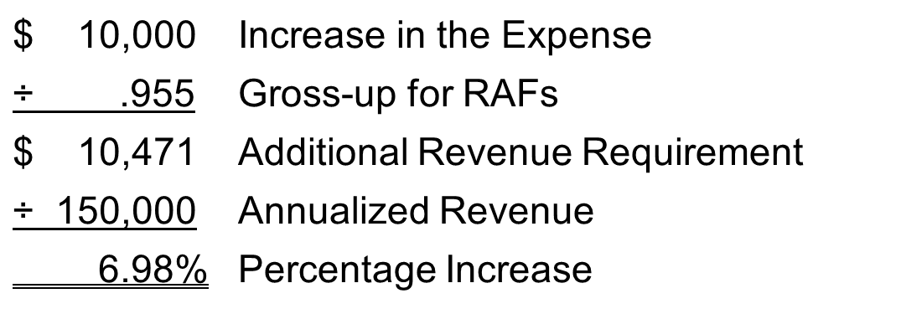
Computation
* Note: There is no income tax adjustment because there is no effect on revenue net operating income.

Slide 22
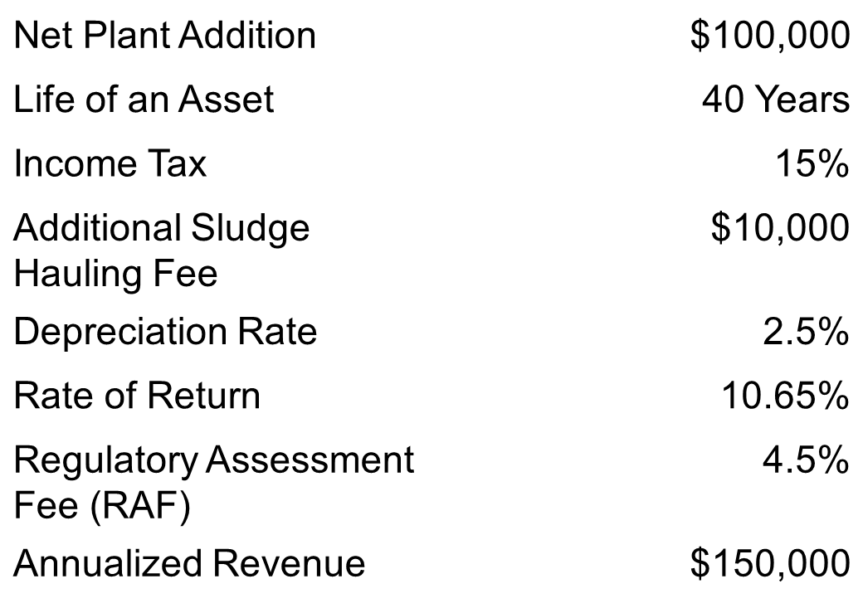
Example No. 3 A Change That Effects Rate Base and Operating Expenses
Assumptions:

Slide 23
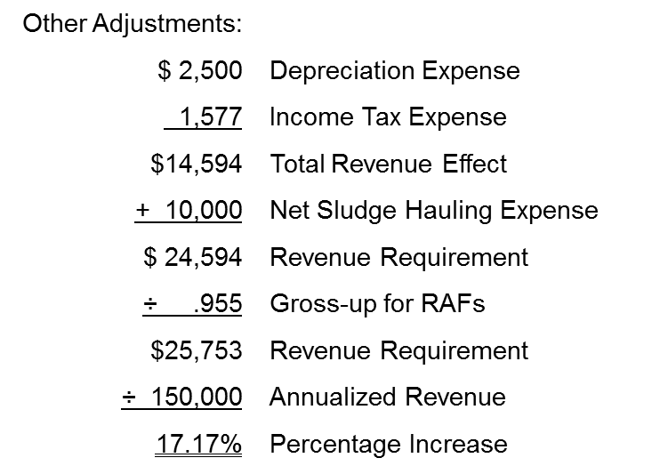
Computation

Slide 24
Months to Process Case
The amount of time it takes to process a case varies, but generally takes five to seven months, depending on the following:
Complexity of issues
How well the case is documented
Whether an audit is required

Slide 25
Emergency Rate Relief?
The interim statute does not apply to Limited Proceedings.
Emergency or temporary rates have been allowed in certain circumstances, depending on how long the case will take, but the emergency must be documented.

Slide 26
Audit of Utility
An audit may be needed depending on the following:
Date of last rate proceeding
Number of issues in current case
Overall earnings of utility

Slide 27
Common Problems
Common problems faced in Limited Proceedings include the following:
Lack of sufficient documentation
Requesting additional items in the middle of case
Case evolves into an earnings evaluation
Lack of identification of offsetting decreases in costs

