Slide 1
Staff Assistance In Alternate Rate Setting

Slide 2
Staff Assistance In Alternate Rate Setting
Rule 25-30-456, F.A.C., Staff Assistance in Alternative Rate Setting, covers the timeframe, eligibility, rate increase limit, and the Proposed Agency Action (PAA) procedure for this type of case.
Staff Assistance In Alternate Rate Setting is a procedure whereby a utility qualifying for staff assistance can obtain a rate increase in an expedited manner to recover operation and maintenance expense.

Slide 3
Advantages
The advantages include the following:
Quick turnaround
Minimized time and cost of processing an increase
Reduced likelihood of a protest
Reduced likelihood of rate shock between Staff Assisted Rate Cases (SARCs)
Opportunity to recover increased operation and maintenance costs to remain a viable utility

Slide 4
Staff Assistance Eligibility
To be eligible for staff assistance, gross annual operating revenue must be less than:
$275,000 for water service.
$275,000 for wastewater service.
$550,000 on a combined basis.
In determining eligibility, the Commission will also consider:
Whether the utility is current with annual reports.
Whether the utility is current with regulatory assessment fees (RAFs). Calendar year RAFs are due the following March 31.

Slide 5
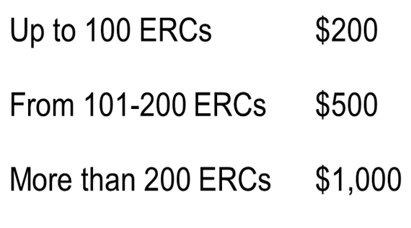
Filing Fees
Filing Fees per Rule 25-30.020, F.A.C., Fees Required to be Paid by Water and Wastewater Utilities, are based upon the equivalent residential connections (ERCs) capacity of the system:

Slide 6
Staff Assistance In Alternate Rate Setting
Section 367.091(2), F.S., Rates, tariffs; new class of service, sets forth certain noticing requirements.
Upon filing an application for new rates, the utility shall mail a copy of the application to the chief executive officer of the governing body of each county within the service areas included in the rate request.
The governing body may petition the Commission for leave to intervene in the rate change proceeding and the Commission shall grant intervener status to any governing body that files a petition.

Slide 7
Rate Increase
Commission staff will compare operation and maintenance expenses to test year operating revenues.
The maximum increase is 50 percent of test year revenues.
There is no review of the utility’s rate base.
Allowance for return on working capital is determined using the one-eighth of operation and maintenance expense formula approach.

Slide 8
Timeframe
The official date of filing will be 30 days after official acceptance of the application.
Commission shall vote on a PAA Recommendation establishing rates no later than 90 days from the official filing date. A Commission order will be issued within 20 days of the vote followed by a 21-day protest period.

Slide 9
Protest Situation
If a protest is filed:
The utility may implement temporary rates, subject to refund with interest.
The utility shall provide direct testimony, through the sponsor of a witness, regarding the appropriate rate base, capital structure, and revenue requirement, as well as its fall-out rates. The utility witness may include factual testimony on any issues which the utility may take a different position on in the case.
The utility must meet all requirements of the order establishing procedure.
The maximum 50 percent increase no longer applies.

